Slide 1

DMR radio
Digital communications
Marty Fitzgerald w5mf

Slide 2


Talkgroup – Different Networks
Remember this Slide?
DMR-MARC
  First in USA
  Motorola Repeaters Only
  Subscriber ID Registration
Brandmeister
  Allows Motorola and Hytera Repeaters
  Allows Hotspots
  Some Talkgroups inter-connected
DMR+
  Old Hytera Network

Slide 3
These Talkgroups are generally available on All networks
Tac310 tg310 ← LINK → Tac310 tg310
Tac311 tg311 ← LINK → Tac311 tg311
Tac312 tg312 ← LINK → Tac312 tg312
DCI/Bridge tg3100 ← LINK → DCI/Bridge tg3100

Slide 4
DMR-MARC vs Brandmeister
DMR-MARC
This is technically incorrect, but used as a general term
Technically it should be called C-Bridge
Earlier slides were to show you that there are more than one general network
Didn’t want to confuse an already confusing subject
Here is the rest of the story, just in case you run into this

Slide 5
C-Bridge(DMR-MARC) vs Brandmeister Repeaters
C-Bridges :
Definition: A server that bridges together regional DMR networks(VA3XPR)
Originate Talkgroups
Anyone can own
Pass Talkgroups from other C-Bridges, based on C-Bridge owner preference
Can Pass Talkgroups from Brandmeister, based on C-Bridge owner preference
Repeater and Hotspot(usually not allowed), based on C-Bridge owner preference

Slide 6
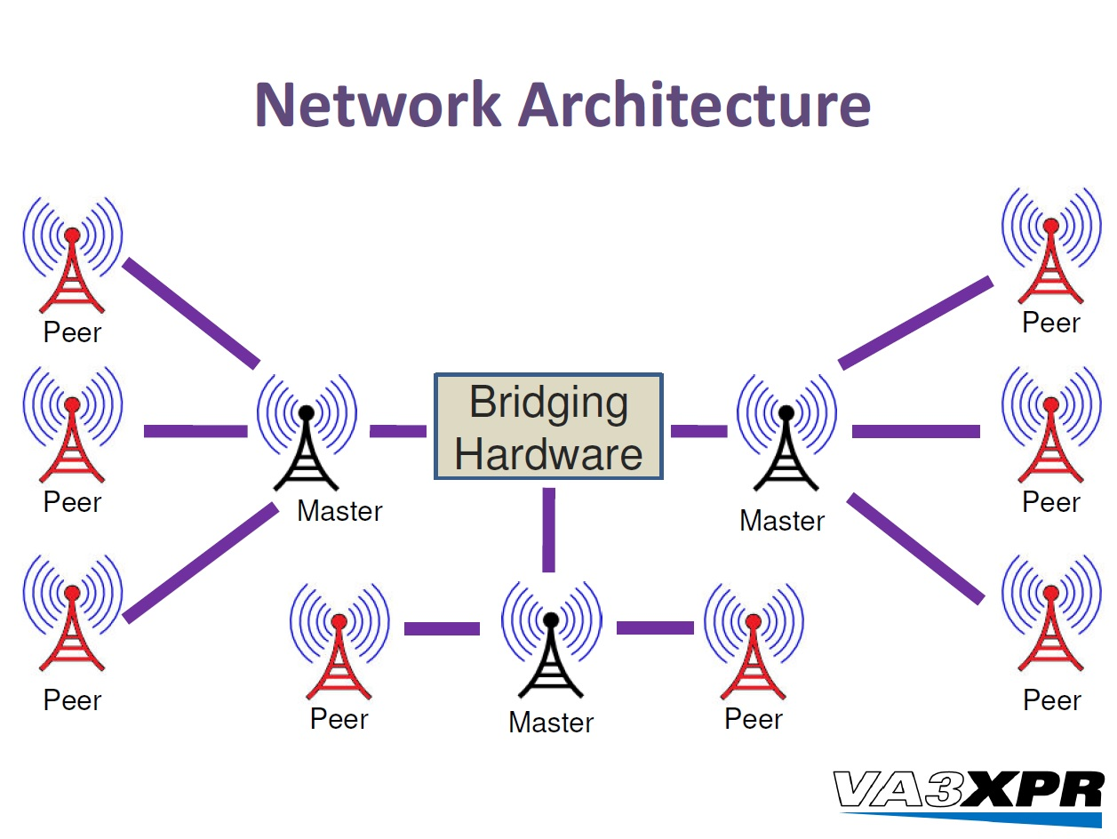
C-Bridge(DMR-MARC) vs Brandmeister Repeaters
C-Bridges :

Slide 7
C-Bridge(DMR-MARC) vs Brandmeister Repeaters
C-Bridges Strengths:
More customizable
Private talkgroups easier
Multiple networks
Mostly repeaters
Don’t have to program a hotspot

Slide 8
C-Bridge(DMR-MARC) vs Brandmeister Repeaters
C-Bridges:
Not ALL talkgroups are available on all C-Bridges based on Owner Preferences
Owners do not want to overload their C-Bridge
Example:
Talkgroup Texas State Wide (3148) may not be available on a C-Bridge in Florida because the C-Bridge Owner doesn’t want that traffic, however they will probably have Florida State Wide. The C-Bridge Owner Texas may not have Florida State Wide because he doesn’t want that traffic.

Slide 9
C-Bridge(DMR-MARC) vs Brandmeister Repeaters
C-Bridges Names:
Example: DMR-MARC*, DCI TRBO, Lonestar**, DMRX, K4USD, Crossroads, Chicagoland, Rocky Mountain Ham, DMR-FL, Bronx TRBO
More than 20 C-Bridges
Pass Traffic between each other based on C-Bridge Owners preference
Some C-Bridges may pass Brandmeister traffic, some do not.
* First C-Bridge
** Used on Cypress Repeater and others in the area
https://dmrtexas.net/

Slide 10
C-Bridge(DMR-MARC) vs Brandmeister Repeaters
Brandmeister :
Originate Talkgroups
Master Server Owned by Brandmeister
Pass Talkgroups from Brandmeister
Repeater and Hotspot Access

Slide 11
C-Bridge(DMR-MARC) vs Brandmeister Repeaters
Brandmeister Strengths:
More uniform
Hotspot setup
Repeater Owner (Sysop) access Dashboard
APRS enabled

Slide 12
C-Bridge(DMR-MARC) vs Brandmeister Repeaters
Brandmeister Masters in the US:
3101
3102 ← Prefer this one for us because its in Dallas, TX
3103
3108 ← Referred to as the test server

Slide 13
DMR-MARC vs Brandmeister Repeaters
DMR-MARC Repeaters have assigned talk groups and time slots per the repeater trustee or administrator.
Brandmeister Repeaters generally do not assign talk groups or time slots.
It is always best to check with your local repeater trustee or administrator.

Slide 14
Credits and Acknowledgements
Jason Johnston KC5HWB presentation

Slide 15
Editing Code Plugs – 3rd Party Software
Contact Manager Version 2.60:
Full Documentation – Free software – Donations accepted
Easy to use
Works on TYT(verified), Anytone, Connect Systems, and others
Mass change is a game changer
Copy and paste
I am always learning something new
Written by N0GSG Tom Wheeler
http://n0gsg.com

Slide 16
Editing Code Plugs – 3rd Party Software
Code Plug Editor Version 1.20, version 1.22 just released:
No Documentation – Free software – Donations accepted
Easy to use, but more options and complicated
Works on TYT(verified) only
Mass changes
Copy and paste, multiple code plugs on screen at the same time
Great for sorting channels
I am always learning something new, I have used as much
Written by G6AMU Cathy
http://g7rvh.com/tyt-md-380/codeplug-editor

Slide 17
Demonstations
Contact Manager 2.60
Code Plug Editor 1.20

Slide 18
Q&A
Questions

