Slide 1

DMR Programming
Here is the wireless info:
SSID = KVFD
Password = 123Fire!
http://www.k5wh.net/dmr/class/
Digital communications

Slide 2
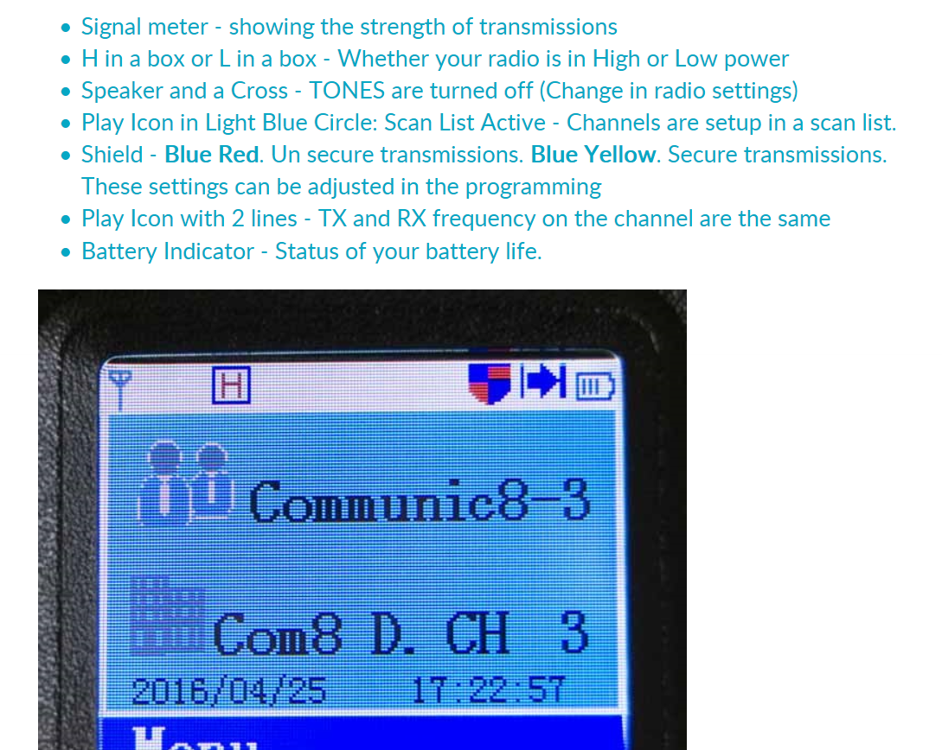
Icons on your Display, from last week

Slide 3
Find and Apply Repeater Details
Finding the Talkgroups available for your local repeater
Launching the TYT CPS software
Configuring the software to support a repeater or hotspot
  Create a Digital Contact, Channel, Zone, Scan List
  Adding Channels to a Zone, Scan List
Upload Codeplug into Radio
Pull down the latest User Database http://amateurradio.digital/index.php
Upload the User Database to the Radio, then wait, wait, wait, wait……..

Slide 4

DMR Texas Website

Slide 5
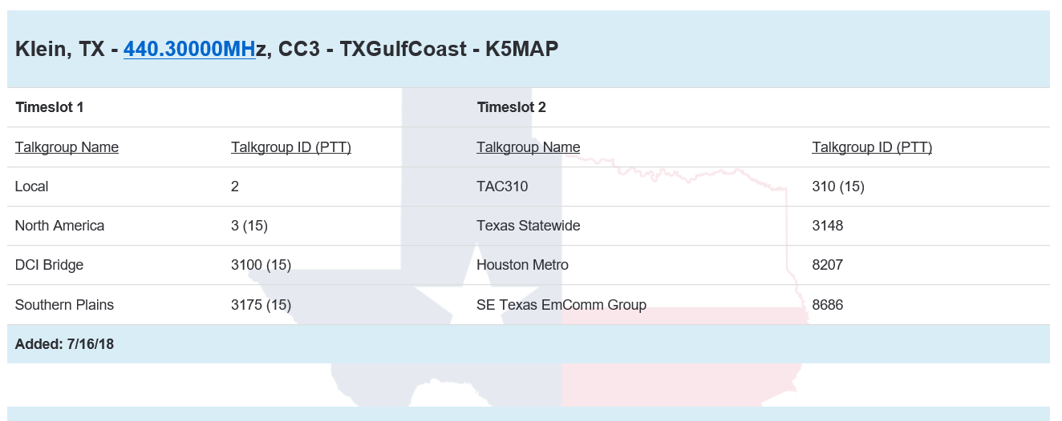
Klein Repeater Details

Slide 6
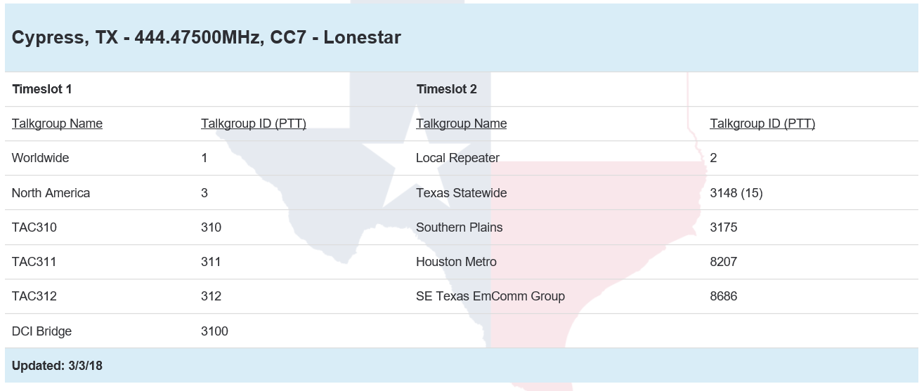
Cypress Repeater Details

Slide 7
Now that you have the Talkgroups

Slide 8
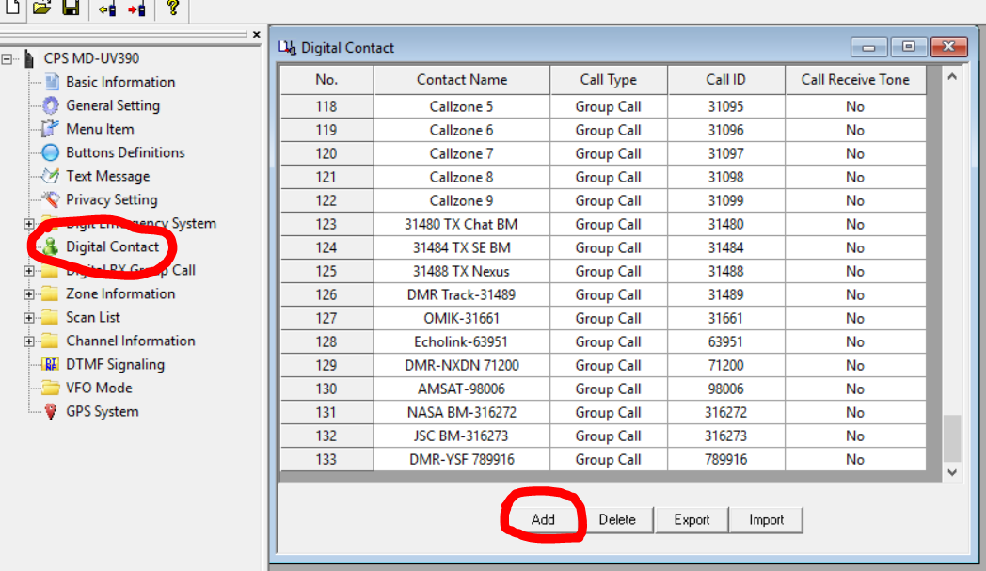
Create a Digital Contact / Talkgroup

Slide 9
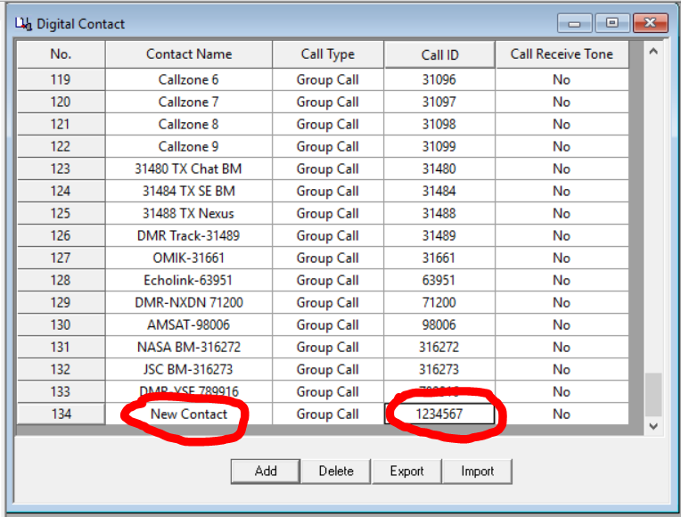
Enter the Name and Call ID

Slide 10
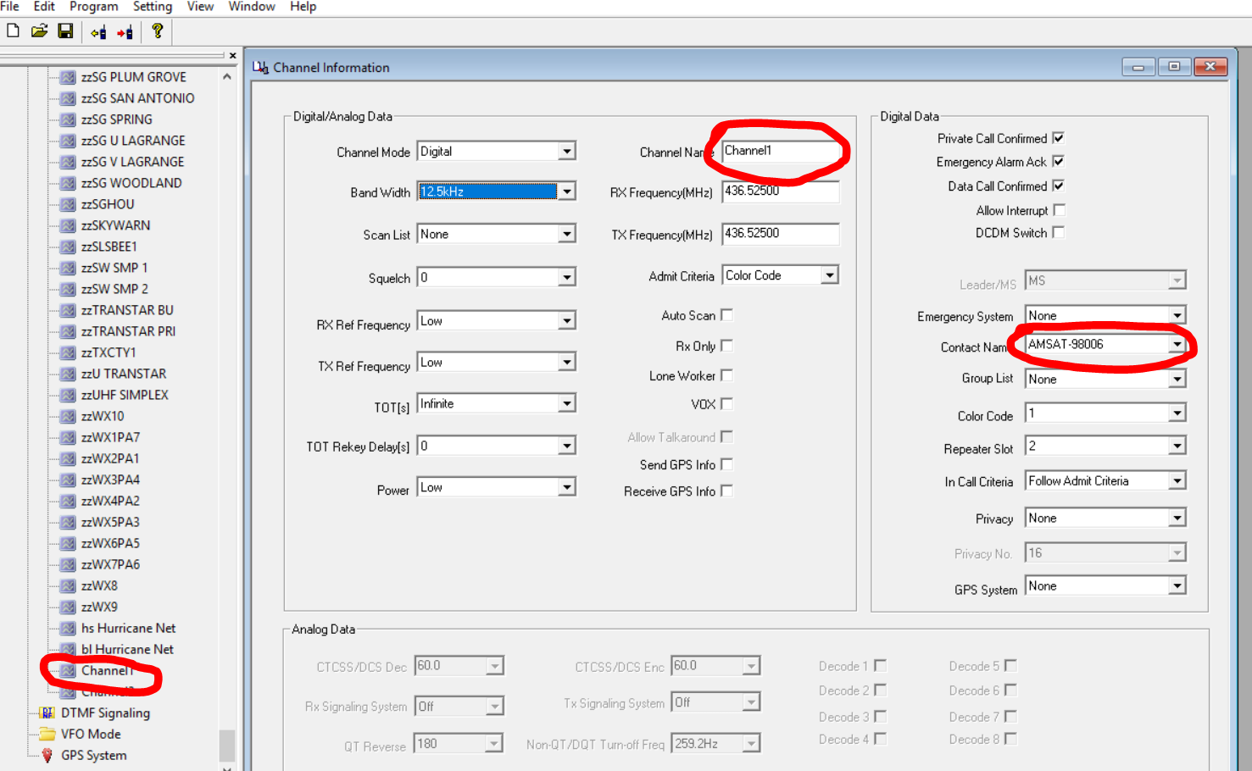
Copy and Paste to the NEW Channel

Slide 11
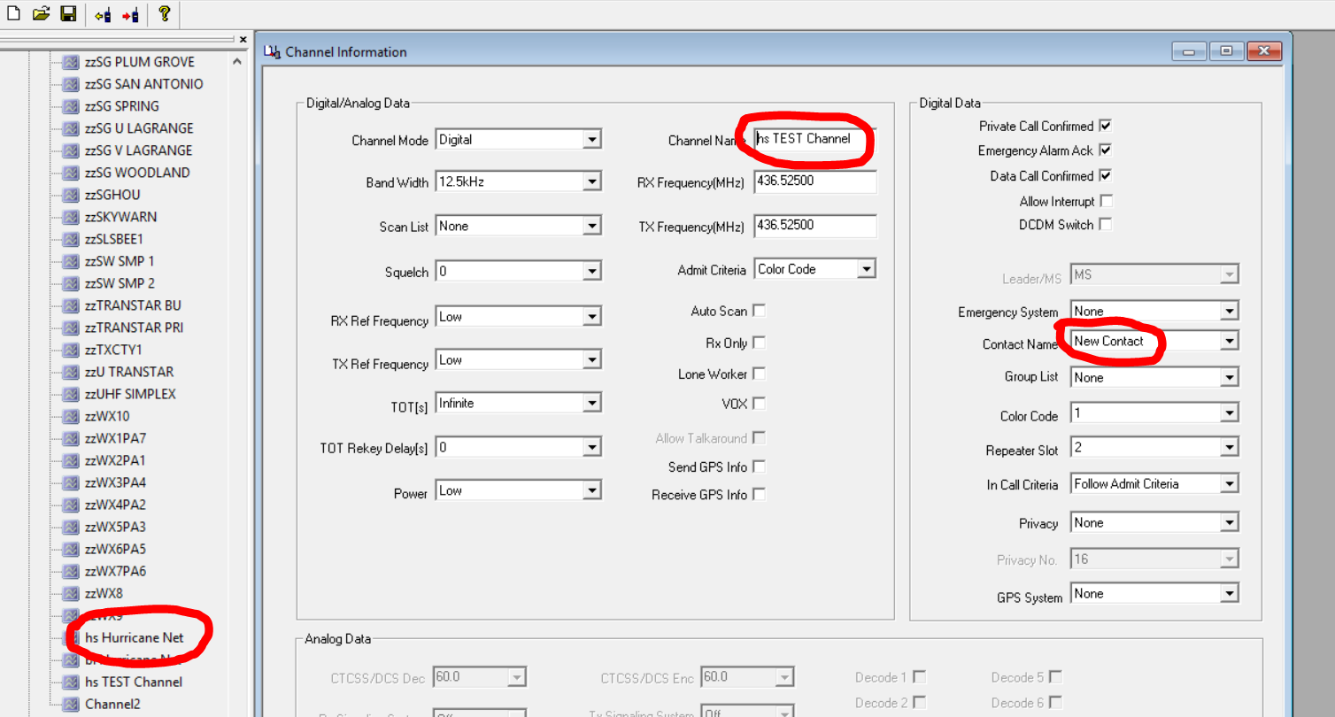
Select the NEW Channel and Contact

Slide 12
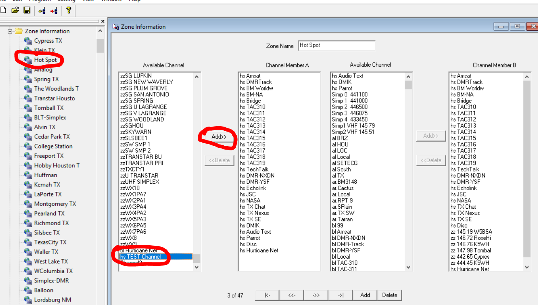
Select a Zone, and ADD Channel

Slide 13
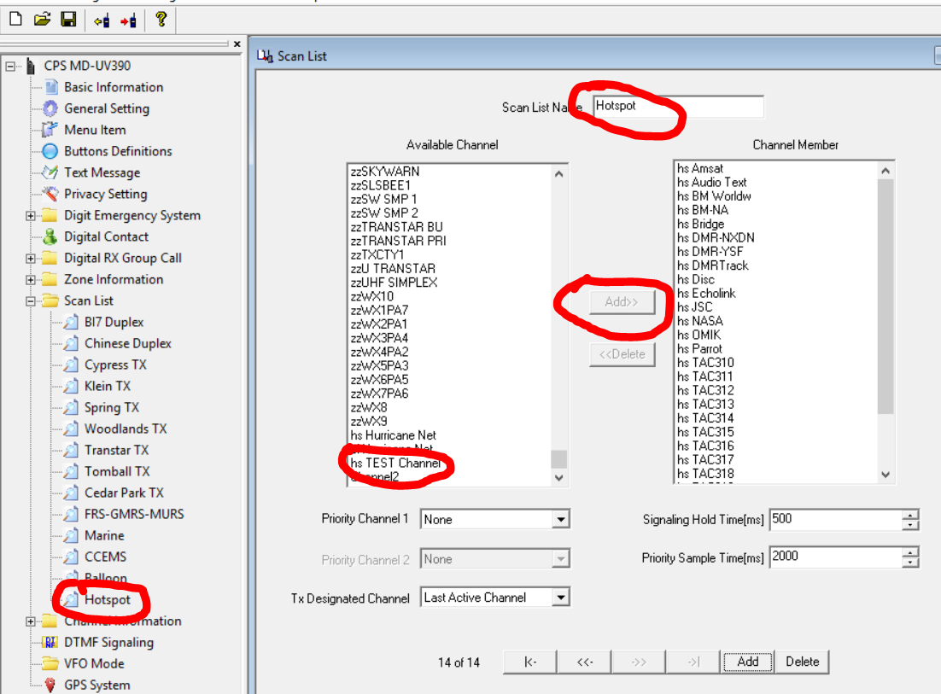
Select a Scan List, add Channel

Slide 14
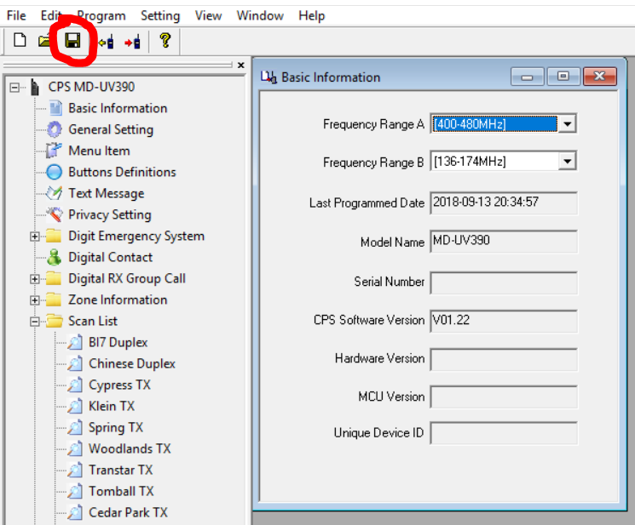
SAVE your Codeplug Often

Slide 15
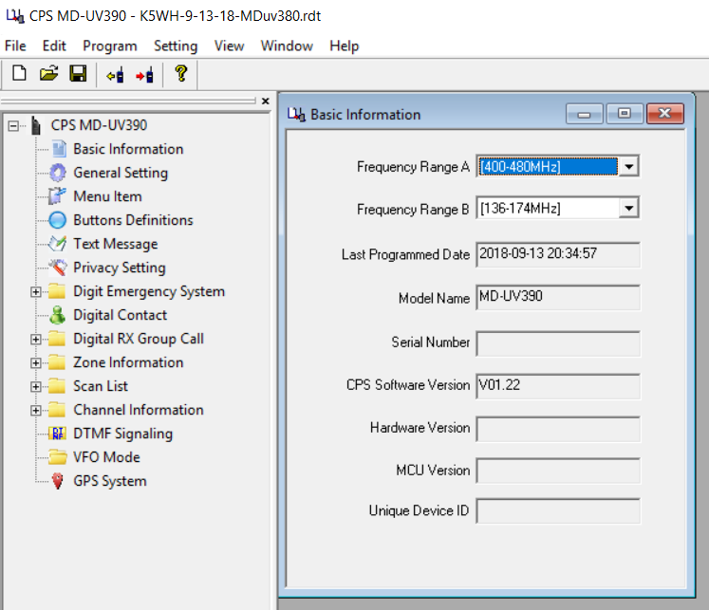
Open Codeplug File

Slide 16
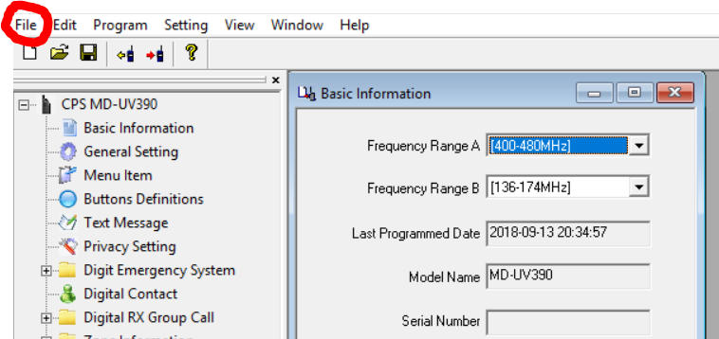
Select File to Open

Slide 17
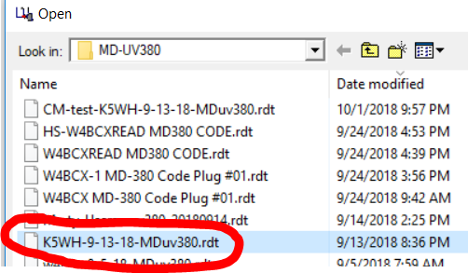
Choose the Codeplug and Open

Slide 18
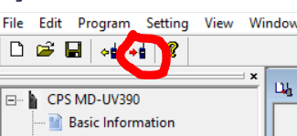
Write Codeplug to Radio

Slide 19
How to Update the User Database

Slide 20

Where to get the User Database

Slide 21
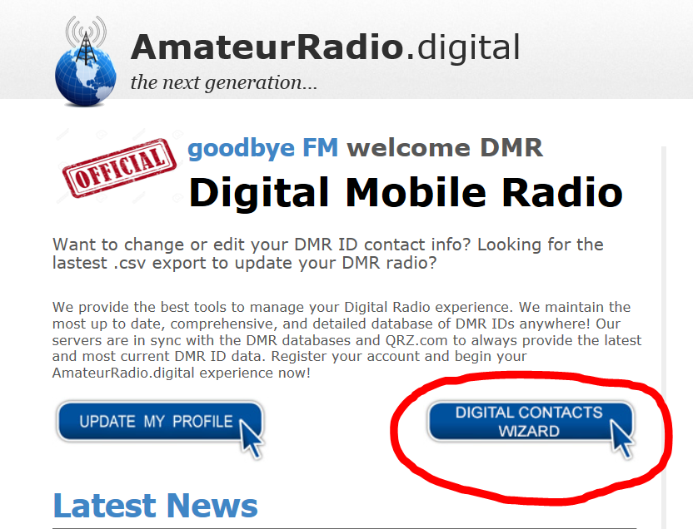
User Database or Digital Contacts

Slide 22
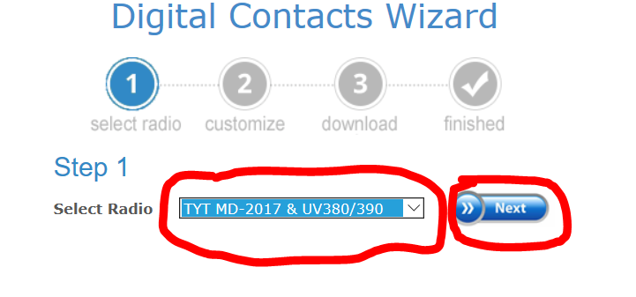
Select Radio for Best Screen Format

Slide 23
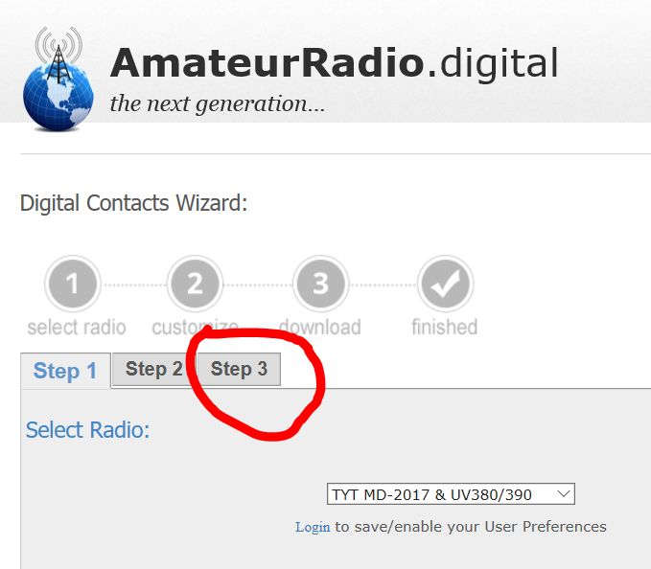
Skip to Step 3

Slide 24
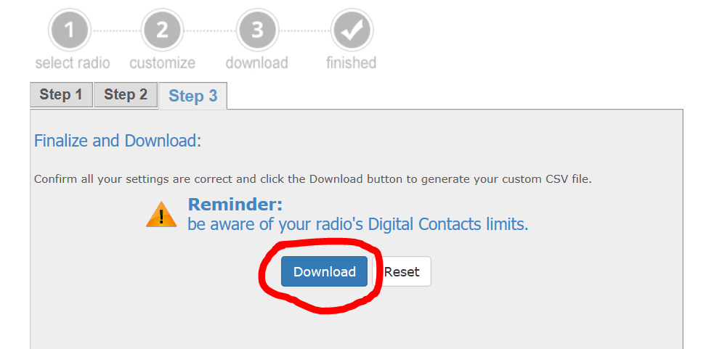
Download file to your PC

Slide 25
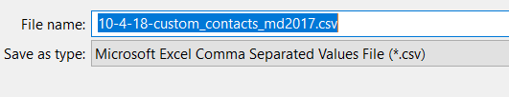
Save the file with a DATE stamp

Slide 26
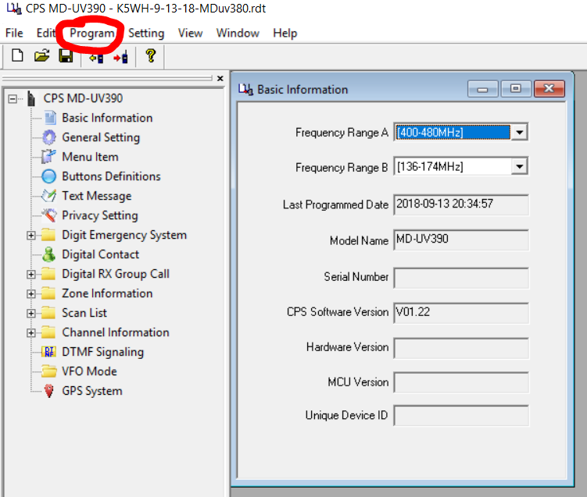
Select Program

Slide 27
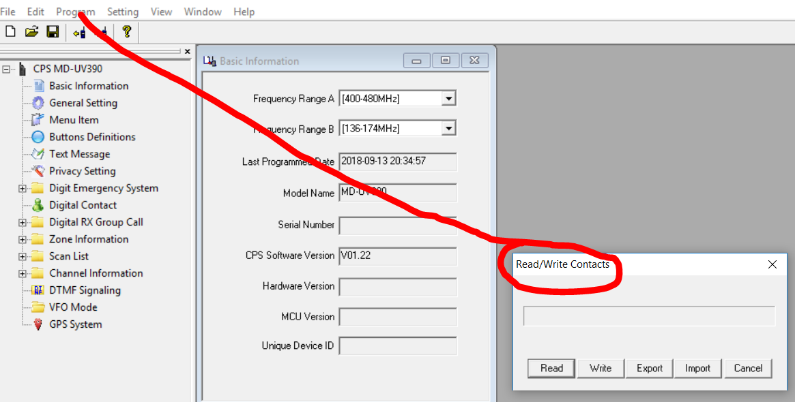
Select Write Contacts

Slide 28
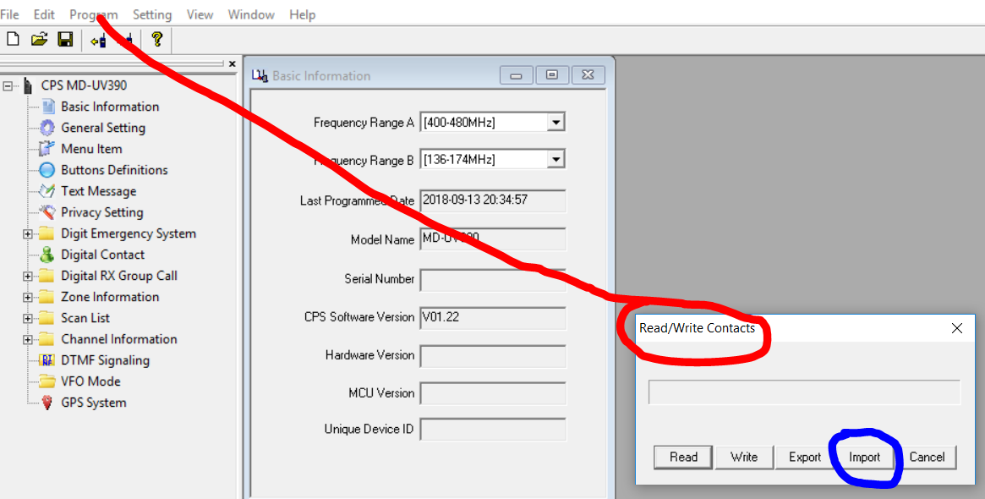
Select Import

Slide 29
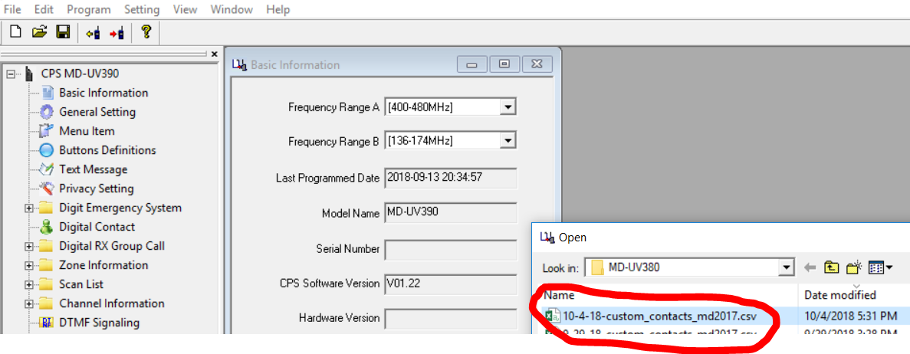
Select User DB File

Slide 30
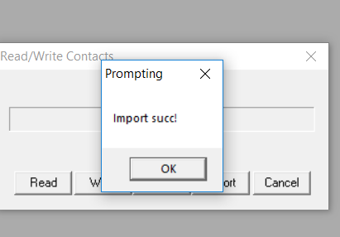
Import Successful

Slide 31
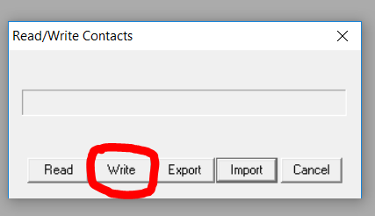
Select Write, to send data to Radio

Slide 32
Hands On
So, you have now heard what DMR is about
You have seen how its implemented in the Real World
Now, let’s get our hands dirty and apply all this great knowledge

Slide 33
Q&A
Questions

Slide 34
Backup Slides

