Slide 1
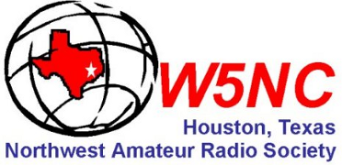
DMR radio
Digital communications

Slide 2
First thing to do is REGISTER yourself
Think “computer network” … Just as every terminal has own IP address & MAC; Users have logins…
Each person is assigned an unique ID Number
First thing you have to do after buying, is register for user-specific MARC ID
  Go to https://dmr-marc.net/cgi-bin/trbo-database/register.cgi
  Select “User Registration” at bottom of page
  Validates callsign using QRZ
  Sends e-mail several hrs later (can be up to 72 hrs)

Slide 3
DMR “MARC” ID
Registration filed on Internet…
https://www.dmr-marc.net/cgi-bin/trbo-database/
Again, select USER
SHOWN on NEXT SLIDE
NAME | CALL | DMR ID
Richard Nelson | KF5WRD | 1148431
Marty Fitzgerald | W5MF | 1148439
Ron Matusek | WA6TQH | 3148924

Slide 4
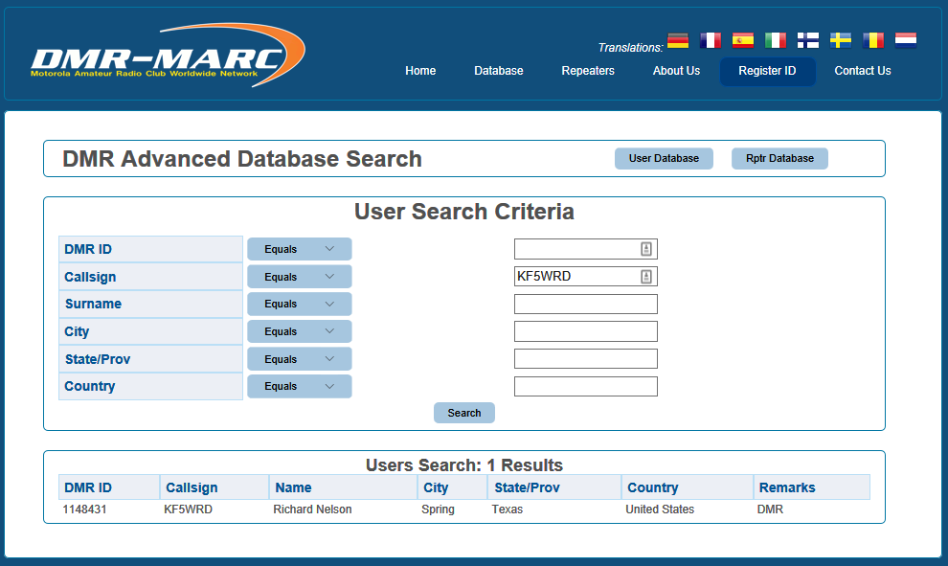

Slide 5
Digital vs. Analog
If you are used to operating on analog FM repeaters, you will have noticed that the audio quality degrades as a station's signal into the repeater (uplink) gets weaker; you start hearing an increase in noise bursts intermixed with the audio until the signal gets too weak that the station can no longer access the repeater or you cannot understand the audio because of noise.
As you move further from the repeater you will start hearing the same noise bursts into your receiver as you the repeater's signal gets weaker (downlink) until you can no longer hear the repeater. A combination of a station's weak signal into a repeater and a repeater's weak signal to the listener can make the usability degrade faster.

Slide 6
DigiDigital vs. Analog, p2
The basic difference with digital repeaters is that the audio quality remains the same on the uplink and the downlink until the very end of the coverage range; then the audio starts sounding broken (missing portions of the speech) on DMR systems caused by lost packets. The internet can also drop the UDP packets used for moving traffic between repeaters and bridges.
DMR has Forward Error Correction (FEC) which can correct small bit errors, slightly extending the usable range and improving communication quality.

Slide 7
Types of Digital Radio
D-Star (ICOM / Kenwood / Flex) proprietary AMBE vocoder with Gaussian minimum shift keying or GMSK
  GMSK is a continuous-phase frequency-shift keying modulation scheme
Fusion (Yaesu) AMBE CODEC with C4FM [4-level FS] modulation
DMR utilizes the DSVI AMBE+2™ 3600 bps vocoder by agreement of the manufacturers. Uses TDMA (Time Division) variant of C4FM

Slide 8
Why DMR?
HAMS adopted Commercial Equipment for repeaters
  Relatively LOW cost
Digital has lower noise / better sound quality
Internet linking lets you access the world
Cheap Chinese Radios

Slide 9
What is DMR(Digital Mobile Radio)?
A European Telecommunications Standards Institute (ETSI) standard first ratified in 2005.
Meets 12.5kHz channel spacing and 6.25kHz regulatory equivalency standards
Two slot Time Division Multiple Access (TDMA)
4 level FSK modulation
Cutting edge Forward Error Correction (FEC)
Commercial ETSI/TIA specs mean rugged performance and excellent service in RF congested urban environments
Equipment interoperability is certified by the DMR Association

Slide 10
Basics of DMR – including some lingo
Timeslots
Talkgroups or Digital Contacts
“Color Codes”
Channels
Zones

Slide 11
Timeslots 2-Slot TDMA
DMR utilizes 2 separate Timeslots, called TS1 and TS2.
Each timeslot is independent from the other meaning both can be used at the same time with no interference from each other.
TS1 is typically Wide-Area, while TS2 is typically more localized.

Slide 12
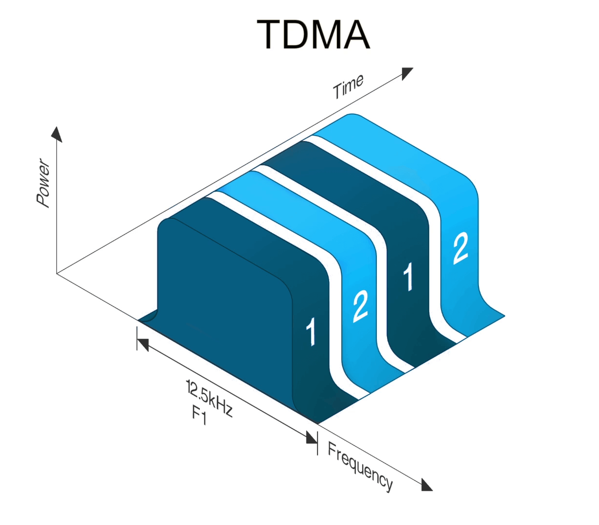
(C) TIME SLOTS (TDMA)
Radio only monitors 1 or 2 – NOT BOTH
Time Division Multiple Access
two logical channels
each 12.5-kilohertz channel space
Separated by 30 ms
http://www.taitradioacademy.com/wp-content/uploads/2014/12/Image-21.png

Slide 13
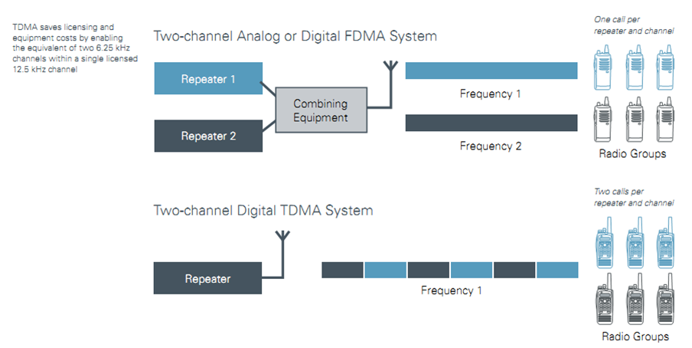
2-Slot TDMA

Slide 14
Talk Groups or Digital Contacts
Like the old telephone “party line”
Talk Groups (TG) are a way for groups of users to share a time slow (one to many) without distracting or disrupting other users of the time slot.
It should be noted that only one talk group can be using a time slot at a time.
If your radio is not programmed to listen to a talk group, you will not hear that talk group's traffic.
Only 1 TG per TS can be used at a time. This means that you can have access to dozens (hundreds) of Talkgroups per Timeslot, but they will all be competing with each other for usage.

Slide 15
Talk Groups or Digital Contacts
Talkgroup Examples
Local tg2 just this repeater or group of linked repeaters
Area Wide like Houston tg8207
Statewide (all repeaters in the State) like Texas State Wide tg3148
Regional (US is divided into 8 multi-state groups) like South Plains tg3175
North America tg3
Worldwide English tg13
Worldwide tg1 (DMR-MARC) or tg91(Brandmeister)
TAC310 and TAC311 tg310 and tg311
DCI Bridge tg3100
DCI Fusion Link
All-Star Link
Cactus (TX, AZ, CA)

Slide 16
Geographic by Continent → Country
3-Digit Country Code
United States
(310 or 311)
3 1 n xxx
GEORGRAPHIC REGION
N. AMERICA

Slide 17
(E) TG are Geographic by Continent
0 | TEST NETWORKS | 9 | WORLDWIDE
2xx | EUROPE | 3xx | N. AMERICA & CARRIBEAN
 | 208 = France ; 235 = UK; 262 = Germany |  | 302 = Canada ; 310 = US; 334 = Mexico
4xx | ASIA & MIDDLE EAST | 5xx | OCEANIA
 | 208 = France ; 235 = UK; 262 = Germany |  | 505 = Austrailia ; 310 = US; 334 = Mexico
6xx | AFRICA | 7xx | S. & CENTRAL AMERICA
 | 208 = France ; 235 = UK; 655 = S. Africa |  | 302 = Canada ; 310 = US; 334 = Mexico

Slide 18
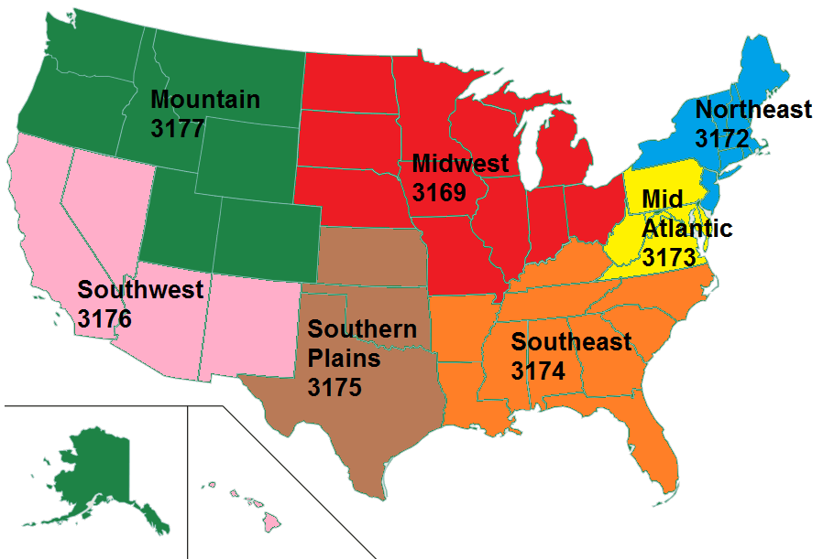
Regional Talkgroup Structure
3175 | S. (Plains) TX + OK
3148 | Texas
3140 | Oklahoma

Slide 19
TG can get more specific within each region; Some ignore pattern
TG | NAME | COMMENTS
1 / 91 | Worldwide | Any Language
2 | Local/Metro | Common Local Area Metro or Local Repeaters
3 / 93 | North America | United States/Canada (DMR-MARC)
9 | Repeater | Used with SharkRF Openspot
13 | Worldwide English | English Only
9990 | Parrot (Echo) | test
4000 | Disconnect | Used with SharkRF Openspot
5000 | Status (Echo) | Used with SharkRF Openspot

Slide 20
More Detail (5 & 6 Digit codes)
STATE Sub-Units (5 Digits) , so TX = 3148
  31481 = N Texas; 31482 = S Texas; 31483 = W Texas
REPEATERS – 6 Digits (4 State + 2 ID)

Slide 21
US and Texas Talkgroups
TG | NAME | COMMENTS
310 | TAC 310 | North America Repeater-to-Repeater TG
3100 | DCI Bridge | a general "ragchew talkgroup“ the Bridge has evolved into a worldwide talkgroup since it's cross connection to the Brandmeister platform
3102 | Brandmeister TG
3148 | Texas | "Lonestar Talk Group"
3175 | Southern Plains | TX/OK/KS/AR
3185 | Cactus | TX/AZ/CA
8207 | Houston Area Local | Activates all Upper Gulf Coast Repeaters

Slide 22
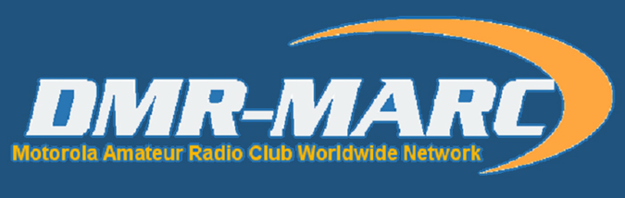
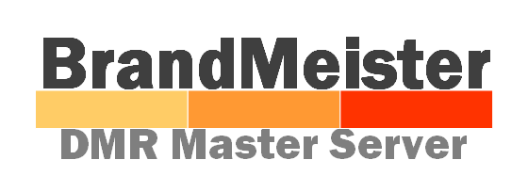
Talkgroup – Different Networks
DMR-MARC
  First in USA
  Motorola Repeaters Only
  Subscriber ID Registration
Brandmeister
  Allows Motorola and Hytera Repeaters
  Allows Hotspots
  Some Talkgroups inter-connected
DMR+
  Old Hytera Network

Slide 23
Talkgroup – Different Networks
Tac310 tg310 ← LINK → Tac310 tg310
Tac310 tg311 ← LINK → Tac310 tg311
Tac310 tg312 ← LINK → Tac310 tg312
DCI/Bridge tg3100 ← LINK → DCI/Bridge tg3100

Slide 24
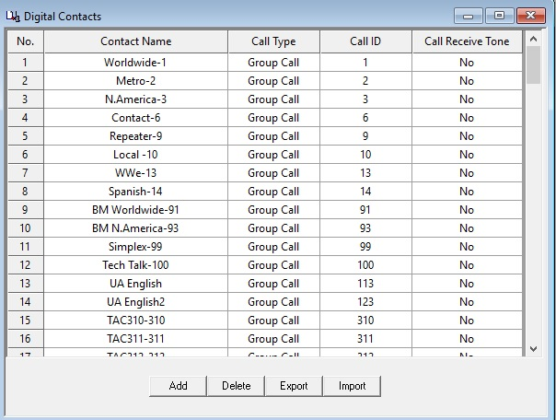
Talkgroup – Digital Contacts

Slide 25
Color Codes (CC)
DMR repeaters use Color Codes much like analog repeaters use CTCSS or DCS.
To access a repeater, you must use the same CC as the repeater.
There are 16 different CCs (CC0-CC15)
The use of Color Codes is not optional on DMR repeaters.
If your Color Code is not set correctly, you will not be able to access the repeater.
The only real purpose of using Color Codes is when multiple repeaters operating on the same frequency have overlapping coverage areas.

Slide 26
Channels
Channels are a way to define a frequency, timeslot, color code, and talkgroup/contacts
A channel is needed for each talkgroup/contact
If a repeater has 4 talkgroups/contact on each timeslot, it will be necessary to create a total of 8 channels for this repeater.
Remember only 1 talkgroup per timeslot can be used at the same time.

Slide 27
Zones
DMR radios support Zones, a Zone is just a grouping of individual channels. Some radio models may limit the number of channels per Zone and the number of Zones allowed.

Slide 28
CODEPLUG
A code plug is simply a radio's configuration file.
Using a manufacturer's programming software, you can configure the channels and operating parameters of a radio; this file is then uploaded to the radio.
Building a code plug can take many hours, especially if you want to program hundreds of channels.
The code plug can also contain a Contact List of Radio Ids, call signs, and names to be displayed.
You can find copies of configured code plugs on the internet for different models of radios. Check out the different Yahoo DMR groups.
All DMR radios support a limited number of entries in the contact list.
Starter codeplug : https://dmrtexas.net/code-plugs/

Slide 29
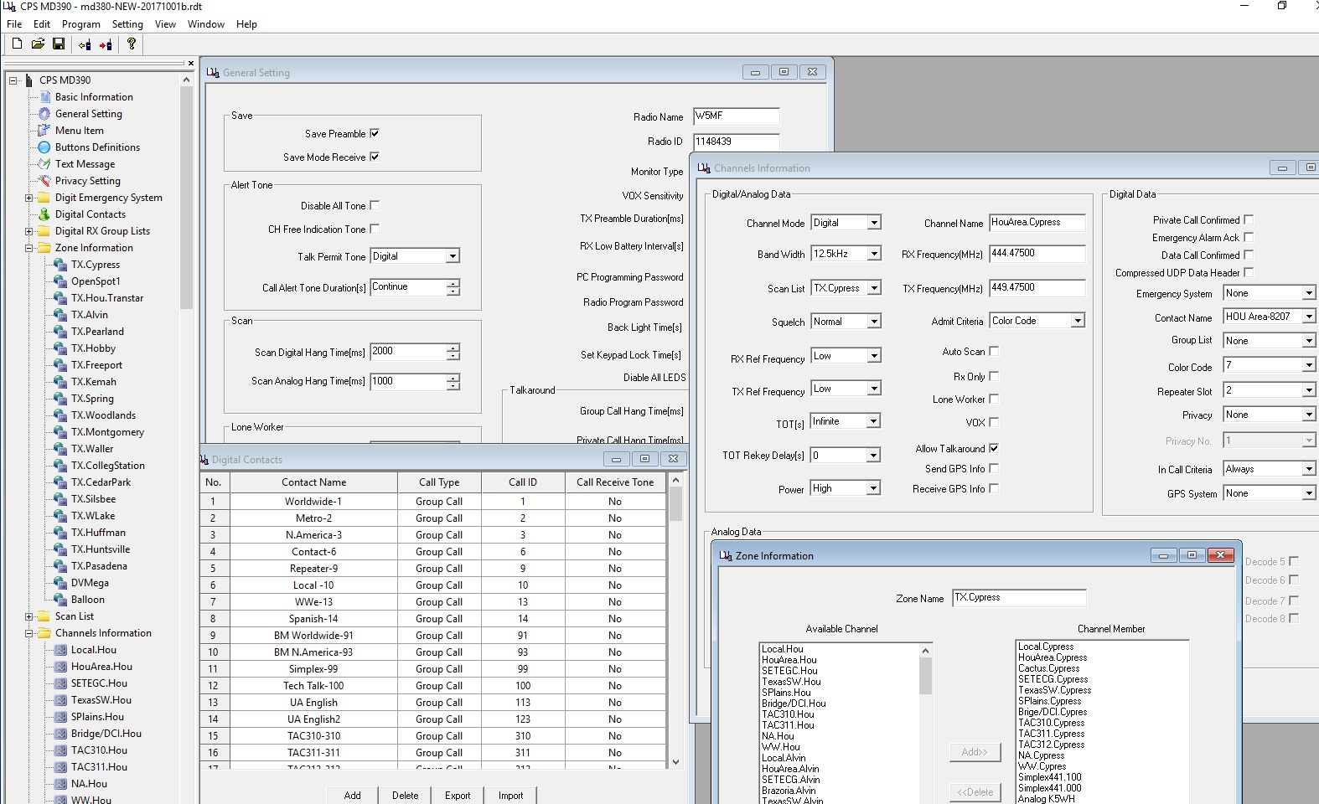
CODEPLUG CPS (Code Plug Software)

Slide 30
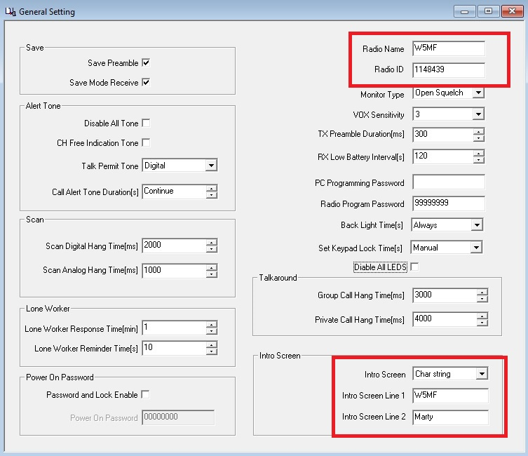
CODEPLUG – General Settings

Slide 31
CODEPLUG – Talkgroups or Contacts

Slide 32
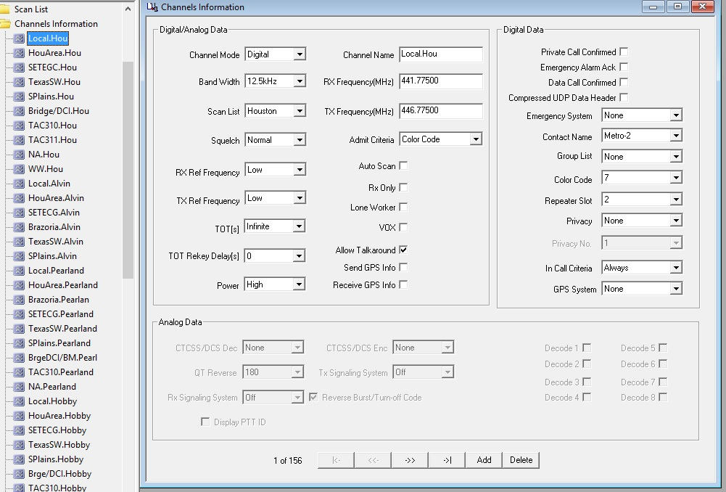
CODEPLUG – Channels

Slide 33
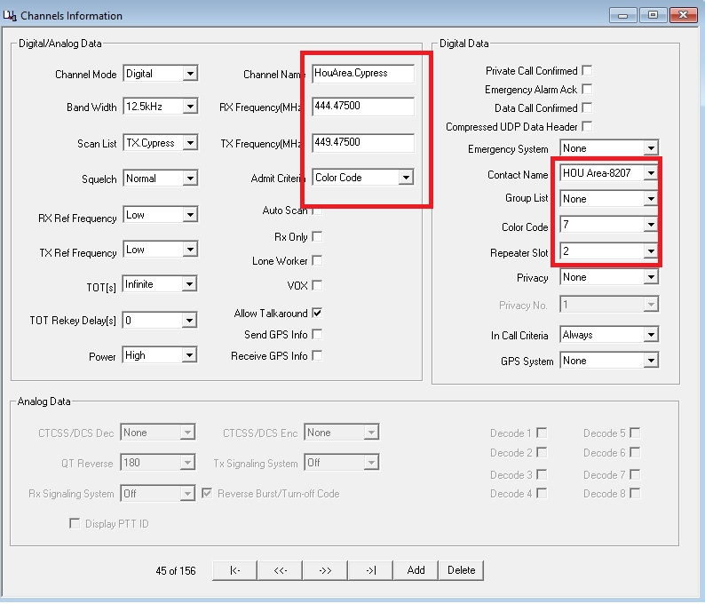
Channels

Slide 34
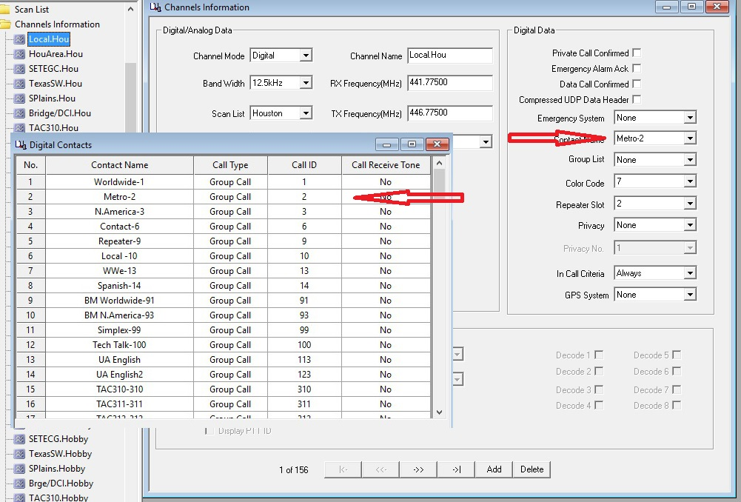
CODEPLUG – Creating Channels

Slide 35
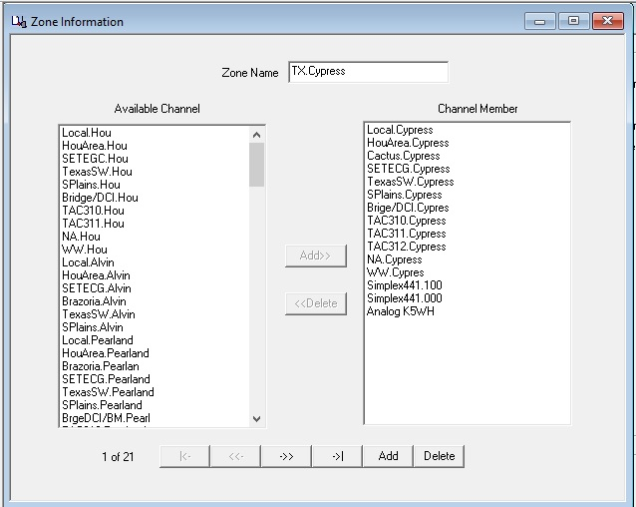
CODEPLUG – Zones

Slide 36
CODEPLUG – Receive Groups
All DMR radios allow you to configure RX Groups.
You can monitor all talkgroups on a single timeslot by adding each Group Contact to an RX Group
Can be used with a dongle like an RF Shark Open Spot to hear messages
Can be confusing. You may rather use scanning in some cases.

Slide 37
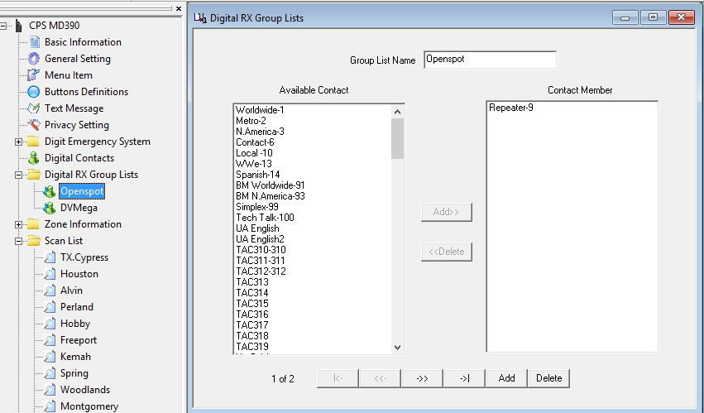
CODEPLUG – Receive Groups

Slide 38
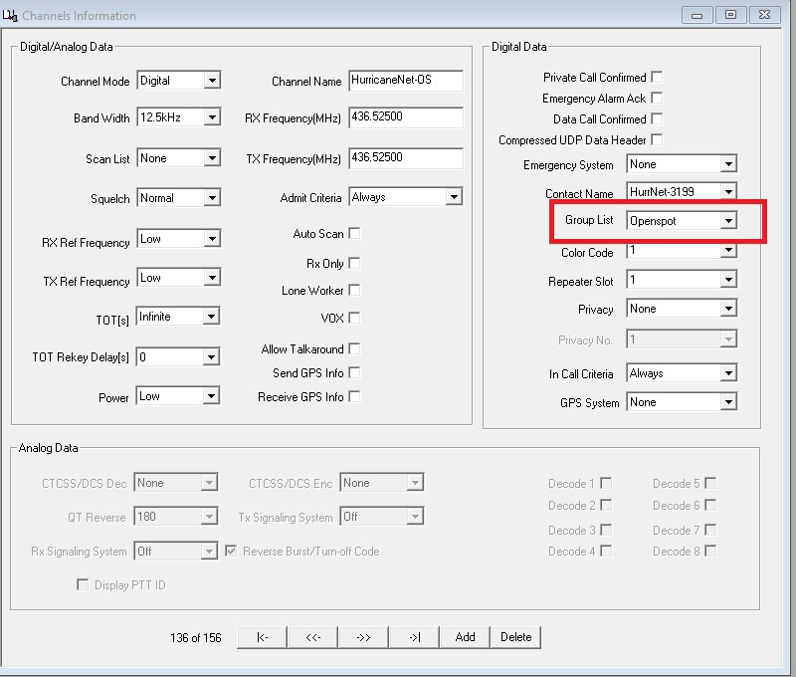
CODEPLUG – Receive Groups

Slide 39
CODEPLUG – Scanning
All DMR radios allow you to configure Scan List.
Used on repeaters to scan Talk groups/Digital Contacts
Cannot be used to scan on dongles like DVMega and Openspot

Slide 40
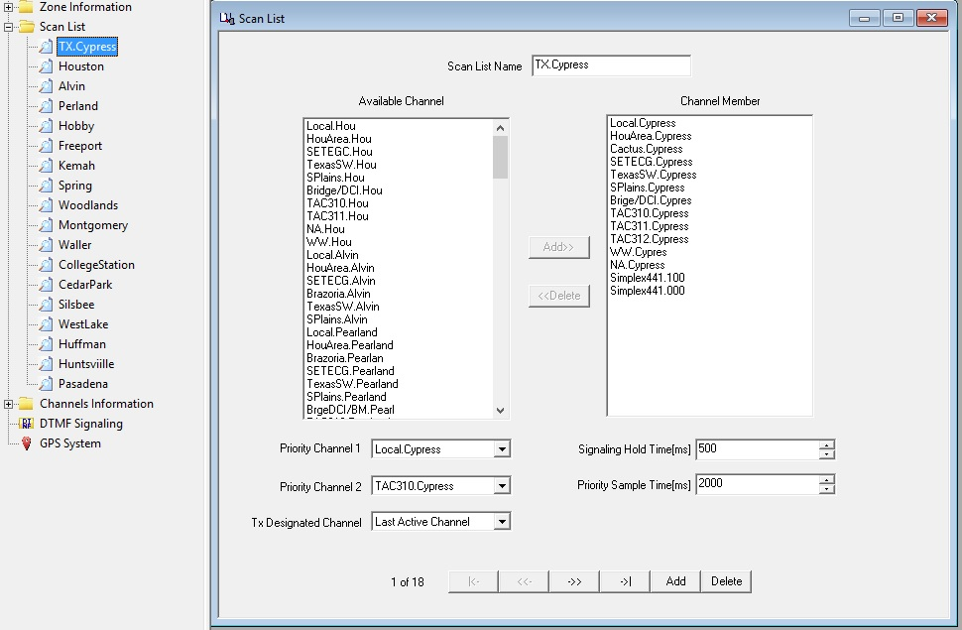
CODEPLUG – Scanning

Slide 41
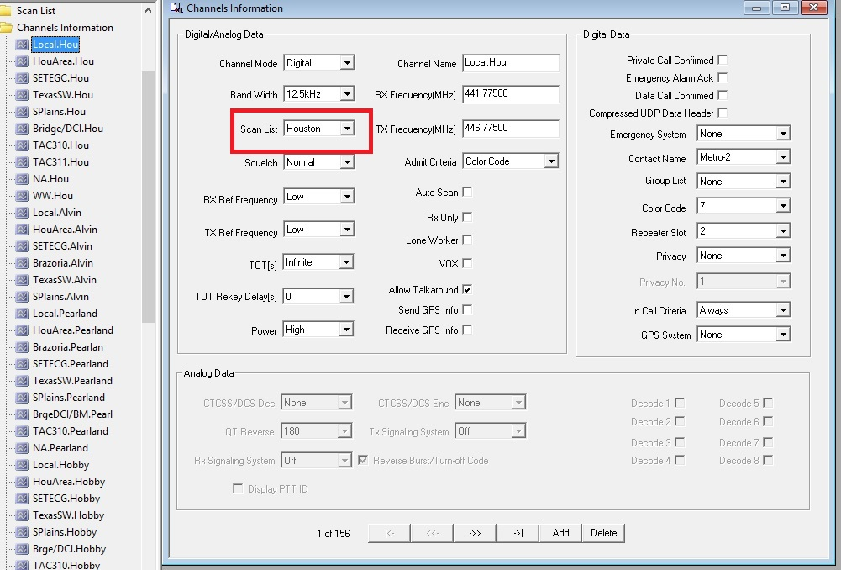
CODEPLUG – Scanning

Slide 42
CODEPLUG – Software
TYT CPS (Code Plug Software – Difficult to use, unable to sort, and unable to do mass changes.
Code Plug Editor for MD380 by G6AMU v0.65.0 – Does everything but only works on TYT MD380
N0GSG DMR Contact Manager 2.40 – Pretty good and work on multiple radios. Cannot sort or insert very easily. Work in progress.
DL5MCC CPSProgrammer 0.33.0 – Software is a bit rough right now, but should allow you to download a group of repeater from a database online and then push it into your code plug. If this gets finalized it will be the best yet.
RFInder – Hardware/Software/Cell Phone Solution

Slide 43
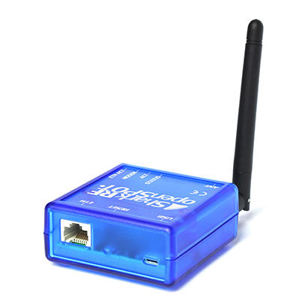
Dongles
Dongles are ONLY Allowed on Brandmeister & DMR+
SharkRF Openspot – has lights, give info via TG9, but needs an adapter to do WiFi
DVMega BlueStack – no lights requires a computer
DVMega Rasberry Pi – no lights stand along, Pi has WiFi (model 3b or model 2 ad and usb adapter)
Several of us have SharkRF OPENSPOT which accesses BRANDMEISTER
YOU can listen via some browsers (Chrome) using Hoseline - BrandMeister
https://hose.brandmeister.network/

Slide 44
RADIO’s
TYT MD-380 (UHF only), most popular, cheapest, and has TY Toolz firmware to add features for free.
TYT MD-2017 (UHF-VHF), gaining popularity, and TY Tools coming.
TYT MD-9600 (UHF-VHF), mobile radio.
Connect Systems, Hytera, Motorola, Rfinder, and several other off brands available.
Kenwood, Icom, and Yaesu not in DMR yet.

Slide 45
Talkgroup Usage
Use local TG2 to talk to you buddy down the street
Use area wide like TG8207 Houston area to talk to a group around town
Use state wide like TG3148 Texas Statewide to talk to people in other Texas towns
Use regional like TG3175 South Plains for multiple states.
For even wider, use North America TG3 on DMR-MARC and TG93 Brandmeister
The widest is Worldwide TG1 on DMR-MARC and TG91 Brandmeister
There special talkgroups like TAC310(TG310), DCI Bridge(TG3100), DMR Track (TG31489)

Slide 46
Talkgroup Usage – Repeater PTT
Repeater owners may implement PTT on certain Talkgroups
Has a time out setting, usually, 10 minutes.
This is so one Talkgroup cannot monopolize a timeslot
To activate, you must key your radio on that Talkgroup. The repeater will remain on that Talkgroup in that timeslot for what ever the time out is set to.

Slide 47
RF Finder Presentation
Ron its your turn NOW

Slide 48
Q&A
Check http://www.W5NC.net for this slide deck and a list of area repeaters.

Slide 49
Promiscuous Mode
DMR repeaters these days carry a number of talkgroups, but those talkgroups are always changing and it can be a pain to constantly update to the latest codeplugs, or to merge codeplugs from multiple repeaters in your region.
MD380Tools comes to the rescue with Promiscuous Mode. Enabling this optional feature will cause your radio to play audio whenever any traffic comes in on your selected timeslot. You can then quickly jot down the settings to update your codeplug.

Slide 50
DMR-MARC vs Brandmeister Repeaters
DMR-MARC Repeaters have assigned talk groups and time slots per the repeater trustee or administrator.
Brandmeister Repeaters generally do not assign talk groups or time slots.
It is always best to check with your local repeater trustee or administrator.

Slide 51
Demonstations and Q/A
TYT MD380 and TYT MD2017
DVMega PI-Star

