Slide 1

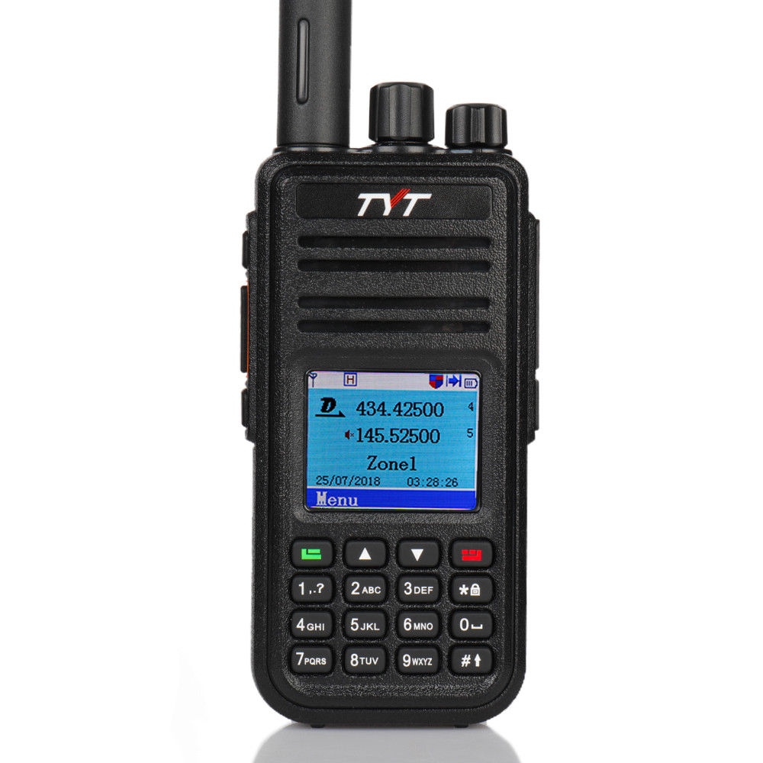
DMR Radio Training
Instructors
Marty Fitzgerald – W5MF
Walter Holmes – K5WH
Ron Matusek - WA6TQH
Digital Mobile Radio communications

Slide 2

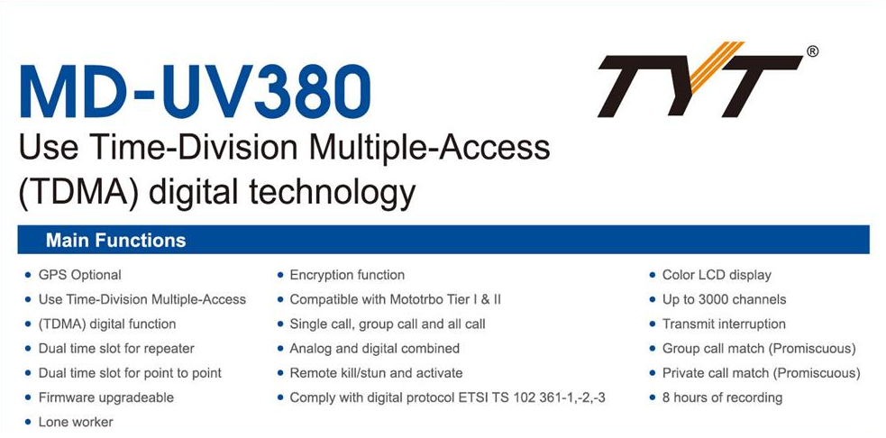
TYT MD-UV380 (GPS)

Slide 3
Training Overview
Marty – W5MF
1. What is DMR
2. DMR Structure
3. Brandmeister Network
4. DMR-Marc Network
5. Local DMR Repeaters i.e. – Klein – Cypress

Slide 4
Training Overview
Walter – K5WH
1. Loading a codeplug into the radio
2. Loading the user database into the radio
3. Making changes to the codeplug
4. Adding a channel
    Creating a Zone and adding channels to it
    Creating a Scan group and adding channels

Slide 5
Training Overview
Ron – WA6TQH
1. What parts do I need to build a “Hotspot”
2. Where do I get the parts for a “Hotspot”
3. How do I program a “Hotspot”
4. Do I want a Simplex Hotspot or Duplex – What’s the difference ?

Slide 6
Types of Hotspot Hardware
Hardware | Simplex / Duplex | Comments
Zumspot | Simplex | visibility of Time Slot #2 only
Jumbospot | Simplex | Chinese version of above
Pi-Zero WiFi board | -- | used with above to provide wifi access
Banana Pi BPI-M2 Zero | -- | Chinese version of Pi Zero
SharkRF Openspot | Simplex | Late 2018 - Discontinued production Ethernet; need external wifi interface
Duplex board | Duplex | split channel operation visibility of Time Slots #1 & #2
Raspberry Pi-3 b+ | -- | required for Duplex Board adds more power & flexibility for addons i.e. Larger display such as a Nexton LCD &

Slide 7
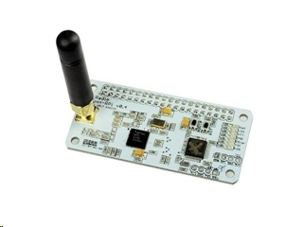
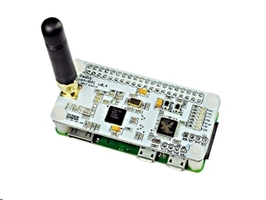
Zumspot assembly
https://www.hamradio.com/detail.cfm?pid=H0-015993
Zumspot with Pi-Zero W attached

Slide 8
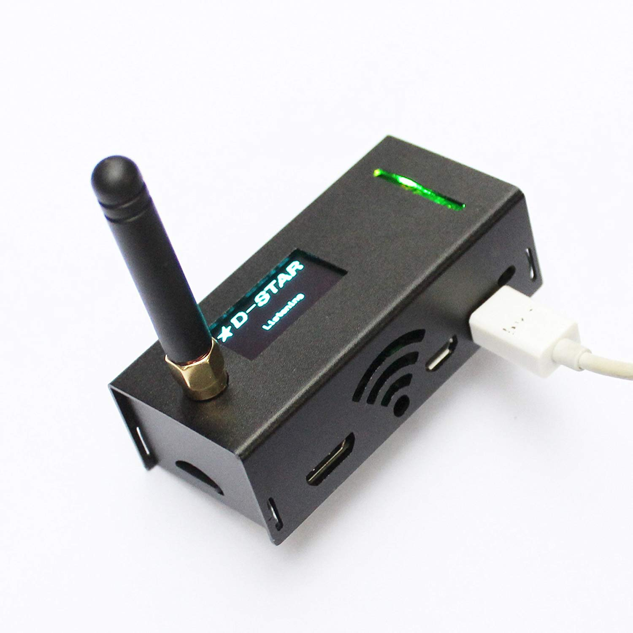
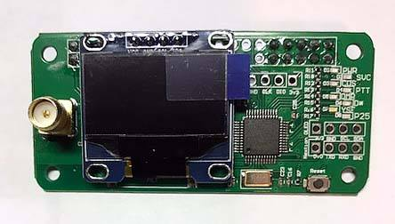
JumboSpot assembly
Search JumboSpot on Amazon
https://www.aliexpress.com

Slide 9
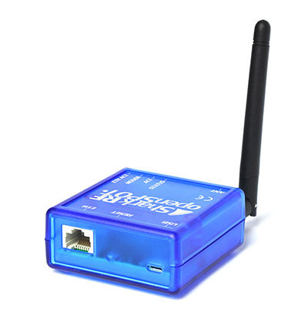
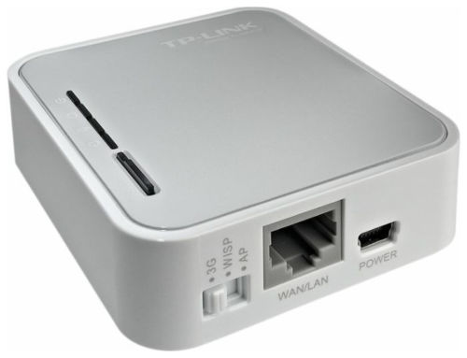
SharkRF Openspot
Structured more for Home WiFi
SharkRF Openspot – has lights, gives voice info via TG9, but needs an adapter to do mobile Wi-Fi
TP-LINK
Portable 3G/4G Wireless N Router
Model No. TL-MR3020

Slide 10
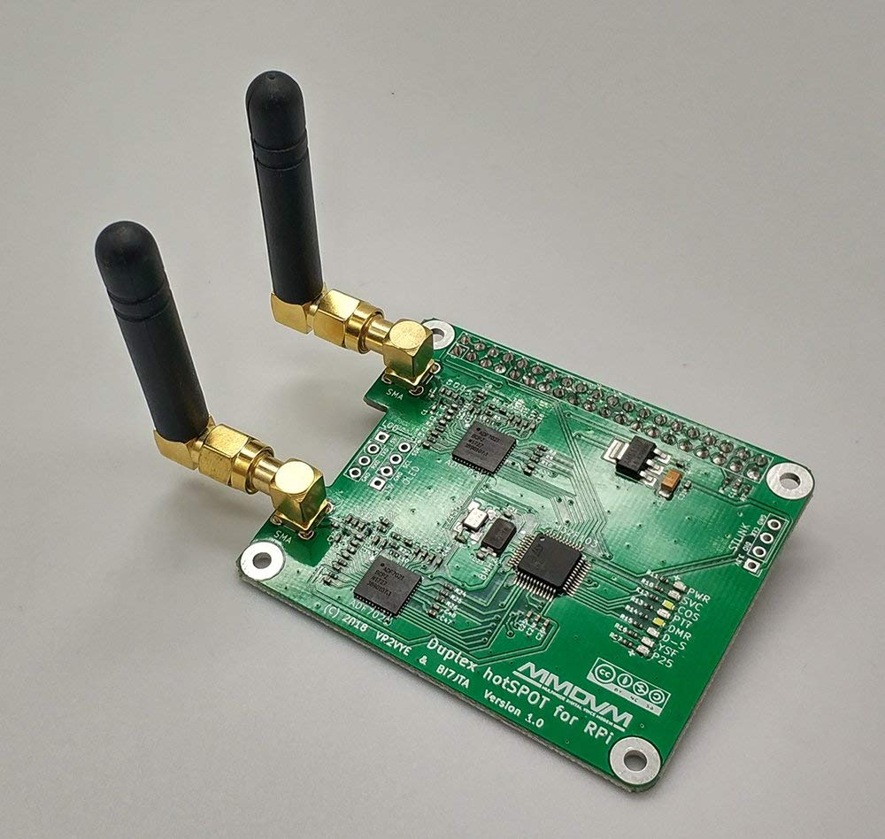
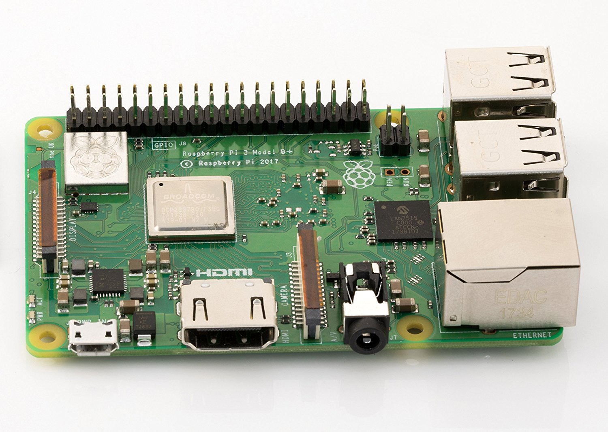
Duplex Assembly with Pi-3 B+
Two TS visability
Winters Huang <bi7jta@gmail.com>

Slide 11
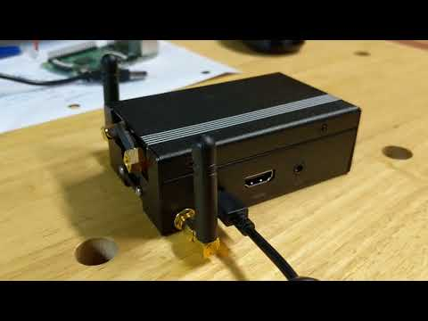
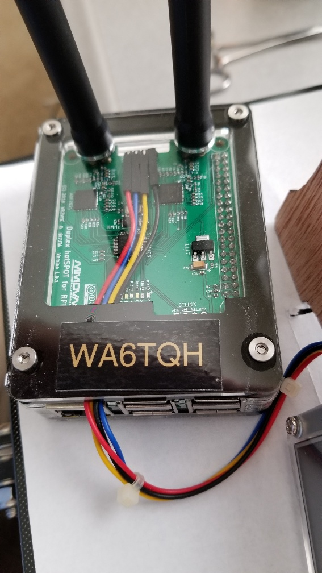
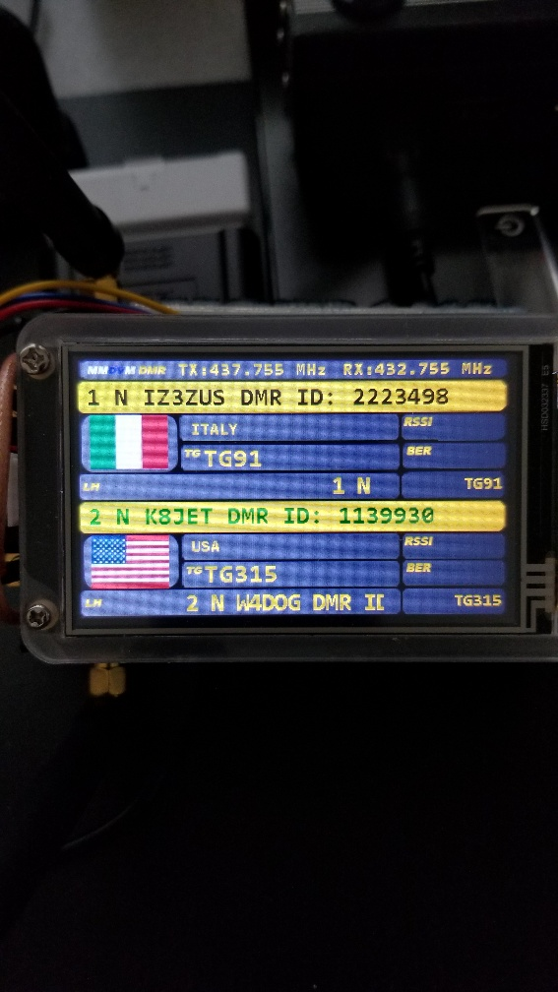
Eleduino Raspberry Pi 3, 2 and B+ Case Aluminum or Plastic
https://www.amazon.com/gp/product/B01LZ3I5R4/ref=oh_aui_detailpage_o09_s00?ie=UTF8&psc=1

Slide 12
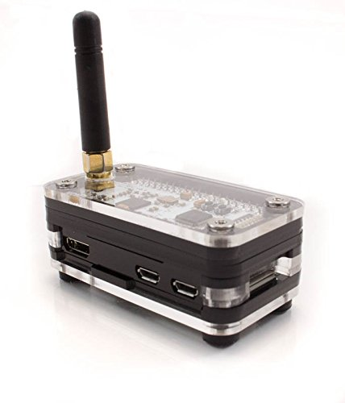
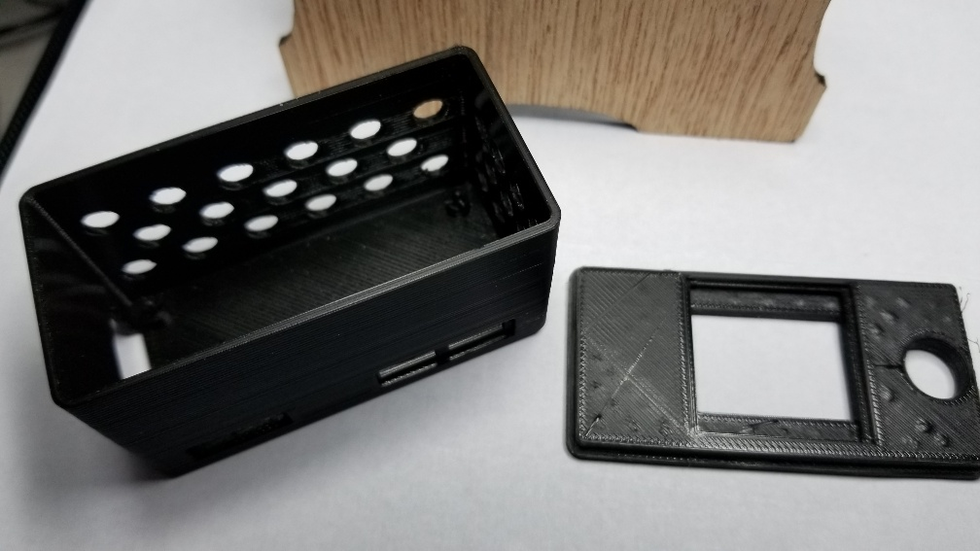
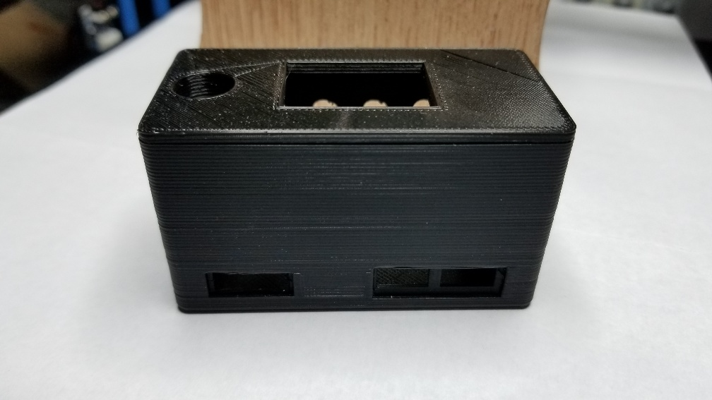
3D Printed or Plastic Case
Zum-Pi plastic Case is available on Amazon

Slide 13
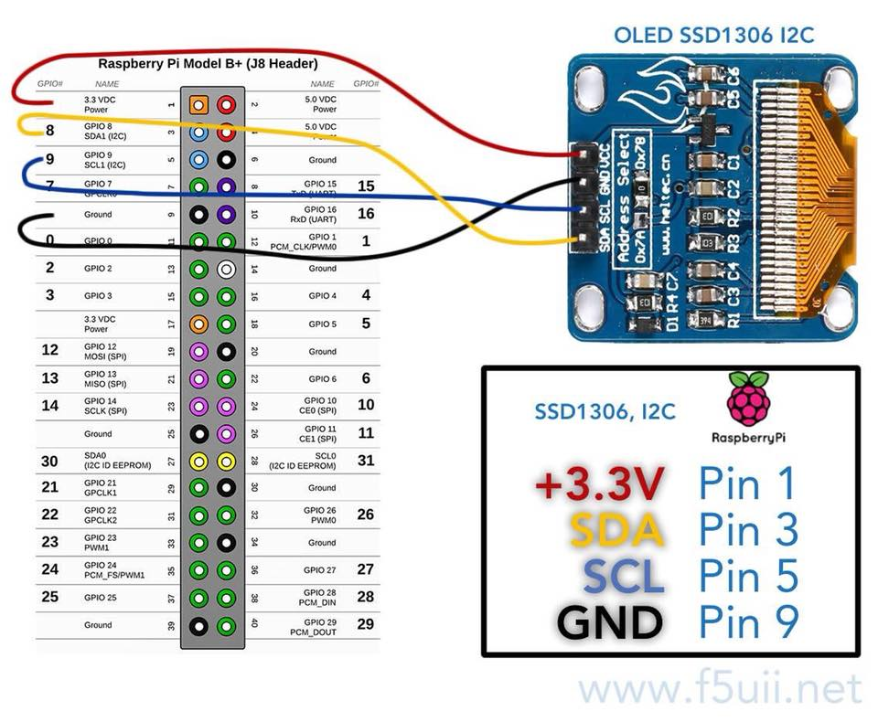
Connecting OLED to Zumspot
MUST USE GPIO PINS!
Do NOT connect the OLED to the LCD pads on the Zumspot board.
The OLED is addressed from the Pi NOT the Zumspot, the I2C pads are connected to the Zumspot processor.

Slide 14
Recommended Software Tools
1. Angry IP – https://angryip.org/
2. Firmware Updater for MD-UV380(GPS) Available at the TYT Website
    http://www.tyt888.com/?mod=download
3. CPS – Code Plug loader and Editor – CPS MD-UV390 Setup V 1.06 (GPS version)
4. Pi-Star application - https://www.pistar.uk/
5. Win32 Disk Imager -
https://sourceforge.net/projects/win32diskimager/files/latest/download
6. Etcher – https://etcher.io/ image writing application for SD

Slide 15
How to Configure a HotSpot
The next few slides outline the steps to getting the HotSpot operational
Download pi-star OS and create wifi wpa file
Locating the IP address of the Hotspot
Using Google Chrome to access pi-star OS on the hotspot
Initial configuration of the pi-star OS
Testing communication between the Radio and HotSpot

Slide 16
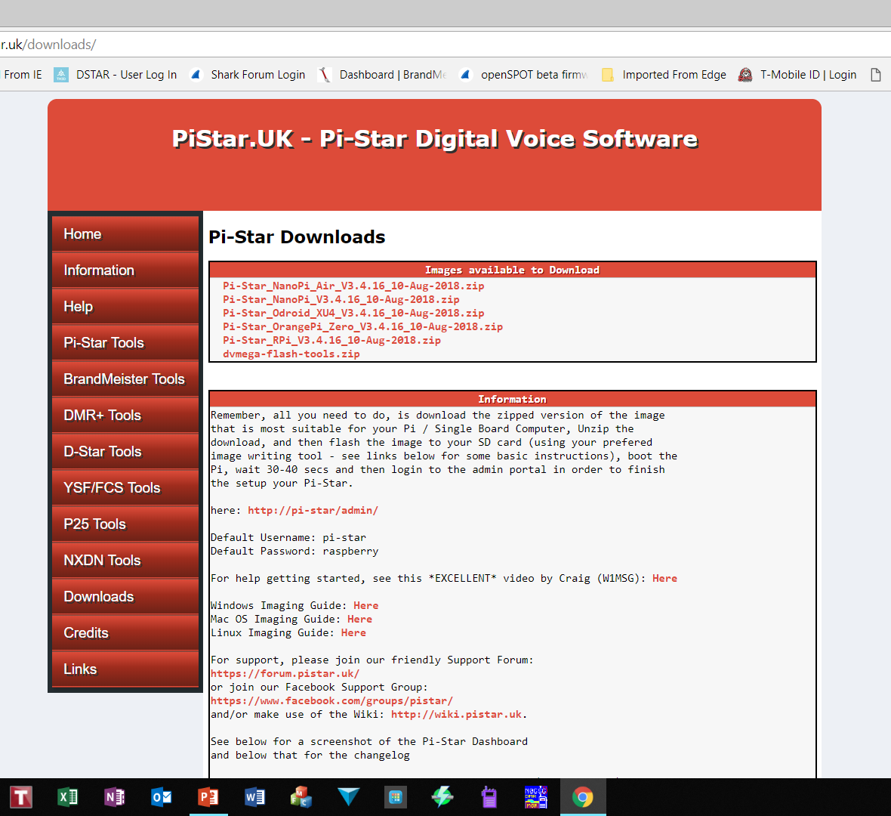
Download Pi-Star
Using Google Chrome type in: http://www.pistar.uk/
SELECT DOWNLOADS
Select Correct Pi-Star Version

Slide 17
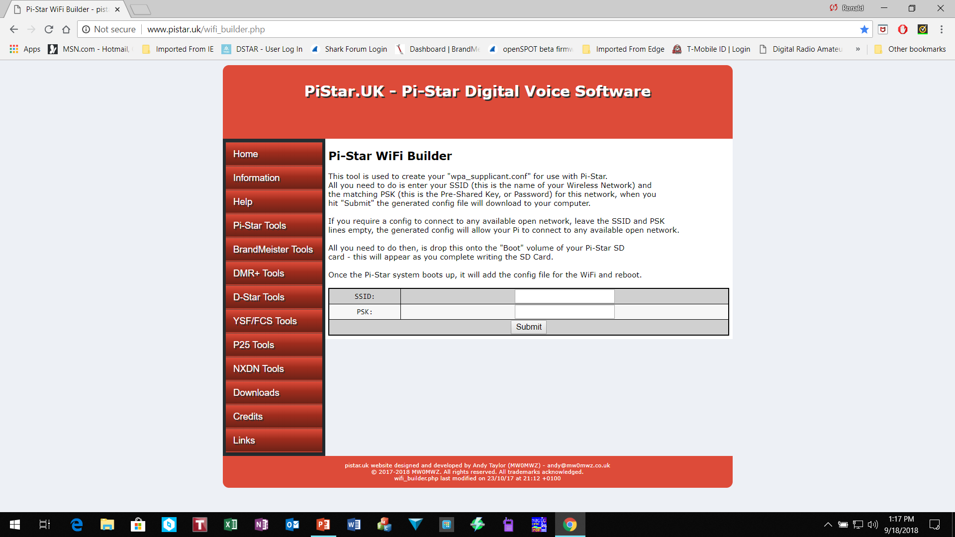
Wifi Builder Tool
Create initial WiFi File
Enter Home Wifi login information or
Cellphone hotspot information

Slide 18
Copy Pi-Star .img to SD along with Wifi wpa File
Un-Zip Pi-Star file to a local folder i.e. DMR Pi-Star Firmware
Go to file location where .img is located
Using Win32 Disk Imager or Etcher Imager write the .img file to SD
Copy the wifi file (wpa_supplicant.conf) file to SD (boot dir)
Insert the SD into the pi-star zero W board
Apply 5V power to the board and wait for boot-up
If using LCD screen it should reflect wifi connection IP on boot up

Slide 19
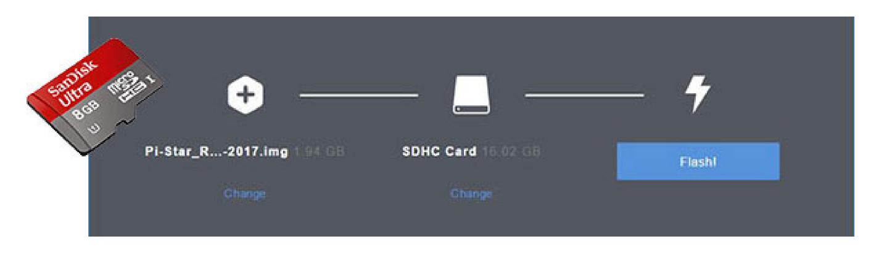
Copy Pi-Star .img file to SD
Etcher Application Example

Slide 20
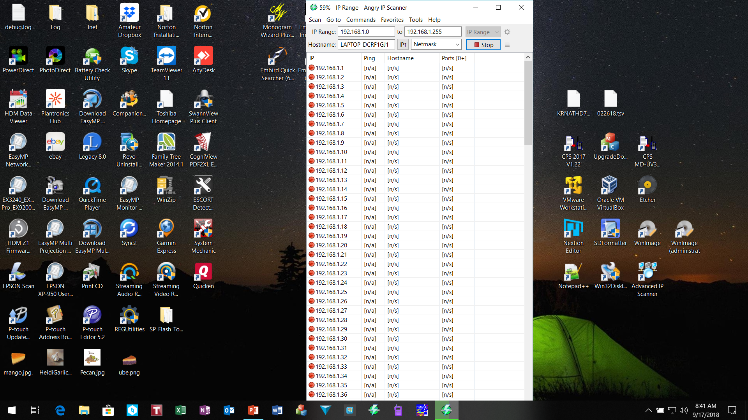
Run Angry IP Scanner to identify IP address

Slide 21
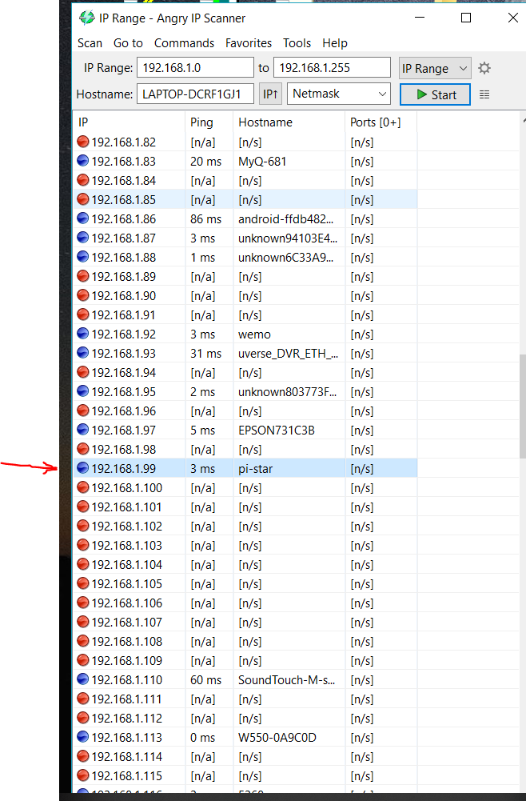
Locate Pi-Star IP Address
192.168.1.99

Slide 22
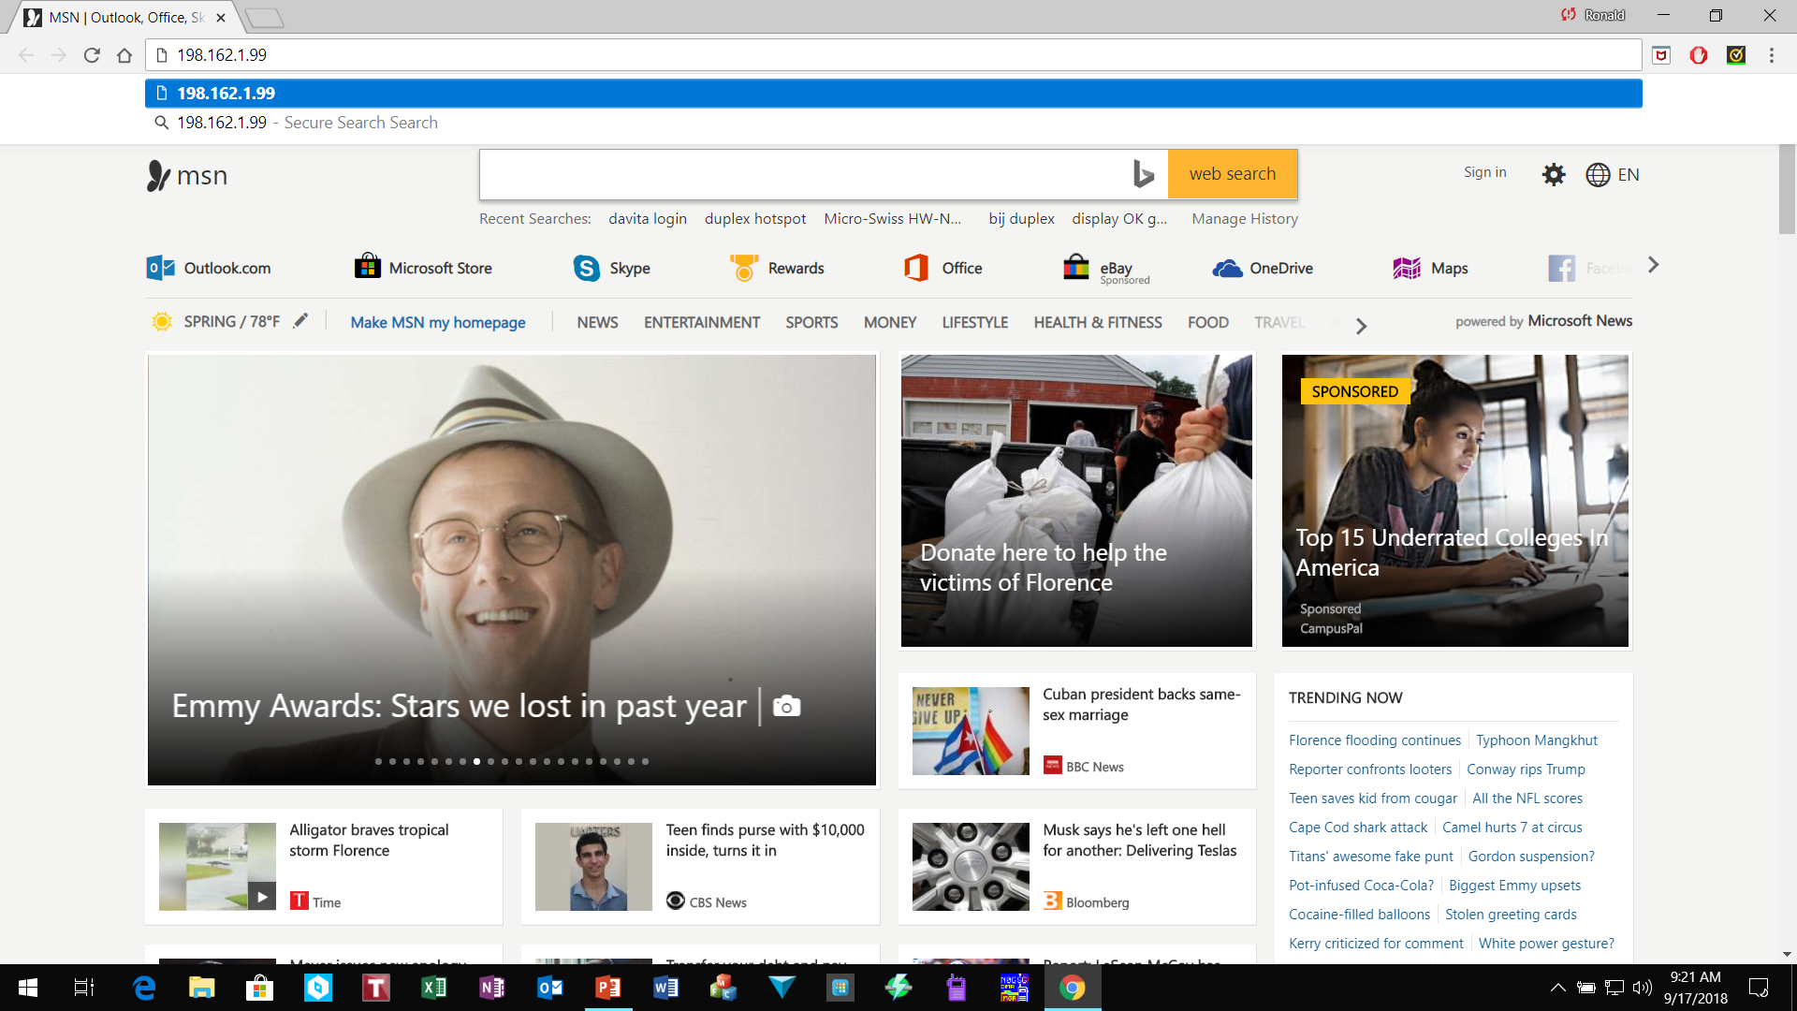
Run Google Chrome Browser
Type in IP address from Angry IP scanner

Slide 23
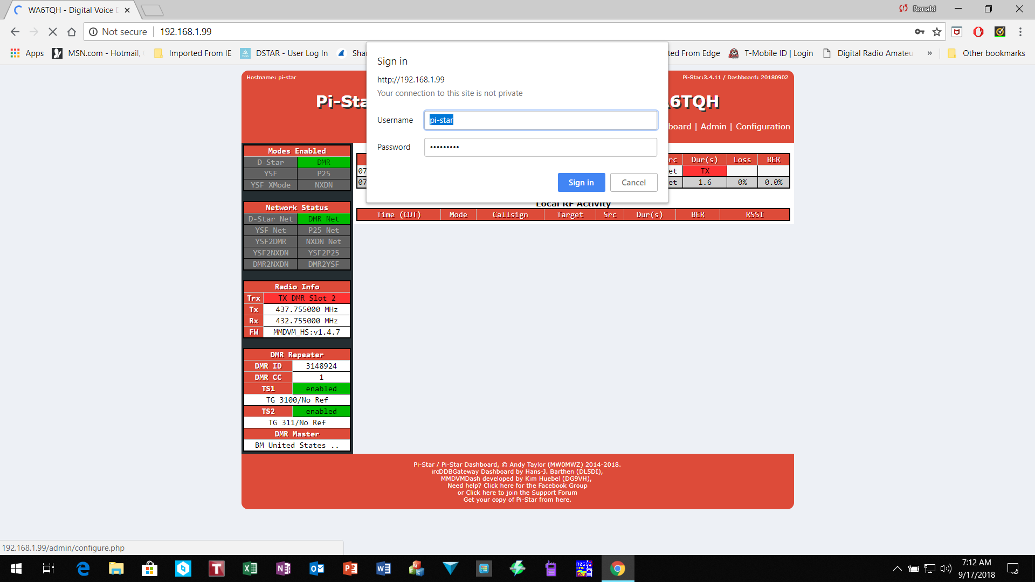
Login to Pi-Star now running on Hotspot
Username: pi-star
Password: raspberry

Slide 24
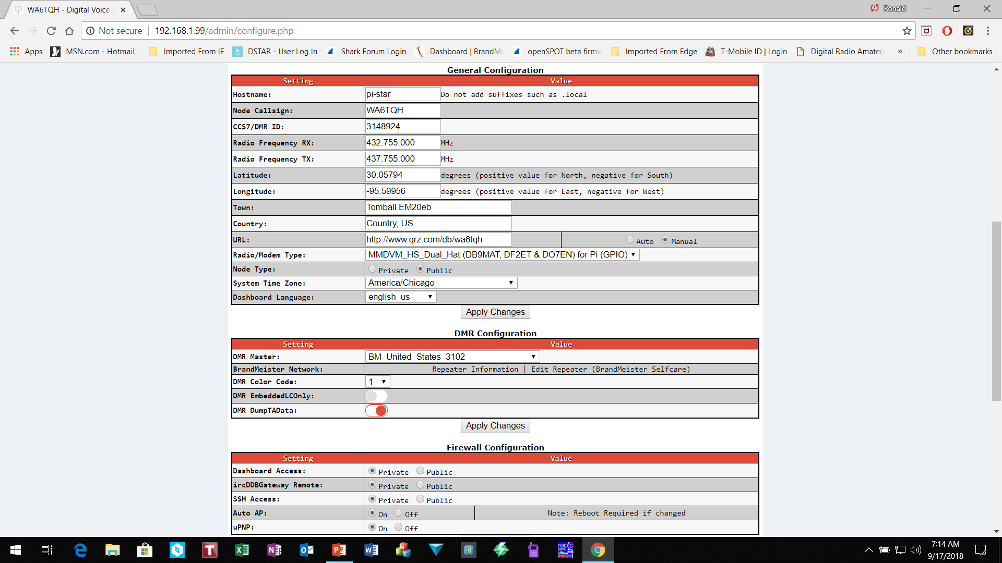
Initial Configuration Requirements
Call Sign
DMR ID
Frequency
Board Type
DMR Master
BM_US 3102

Slide 25
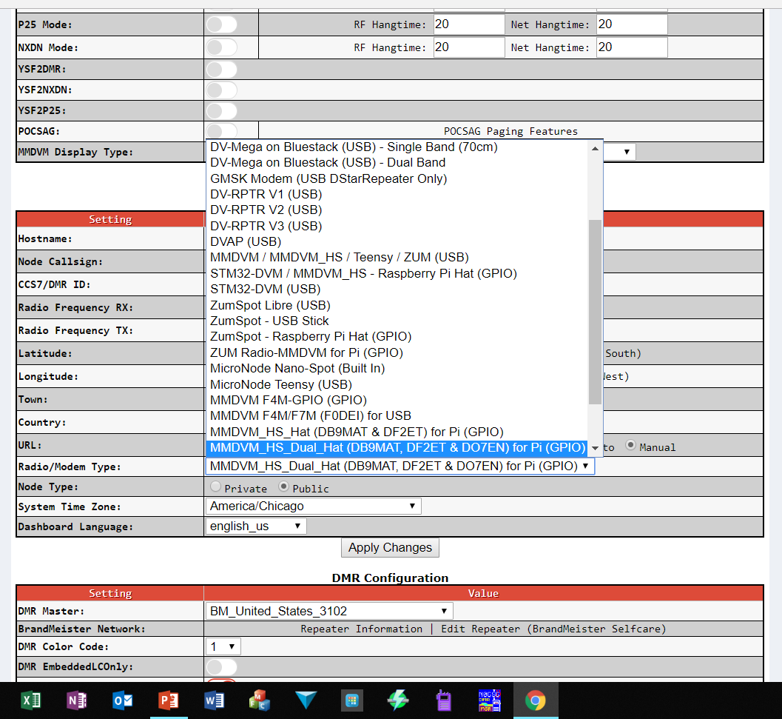
Set Radio/Modem Type
Zumspot
Board
Duplex
Board

Slide 26
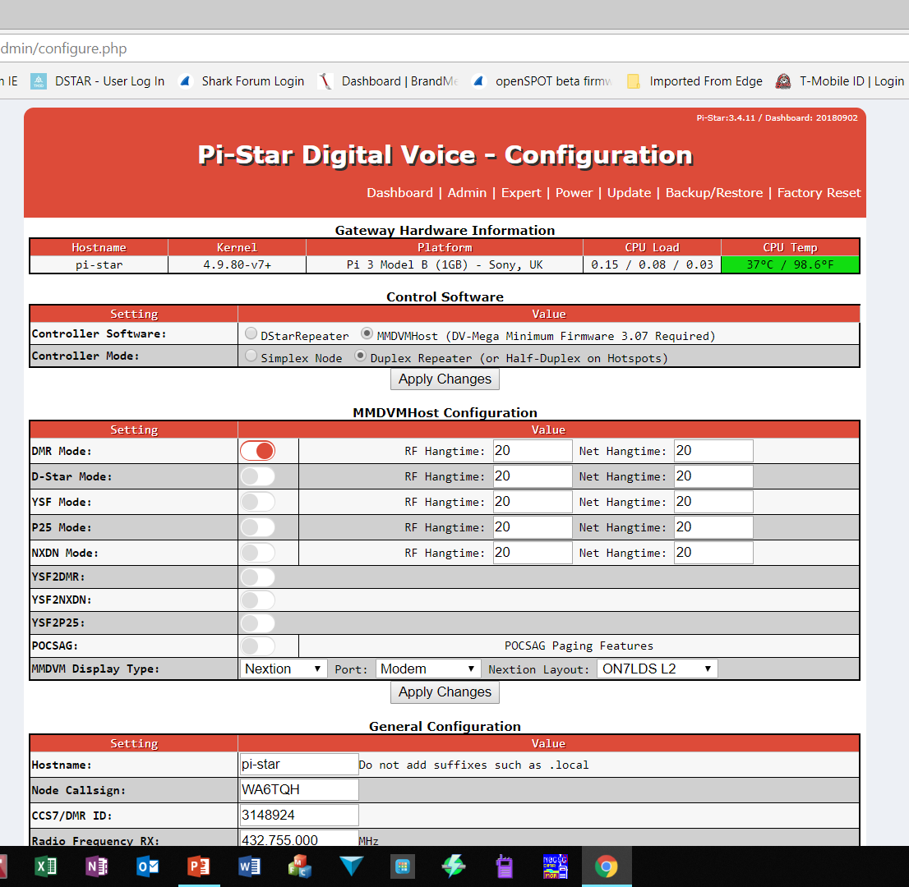
Activate Function Settings
Activate Functions
}
OLED settings:
MMDVM Display: OLED.
Port: /dev/ttyAMAO
Layout: ON7LDS
Settings shown are
For Nexton LCD

Slide 27
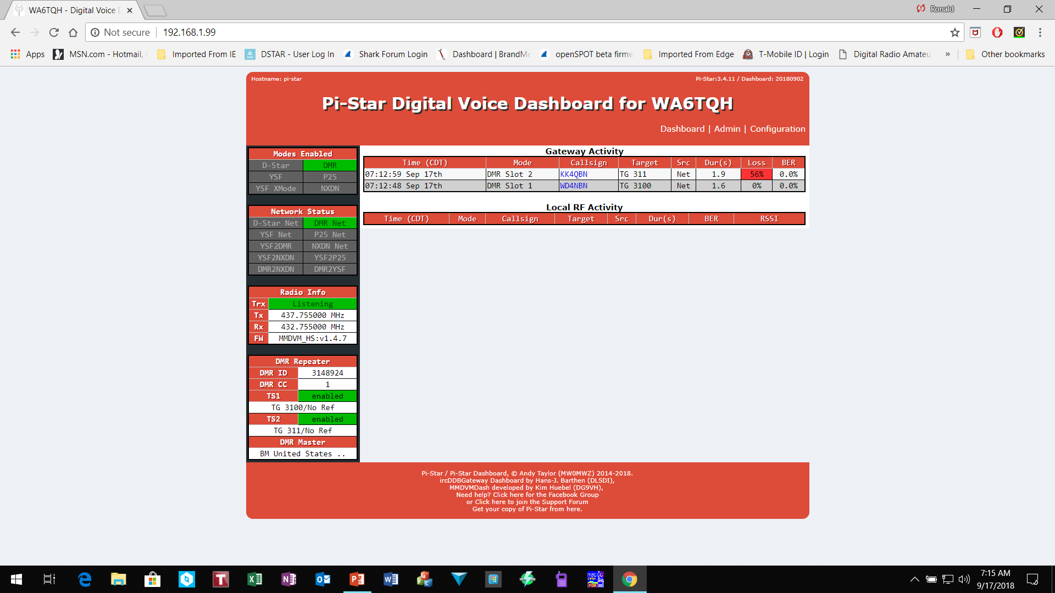
View Dashboard
View communications activity here.
Simplex Hotspot TS2 only
Duplex TS1 & TS2

Slide 28
Talk Group Visability
In practical terms you are limited to the slots available.
If you have a duplex hot spot, you have two talkgroups available at a time,
  1 on slot 1 and 1 on slot 2.
A simplex hotspot 1 talk group / reflector only.
Anyone listening to the transmission can hear any of the transmission provided that they have been made dynamically available or are fixed.
You won't be able to hear two talk groups active on the same slot, unless the dynamic timeout is reached and there more fixed groups available on the slots, in other words, it's first come first served

Slide 29
Talk Group Visability (cont’d)
There are no abilities for multiple radios listen to multiple TG's.
With a simplex board setup, whatever you are connected with will be the one transmitting.
If you have multiple fixed static groups you could use a radio with an Rx channel for each static TG, but again only one can transmit at any given time, so you might miss an over or two on another radio.
With a duplex MMDVM board you have the use of two timeslots which doubles the amount you could listen too.

Slide 30
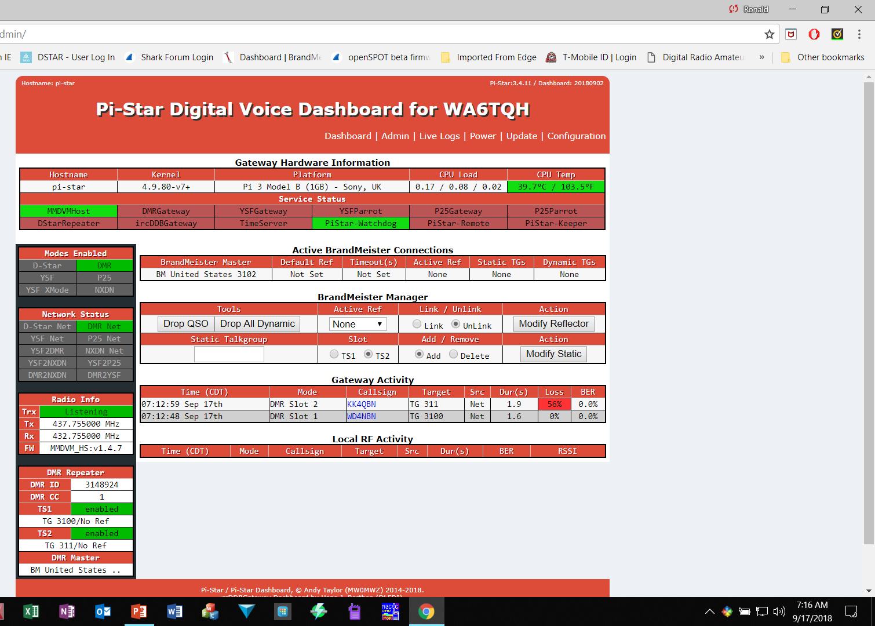
Admin Page
Fine tune BER adjustments
Updates
To current
pi-star rev
RSSI value represent signal strength. i.e. S9+46
The reasonable goal is BER <= 1%.
FINE TUNING FOR LOW BER (BIT ERROR RATE) Adjusting the RX & TX Offset: Testing with your radio. Adjust in small steps (+/- 10) until you achieve the optimal BER

Slide 31
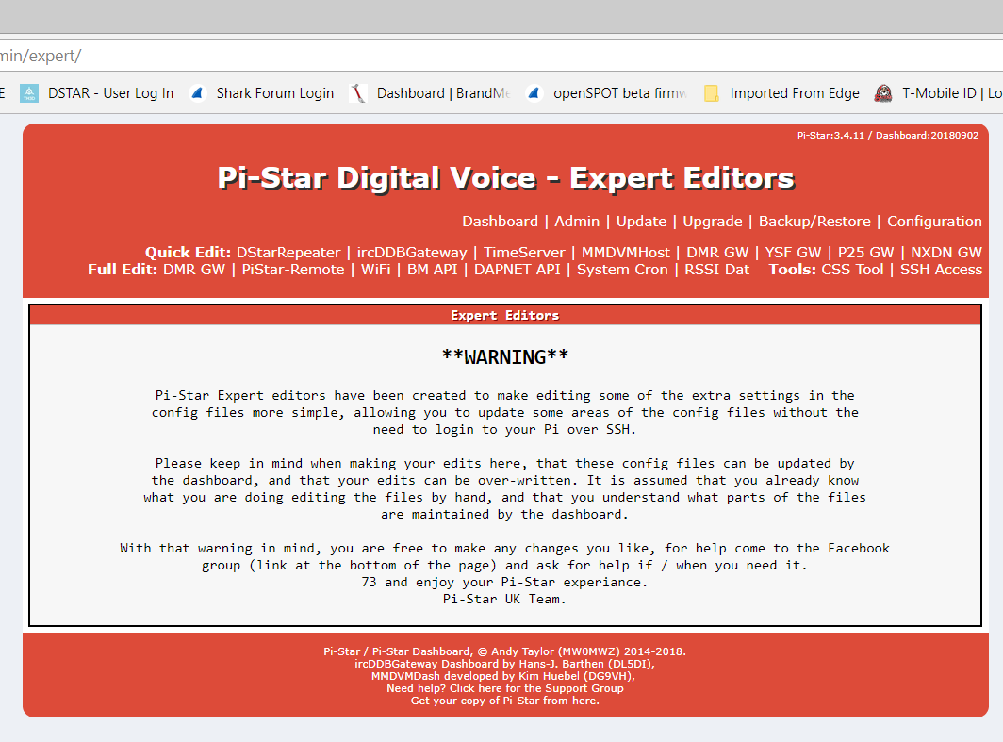
Expert Editor
Select
MMDVMhost

Slide 32
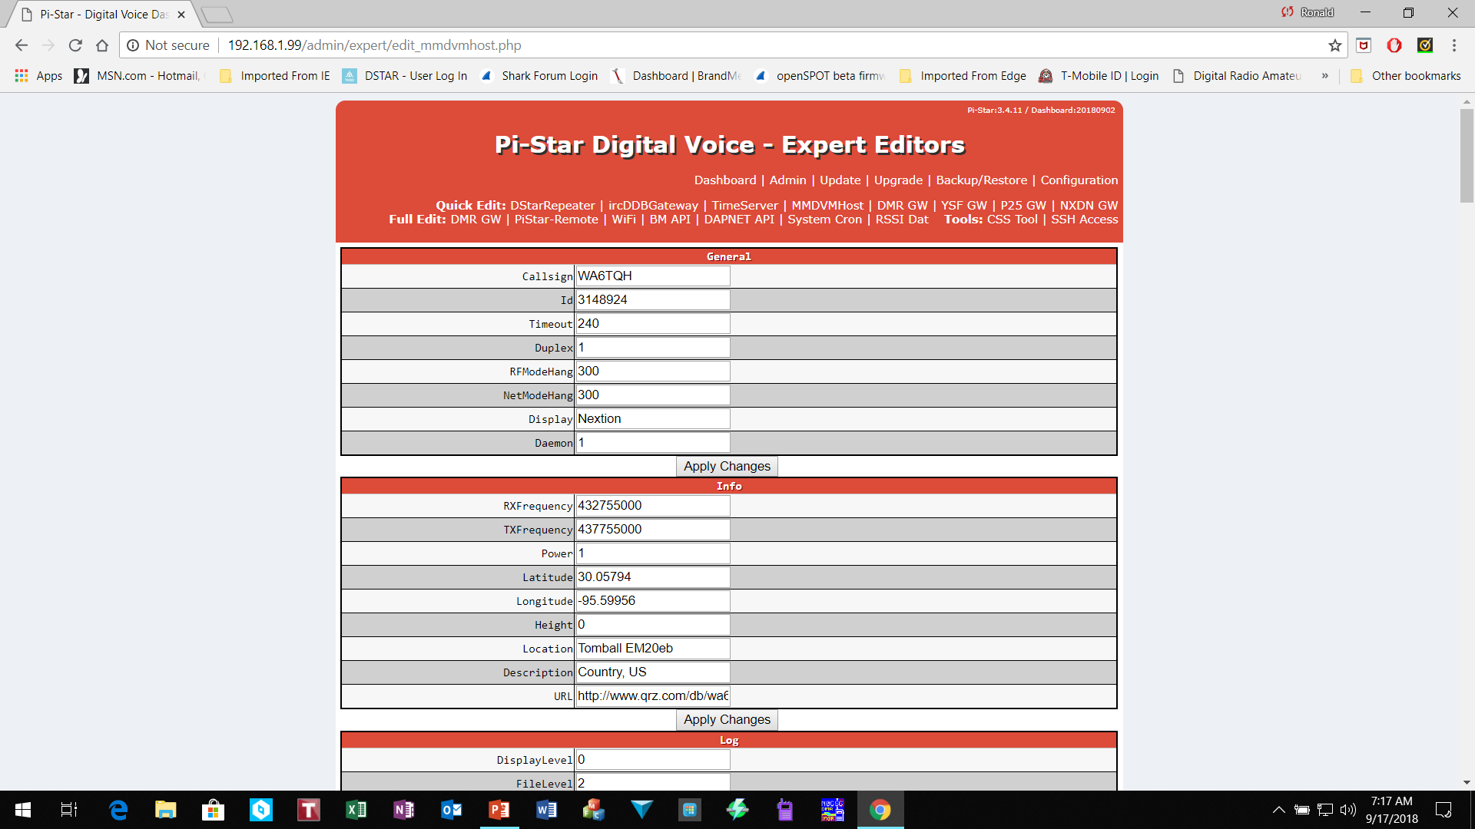
Expert Editors Page
Scroll Down

Slide 33
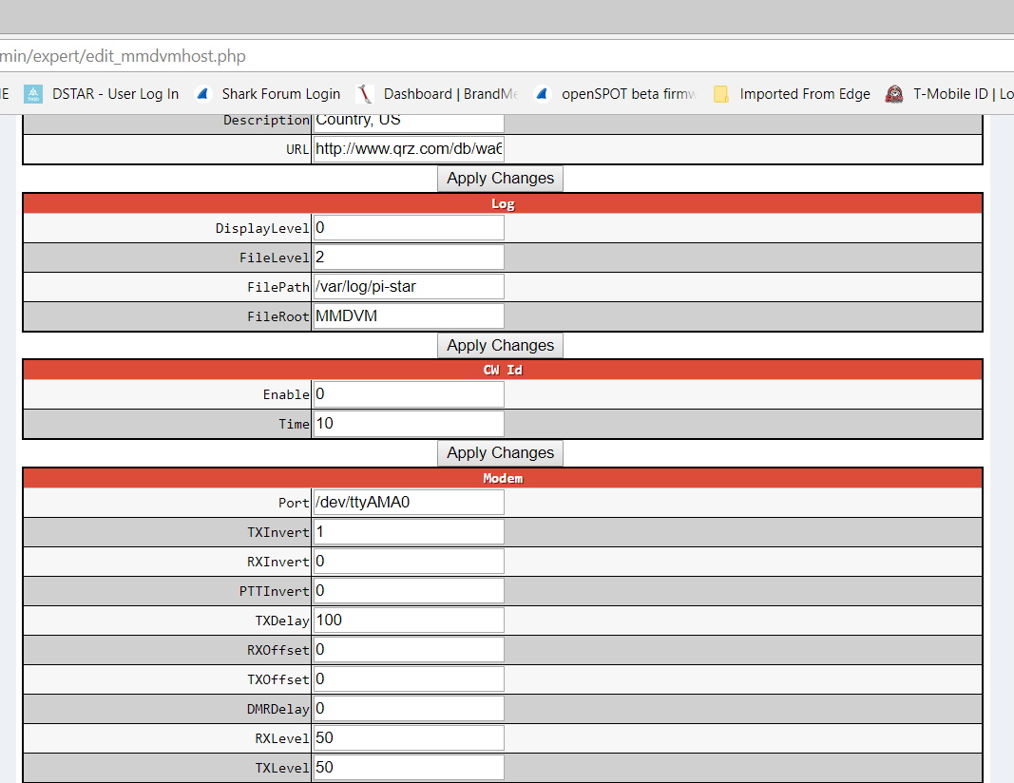
Setting Frequency Offset
The RXOffset and TXOffset are in Hz
Minor Hz shift is supposed to reduce the ber%
TX & RX Offset

Slide 34
Relationship of Radio to Hotspot
BER Fine Tune
Try moving your radio farther from the hot spot.
  Mine works best 10 to 15 feet from the hotspot.
You may also have an issue with the quality of your wi-fi signal.

Slide 35
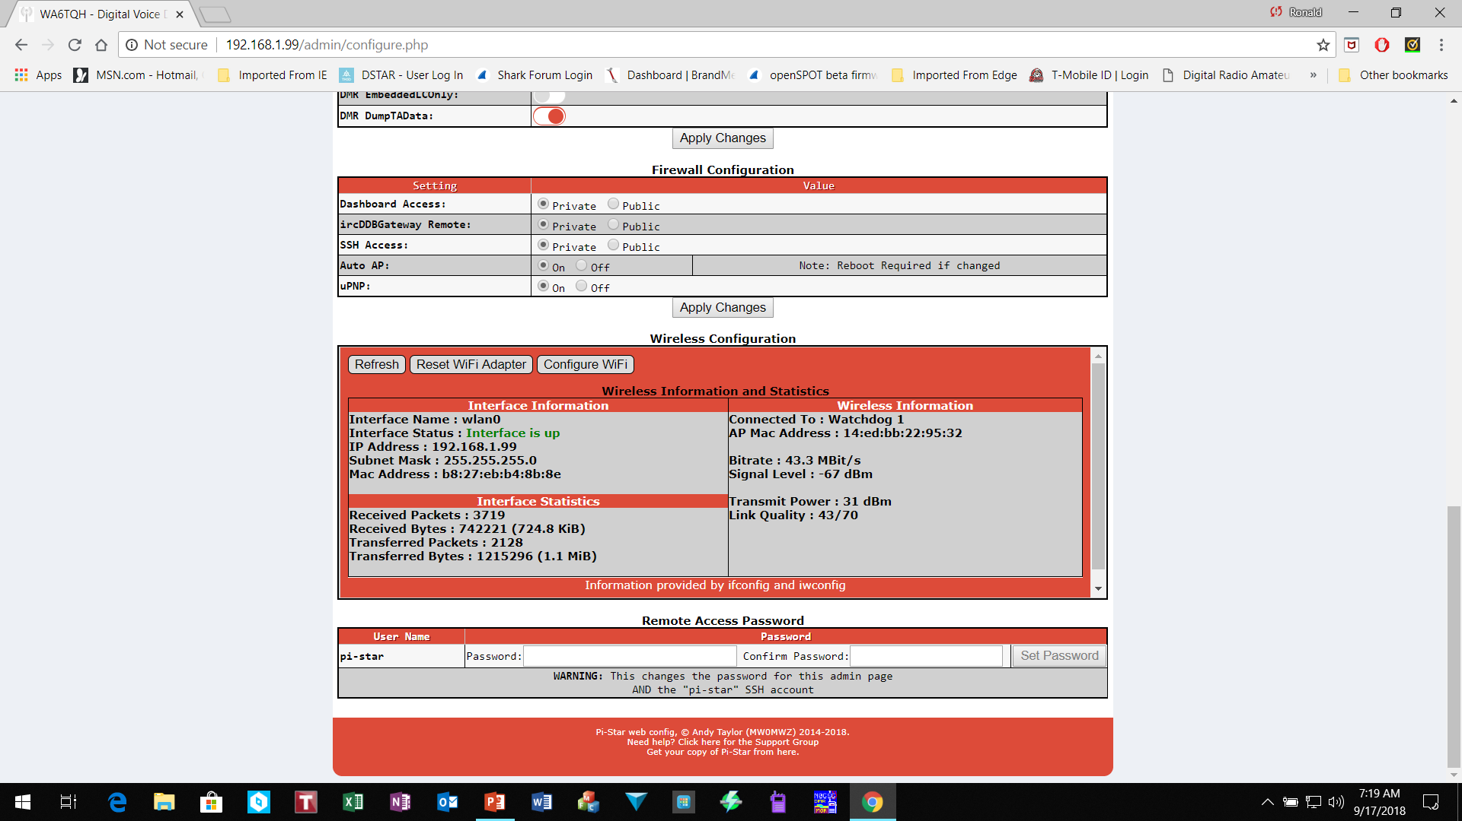
Setup WiFi Login Information
Select configuration page

Slide 36
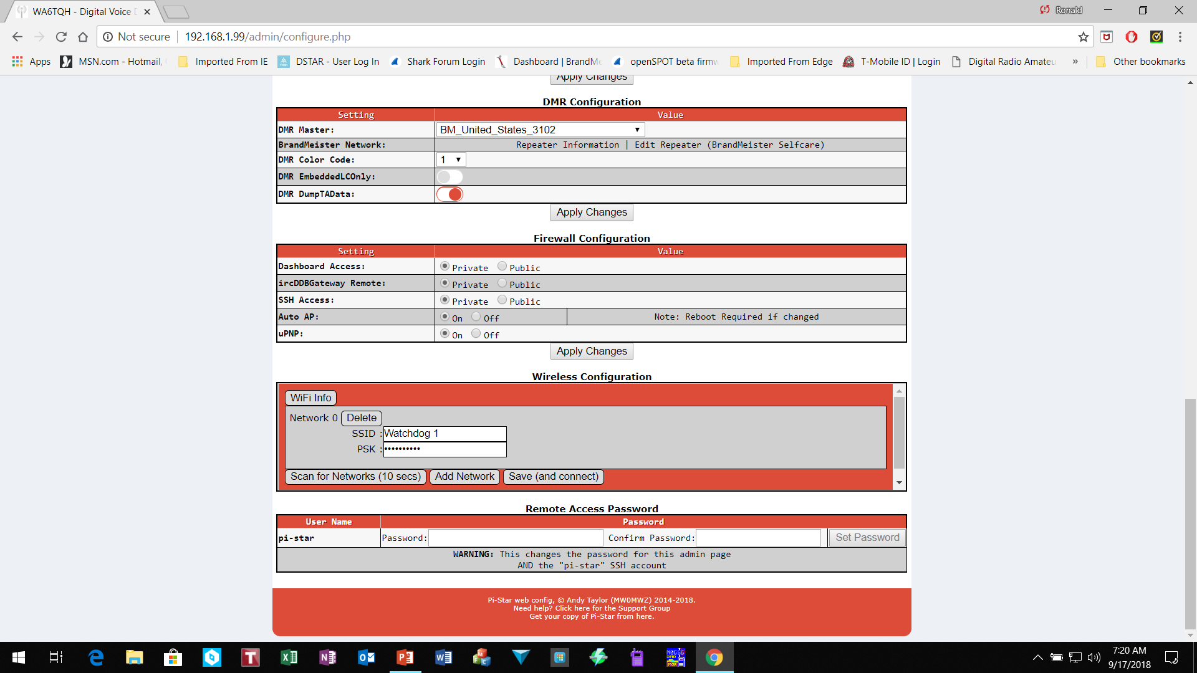
Input WiFi access Information
Input Home wifi login information or cell phone hotspot login
Must SAVE configuration and reboot to take affect

Slide 37
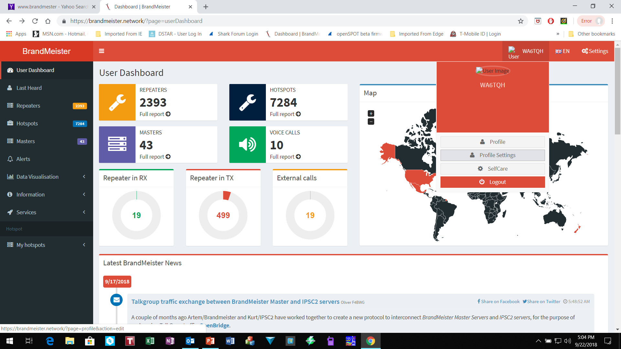
Login to Brandmeister Network
Manage Static TG within pi-star
Login to Brandmeister. https://brandmeister.network/ If you have not setup your static TG yet do so. Make any other adjustments.
Then click on your call sign in the top right hand side.
Choose Profile settings

Slide 38
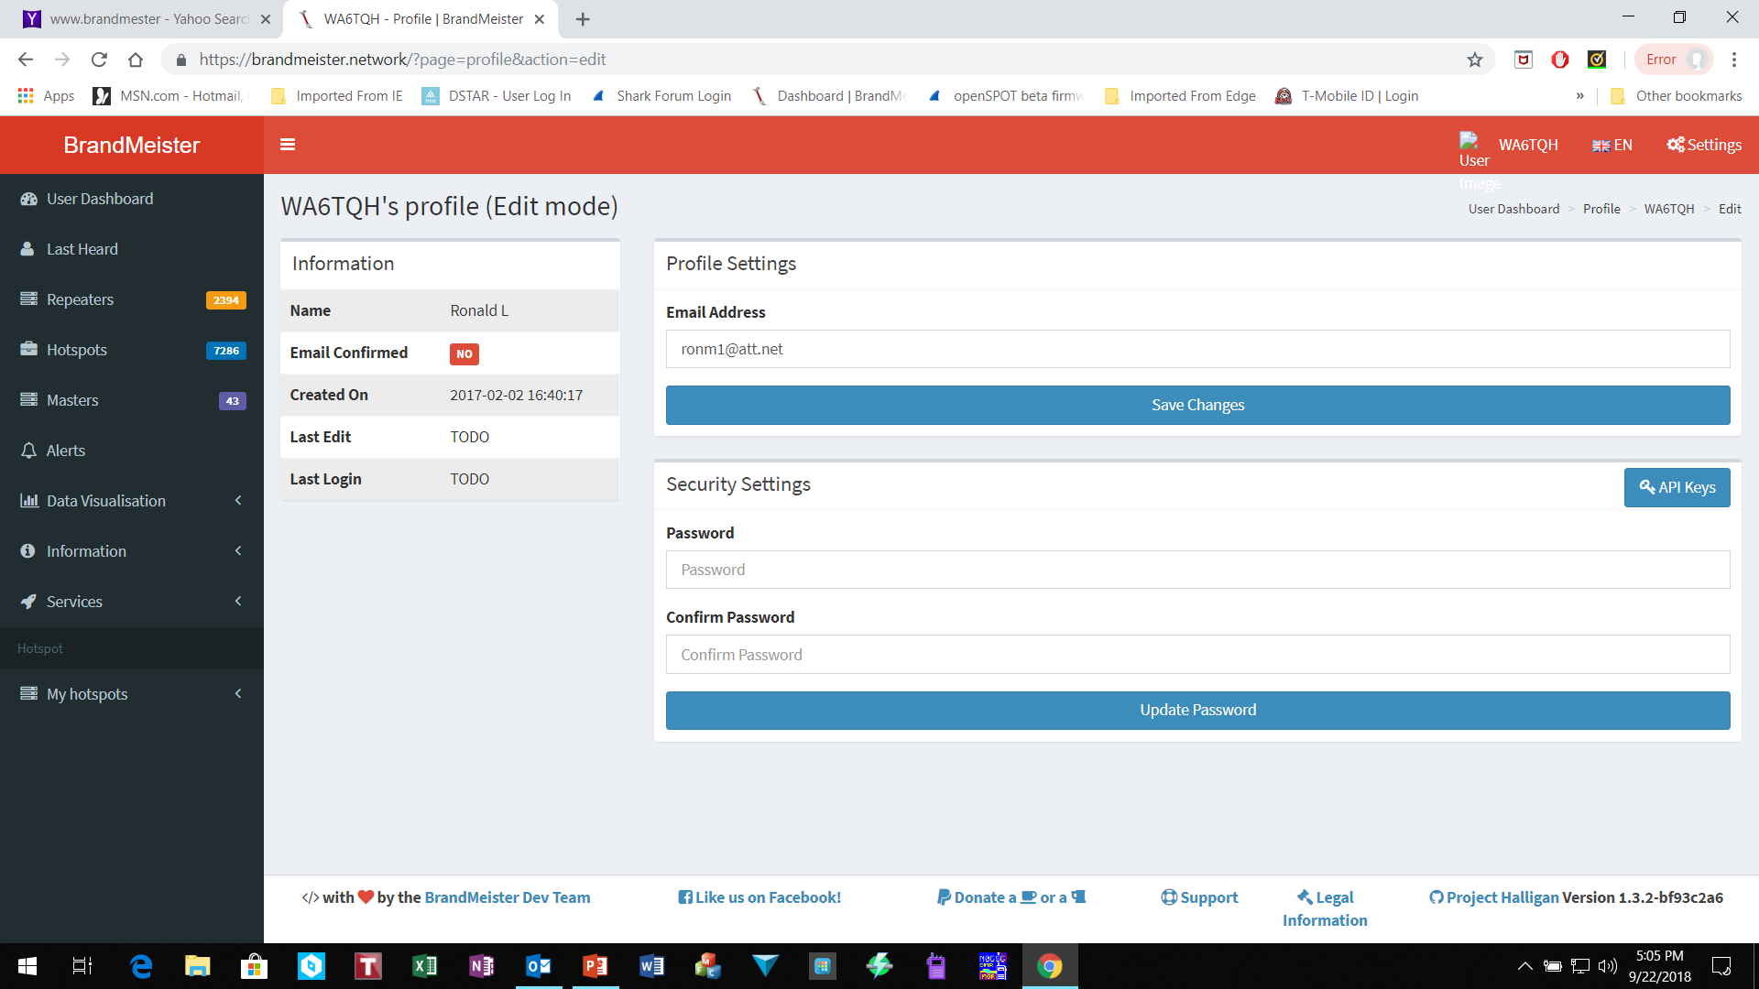
Manage your static TG within Pi-Star
On this screen choose API Keys.

Slide 39
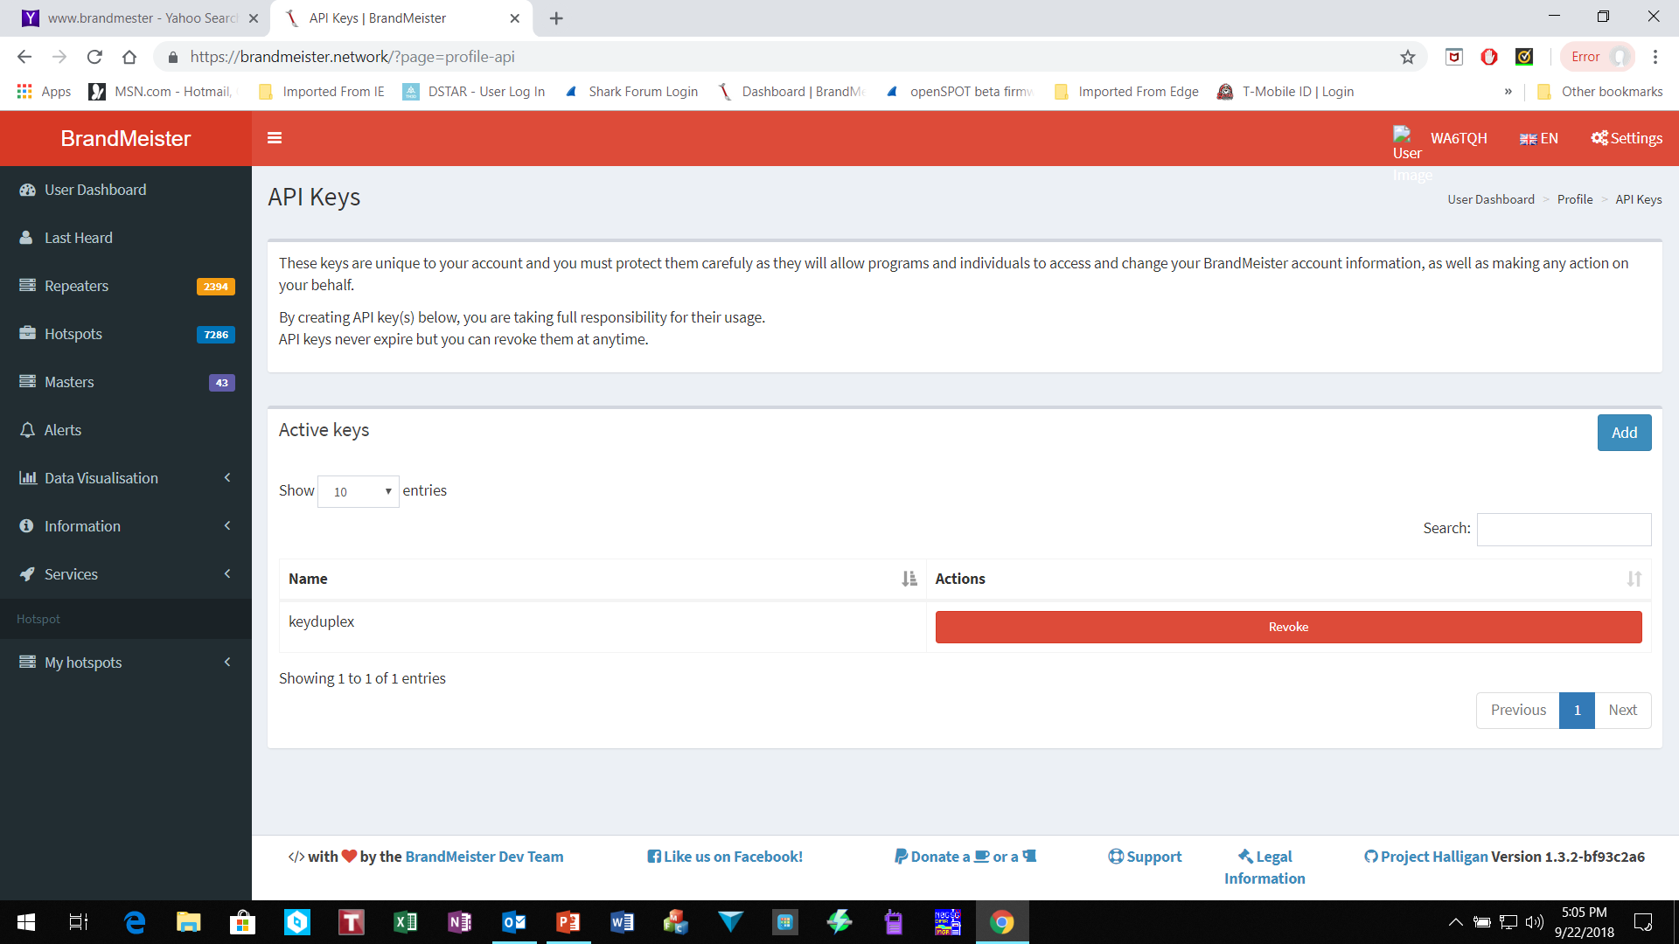
Generate API Keys
Click on Add.
You will be asked for a name for this key
Then you will get a pop up that shows the key and a QR code.
Highlight and copy the key
I would paste this into a text file and name it for safe keeping.

Slide 40
Select Expert Editor
In Pi-Star goto “Expert Editors” and choose “BM API”

Slide 41
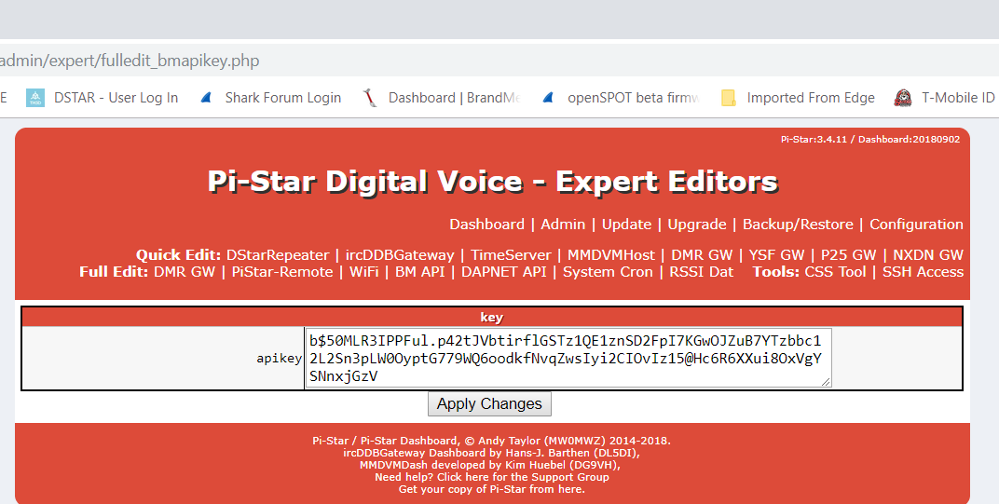
Add API Key
Paste your key into the api key and click on Apply Changes.

Slide 42
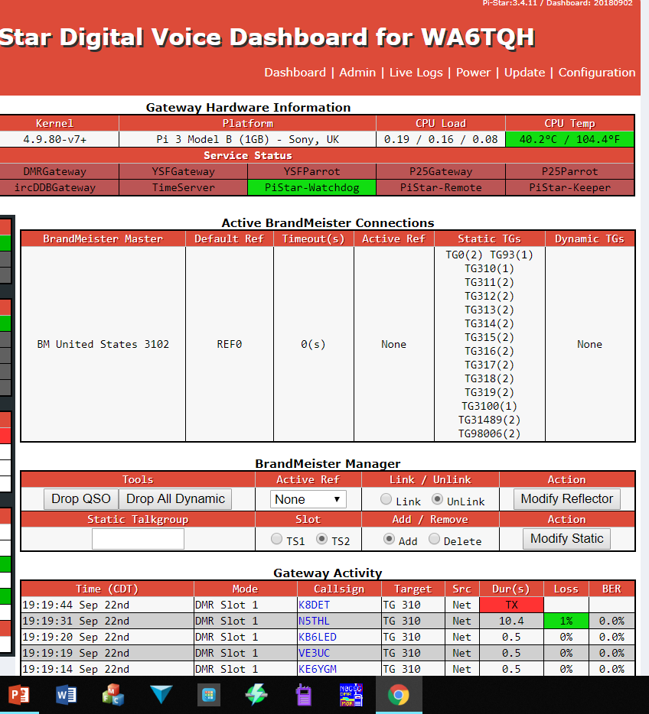
Brandmeister Static TG Manager
Select the ADMIN page
Here you can add or delete TG. Action here will make changes in Brandmeister Network

Slide 43
DMR Help Talk Group
If you need any help outside of the training sessions you can find help here:
Amsat Talk Group – (98006) – Access this Amsat TG using your Hotspot
Klein Local DMR Repeater – Direct Access
Cypress Local DMR Repeater – Direct Access
To use the local DMR repeater do the following:
  Go to ZONE – Select Zone List – Select Klein TX – turn dial to Klein Local
  Go to ZONE – Select Zone List – Select Cypress TX – turn dial to Cypress Local

