Slide 1

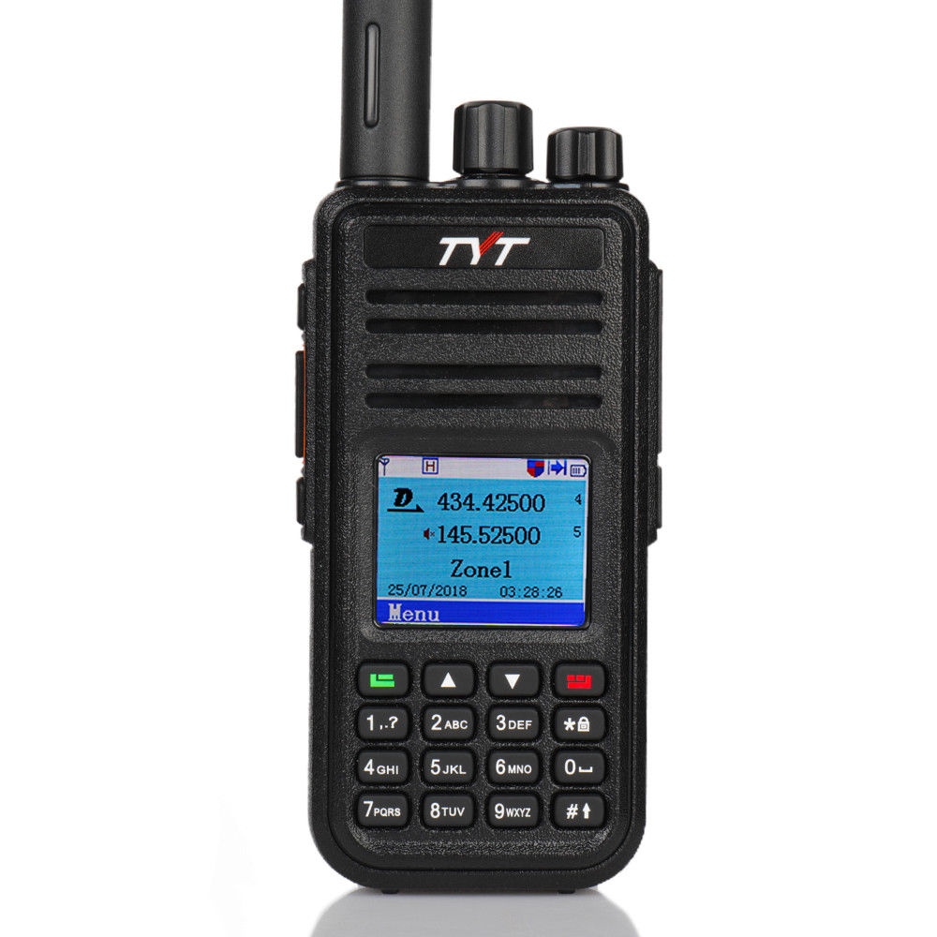
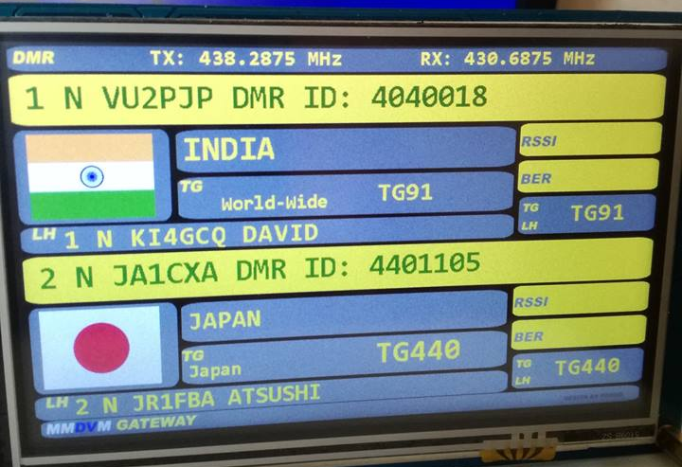
Nextion Display Training
Digital Mobile Radio communications
Presented by:
Ron Matusek – WA6TQH

Slide 2
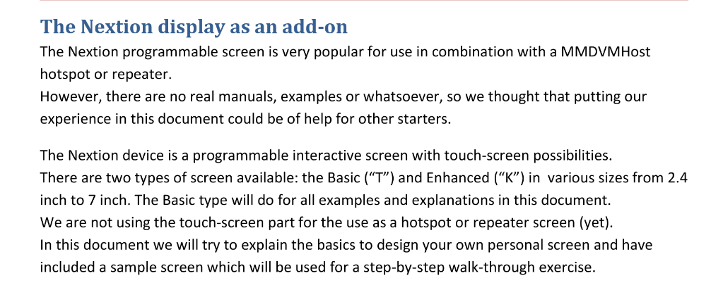
Nextion Display Add-on

Slide 3
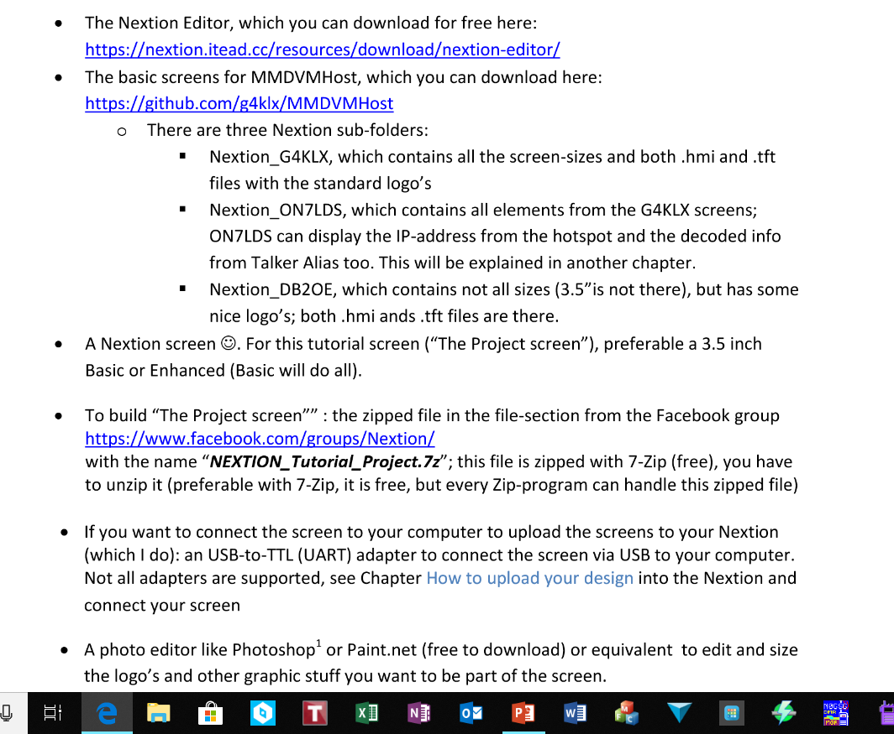
What you need
Nextion Editor Application
Screen Designs

Slide 4
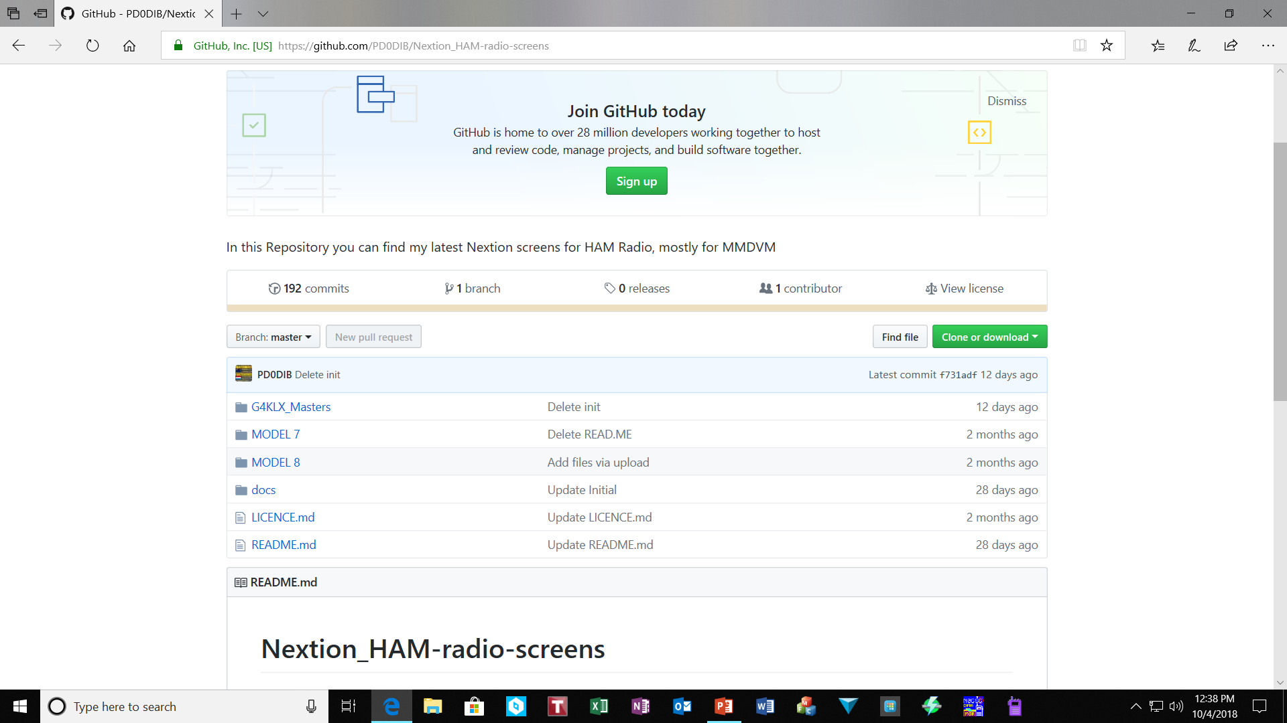
Github Repository
Directory

Slide 5
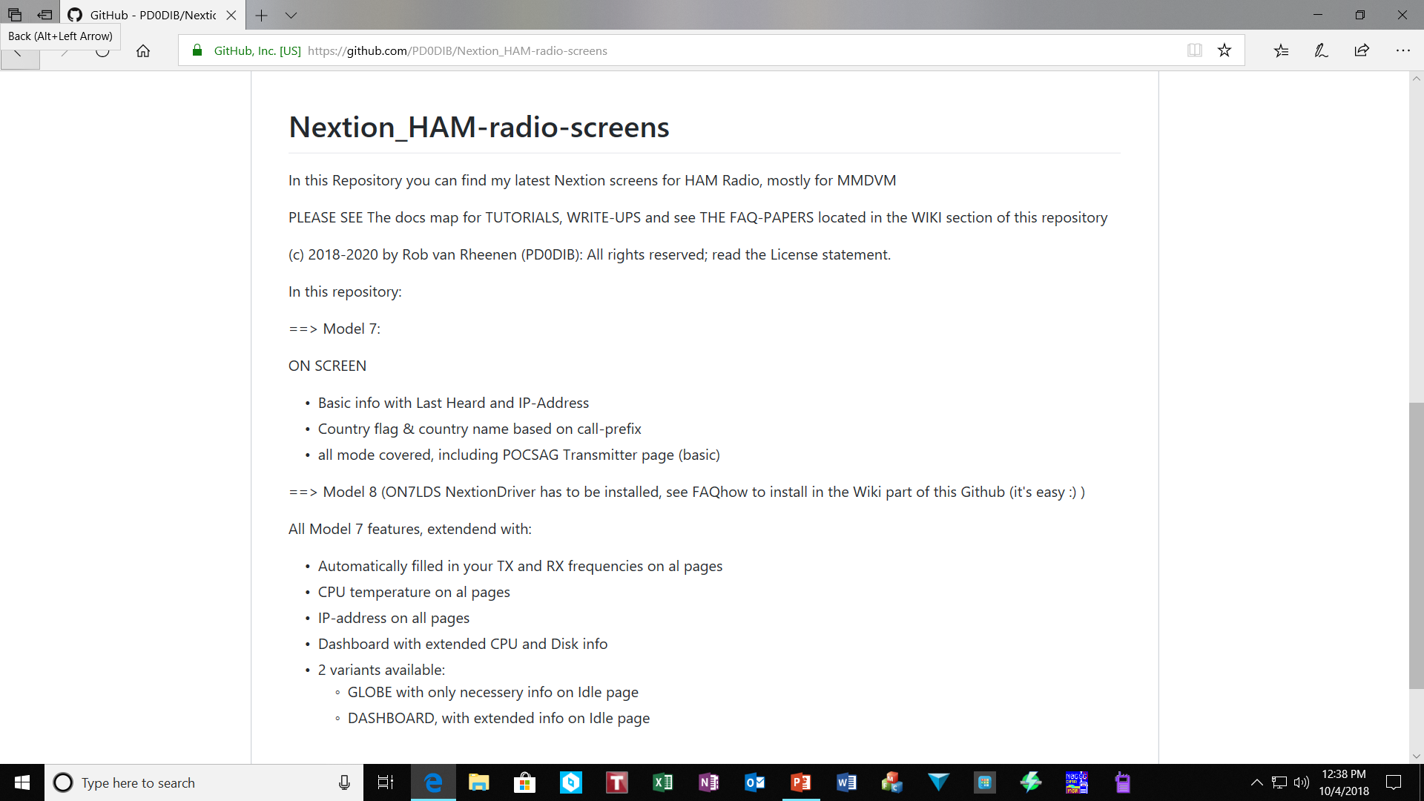
Model 7 Features
Note: Driver requirement

Slide 6
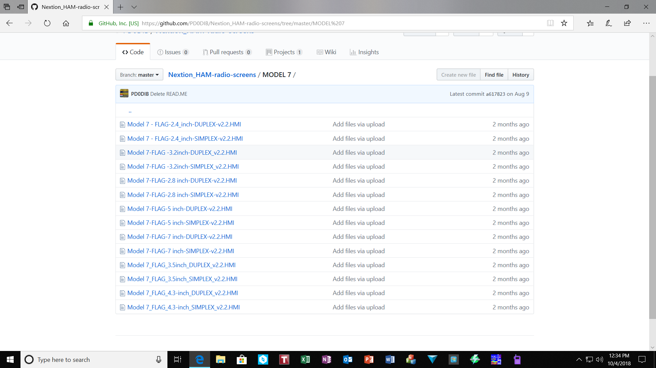
Nextion Model 7 Screen Designs
The Model 7 designs will work with the Non-Enhanced Displays. No Nextion Driver Requirement however limited functionality

Slide 7
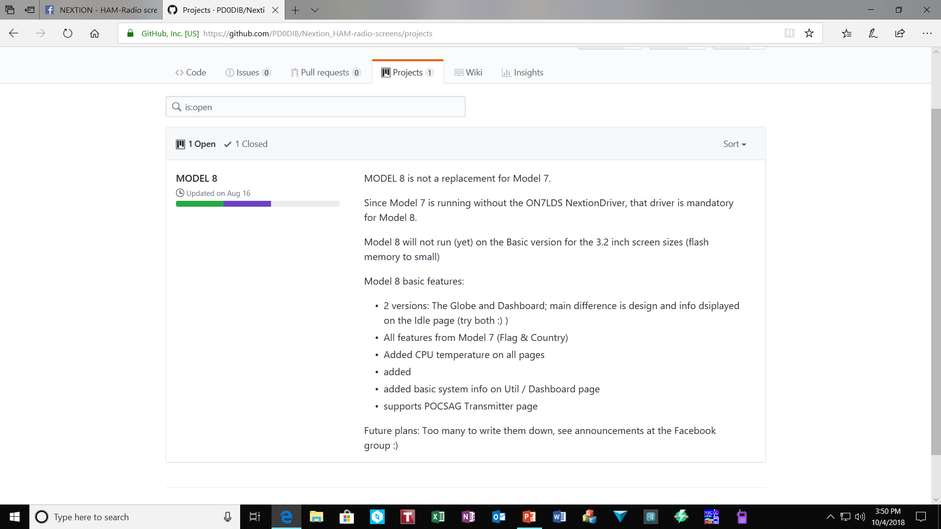
Model 8 Features
Model 8 recent releases now display on the basic 3.2 screens however, limited functionality given low memory capability

Slide 8
Suggested Nextion Display Parts
You will also need to order from Amazon (2) two RF cables based upon what Materials I believe you are purchasing from Bi7JTA
https://www.amazon.com/gp/product/B00COJWKGC/ref=oh_aui_detailpage_o08_s00?ie=UTF8&psc=1
I also recommend ordering the Nextion 3.2 inch Enhanced Display if you want visibility of country Flags and other features.
These functions are only available on the NON-enhanced display with limited functionality due to memory constraints.
https://www.amazon.com/gp/product/B01LAG13DA/ref=oh_aui_detailpage_o07_s00?ie=UTF8&psc=1
You do NOT need the USB to TTL adapter if ordering the duplex board from bi7jta as there is a connection for the display on the board for direct connection between the antenna’s. Not required if connecting directly to the Raspberry Pi GPIO.
If you are ordering the metal case from bi7jta you will need to cut opening in the end of the case to make antenna connections. I recommend purchasing the following acrylic case from eBay.
https://www.ebay.com/itm/Zebra-Duplex-Pi3-Screen-Case-Raspberry-Pi-3-B-Duplex-MMDVM-Black-Ice/123351569940?ssPageName=STRK%3AMEBIDX%3AIT&_trksid=p2060353.m2749.l2649
NOTE: If you go with the acrylic case then you need to tell bi7jta to ship the duplex board with antenna mounts 90 degree to the board.

Slide 9
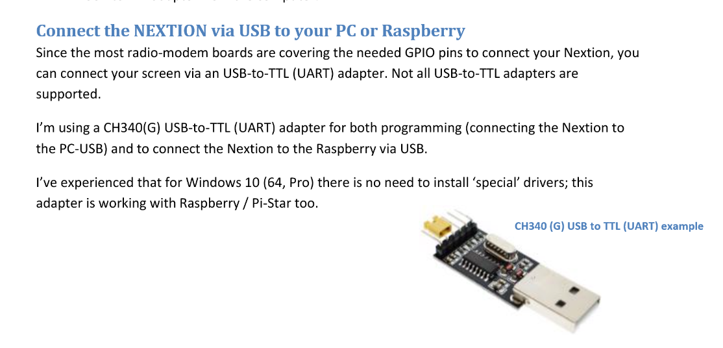
USB to TTL Adapter

Slide 10
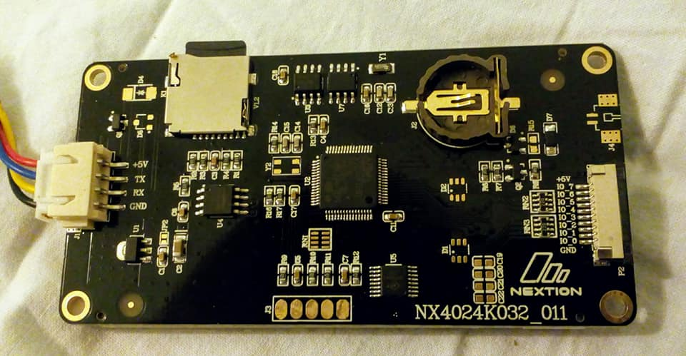
Enhanced Display (K) Model
Note: SD card only installed to load initial design then must be removed
Note: NX = Nextion Display (K) in model number indicates Enhanced Display i.e. touch screen. 032 in model number indicates screen size as 3.2 inch

Slide 11
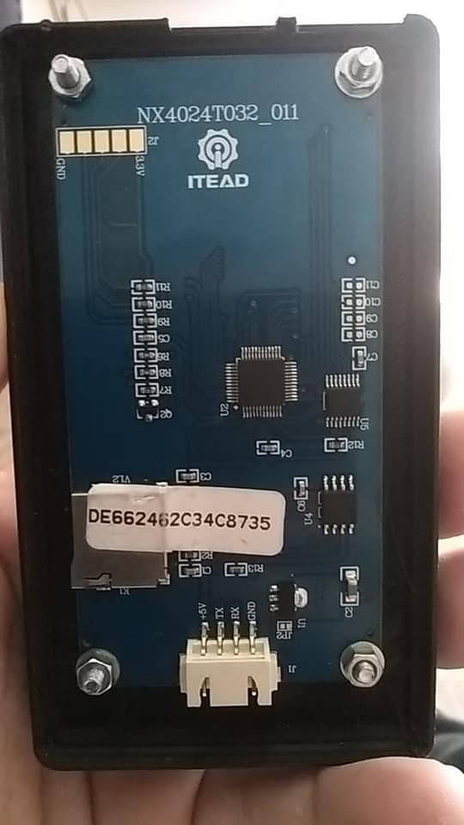
Display (T) Non-Enhanced
Note: “ITEAD” non Nextion original display. (T) in model number indicates non-enhanced. No touch display. Smaller memory limiting size of design. The 032 at end of model number is display size i.e. 3.2 inch

Slide 12
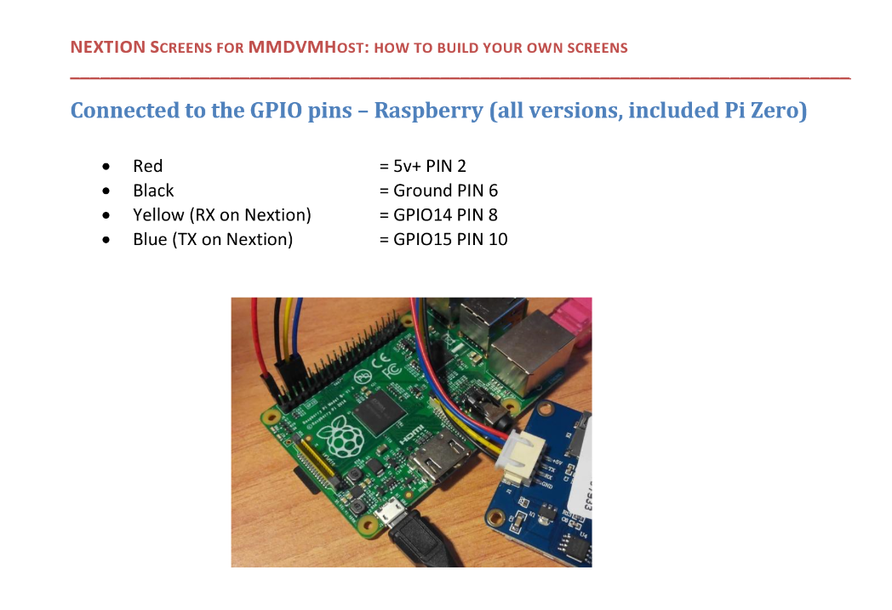
Nextion Connection to GPIO Pins

Slide 13
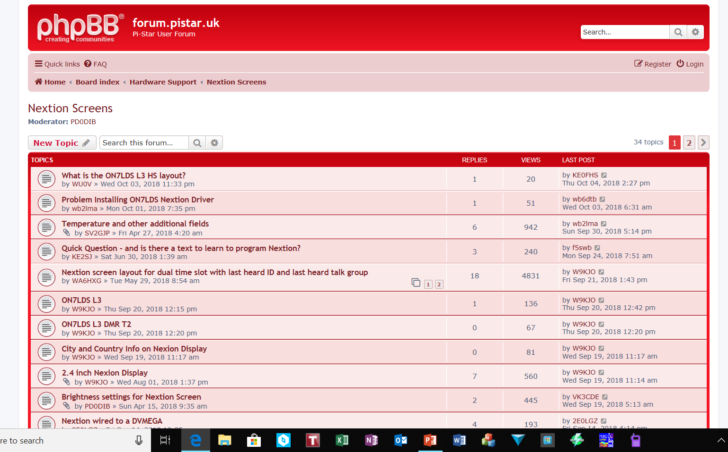
Nextion Display Forum.pistar.uk

Slide 14
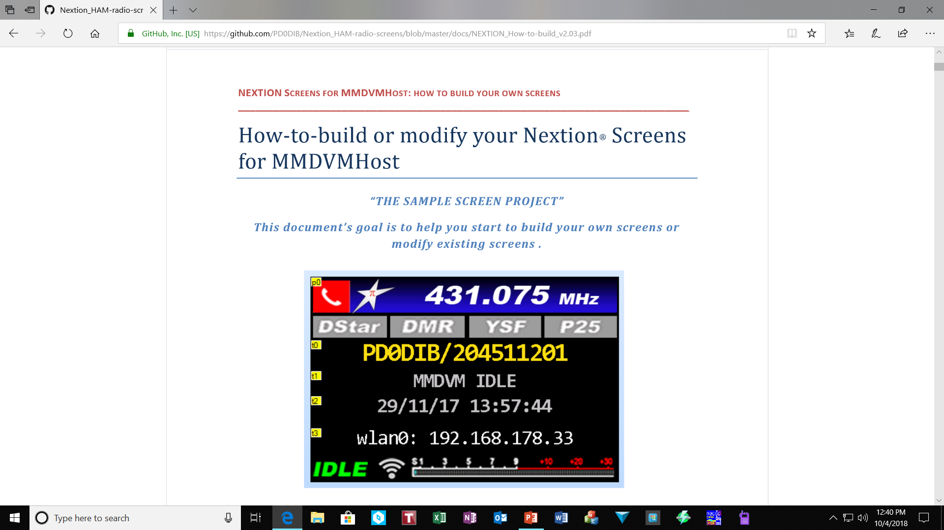
Nextion Editor
Build or Modify Screens

Slide 15
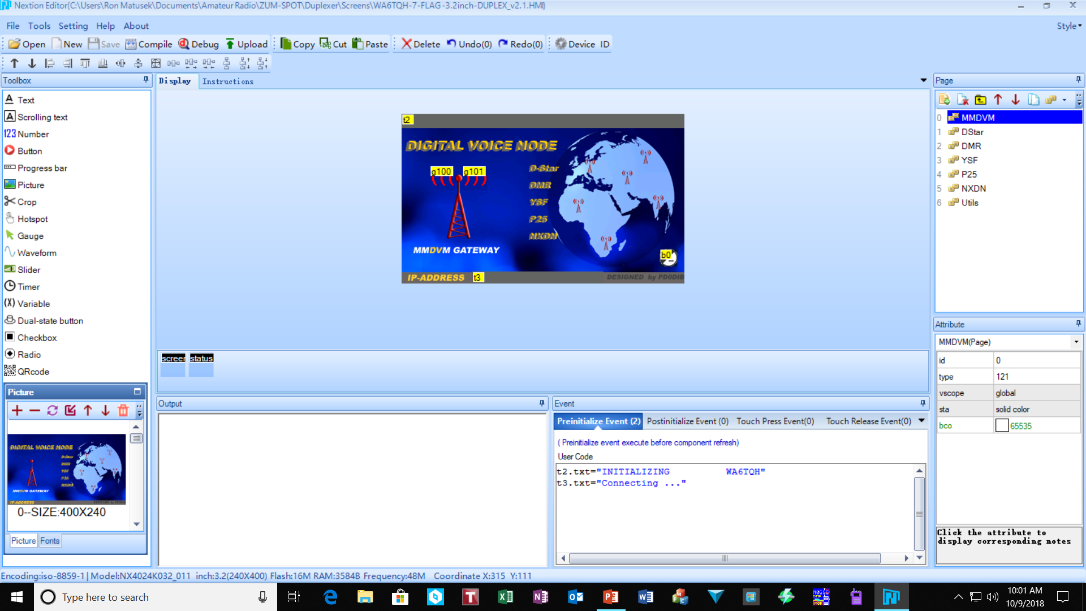
Nextion Editor
Home Screen
First Page
Edit this area with your call sign

Slide 16
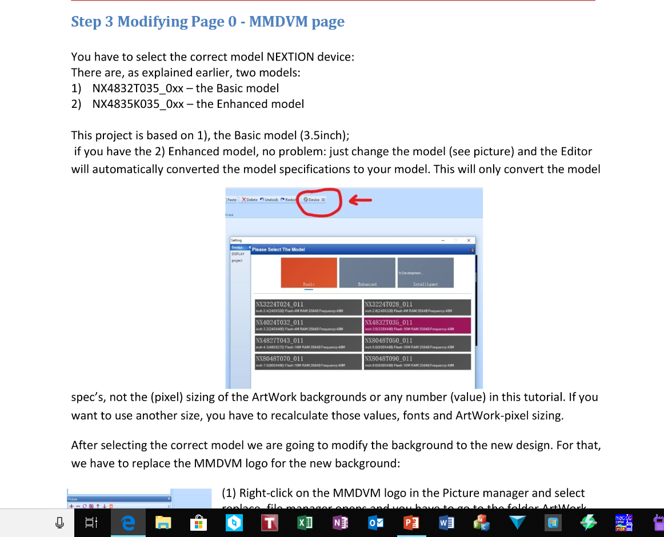
Set Correct Display Model
Important to select correct type of display. If not a Nextion display editing may fail.

Slide 17
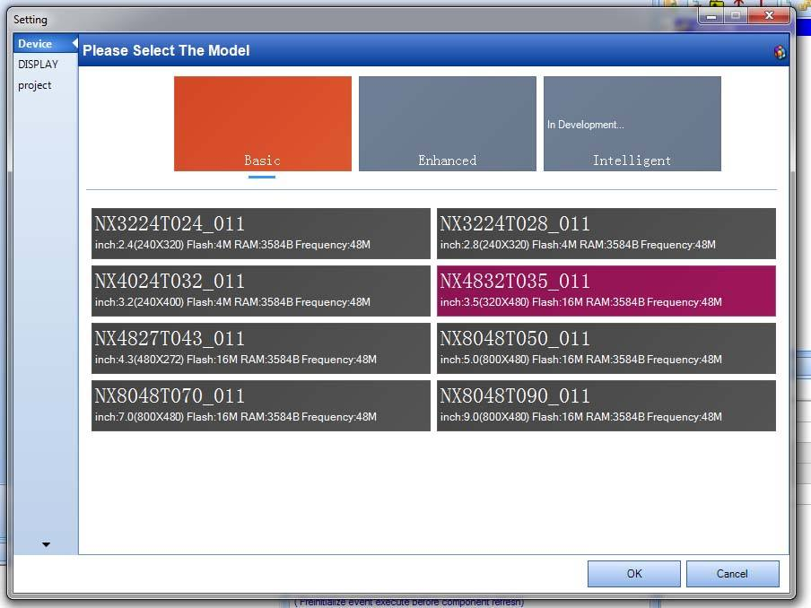
Select correct Model
The Model number of your screen has to be the same listed in the editor or it will not load the design into your screen. Enhanced you will find more screens, make sure your model number is correct!

Slide 18
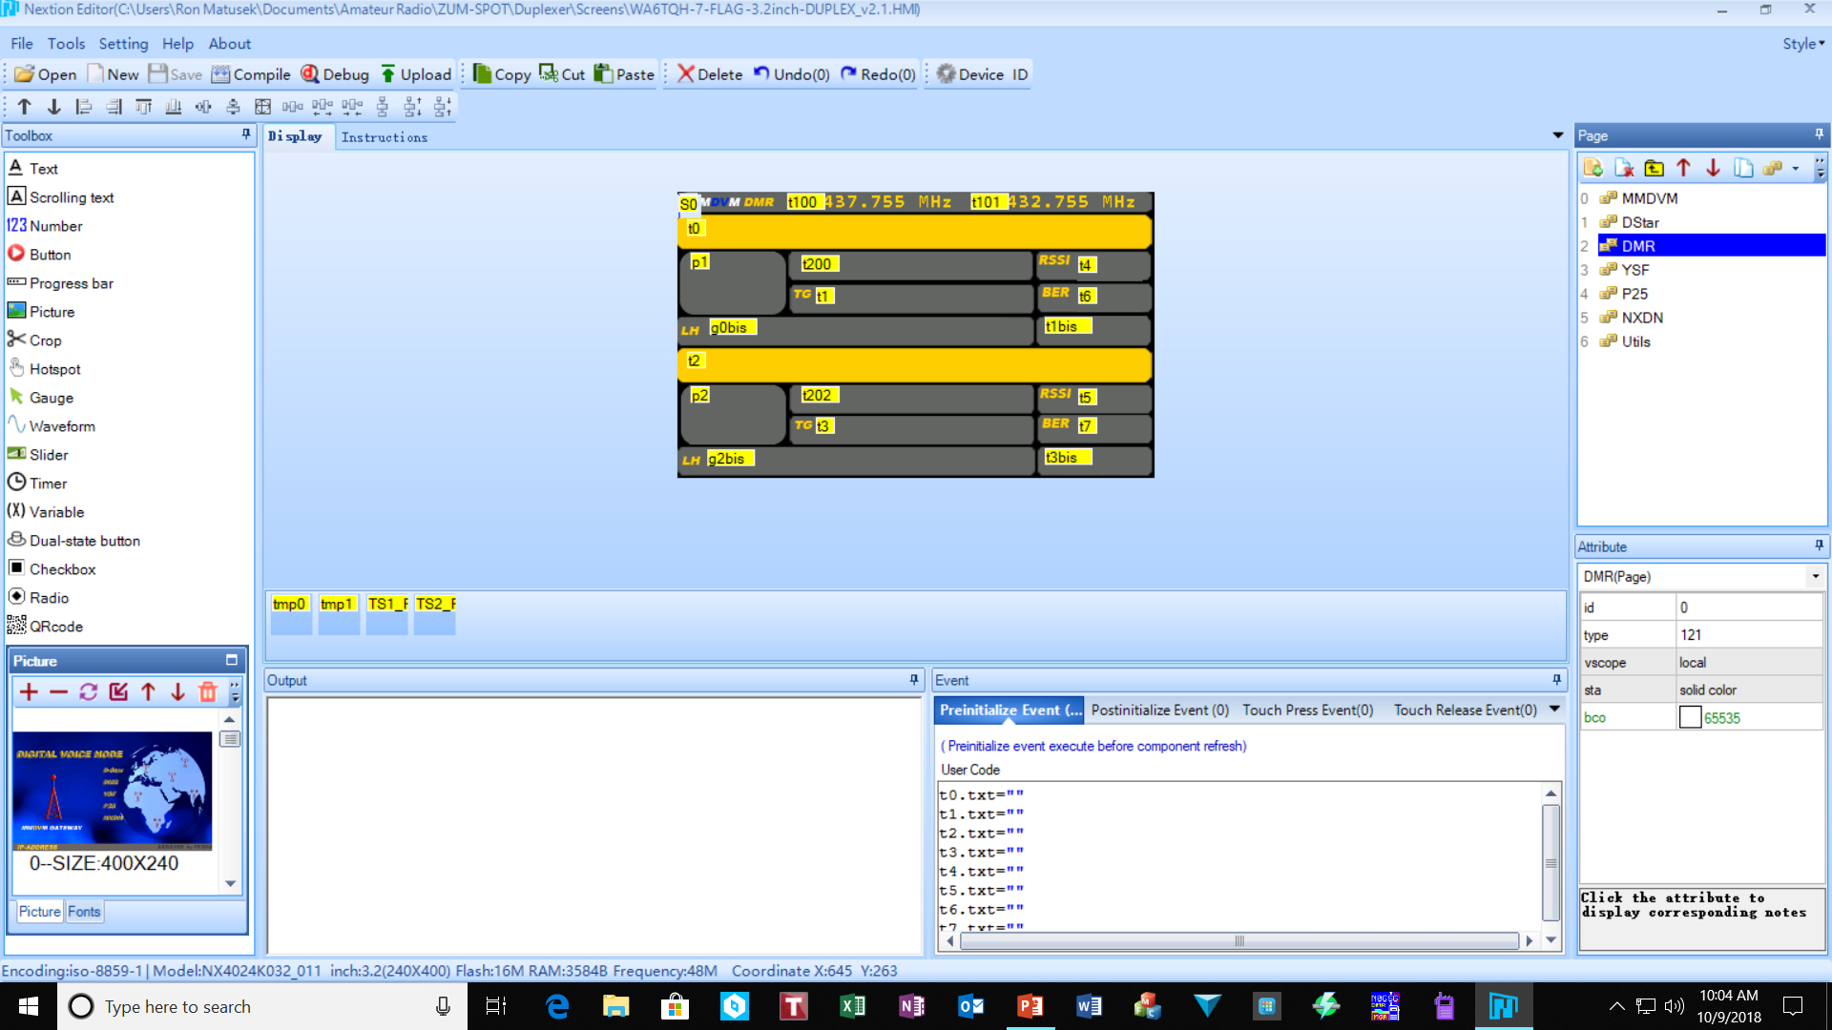
Editing DMR Screen
Select and edit each page with correct frequency information for RX & TX

Slide 19
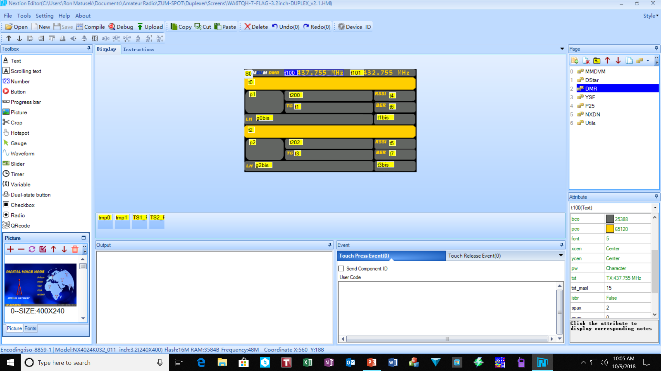
Editing Frequency Display
Repeat this step for every page.
Select TX in Attribute drop down and change TX frequency
Select TX frequency box

Slide 20

Editing Frequency Display
Repeat this step for every page.
Select RX frequency box
Select RX in Attribute drop down and change RX frequency

Slide 21
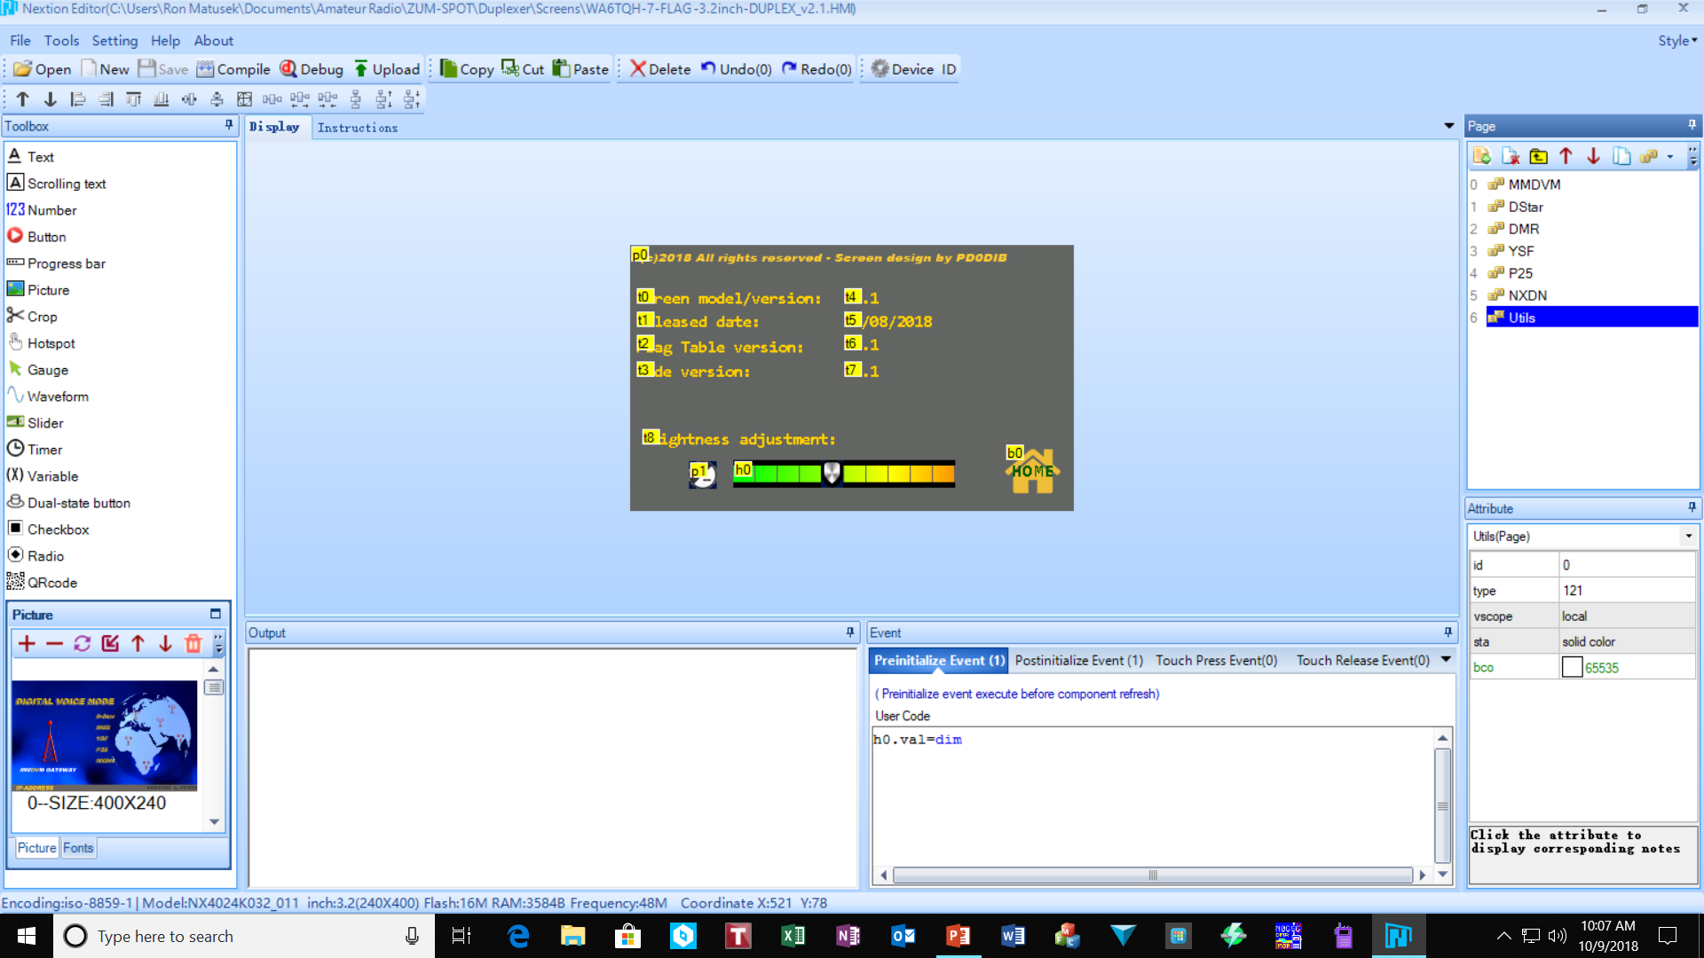
Add-on Features by Model
Example of Utility page

Slide 22
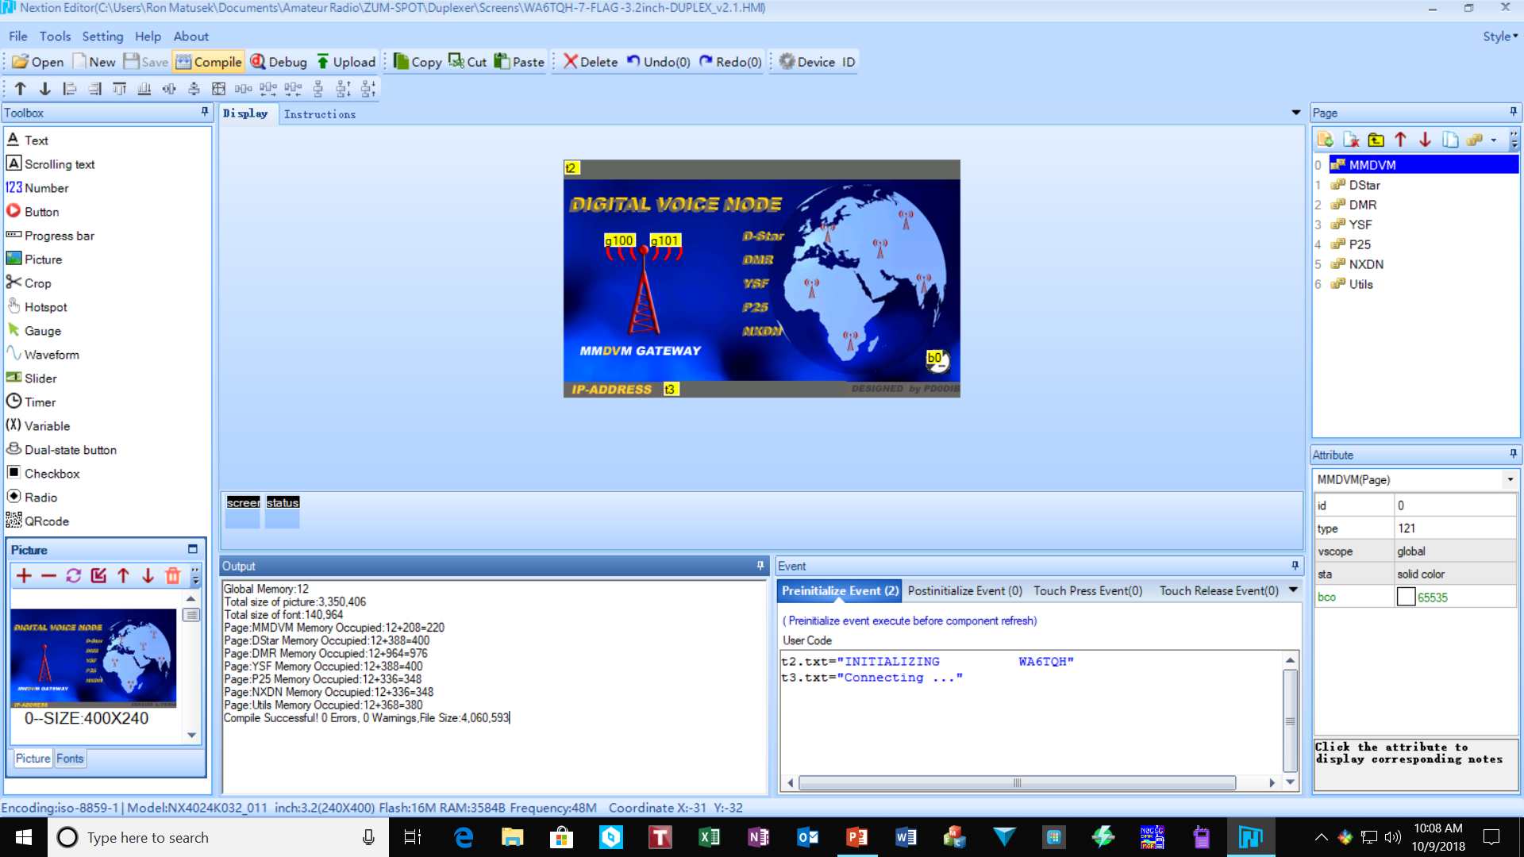
Compiling final Design
Compile the final design
Look for “Compile Successful” or any errors.

Slide 23
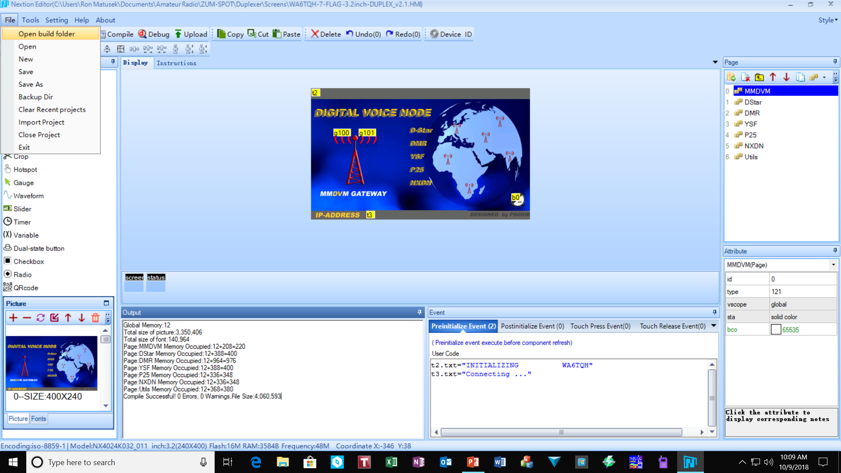
Locating Compiled Output File
Select “FILE” then select “Open build folder”

Slide 24
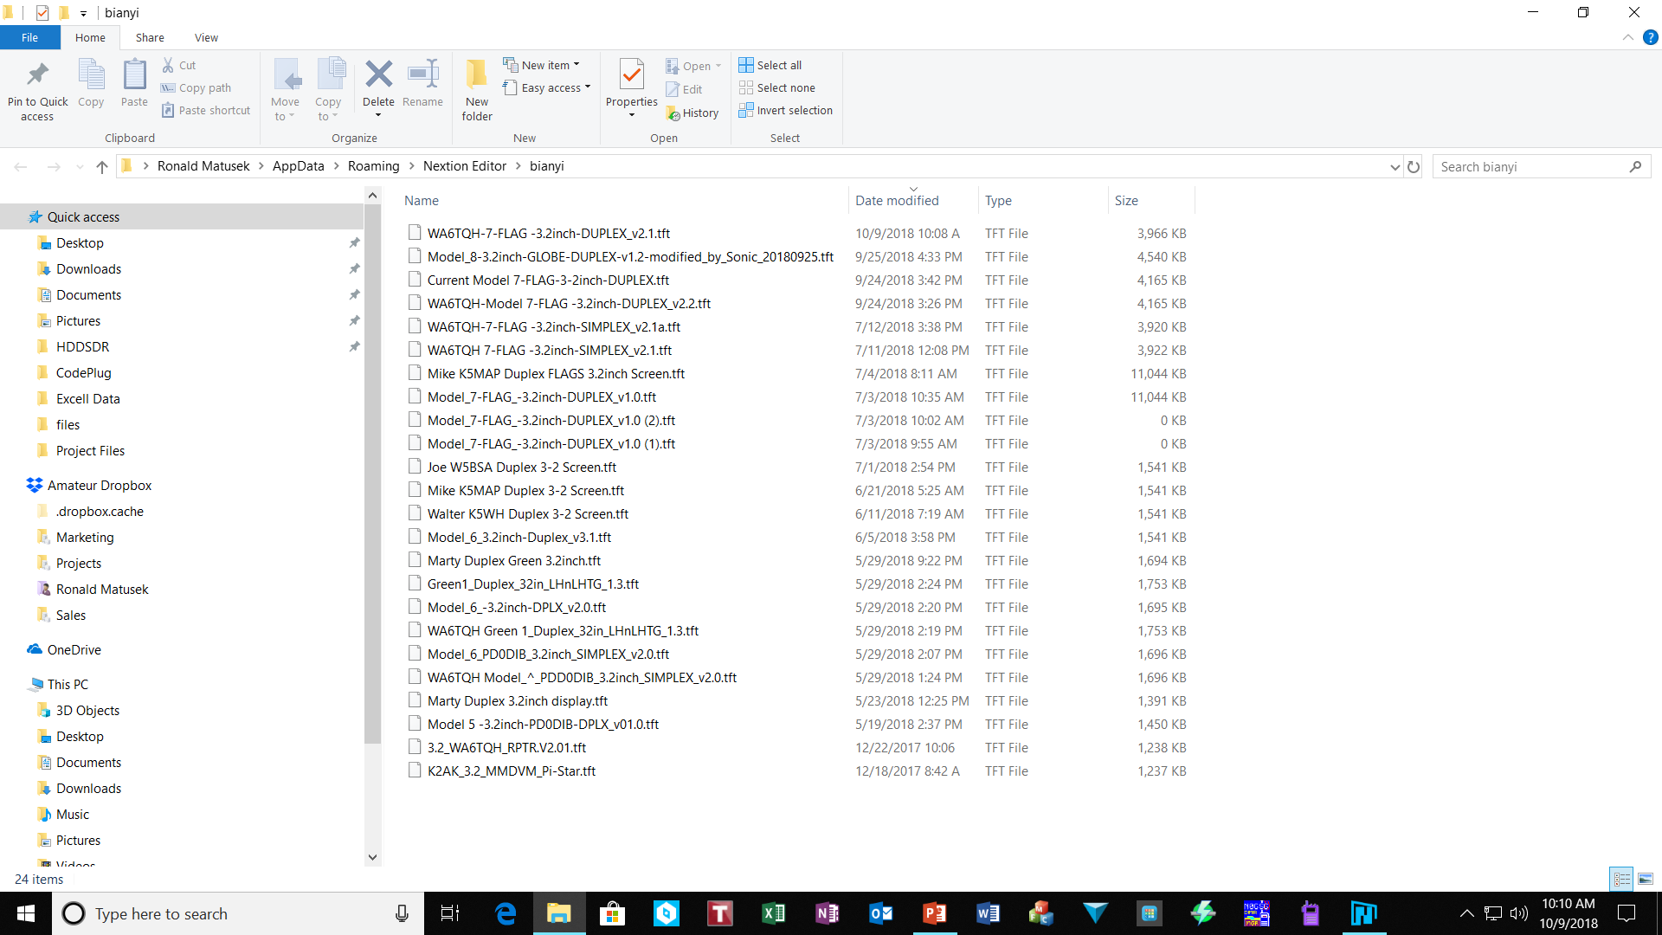
List of Compiled Design Files
This is a list of all your compiled designs.
Copy ONLY the .tft file to the SD card.
Note:
The .tft must be the only file on the SD.
Remember to Remove the SD card after upload finishes.

Slide 25
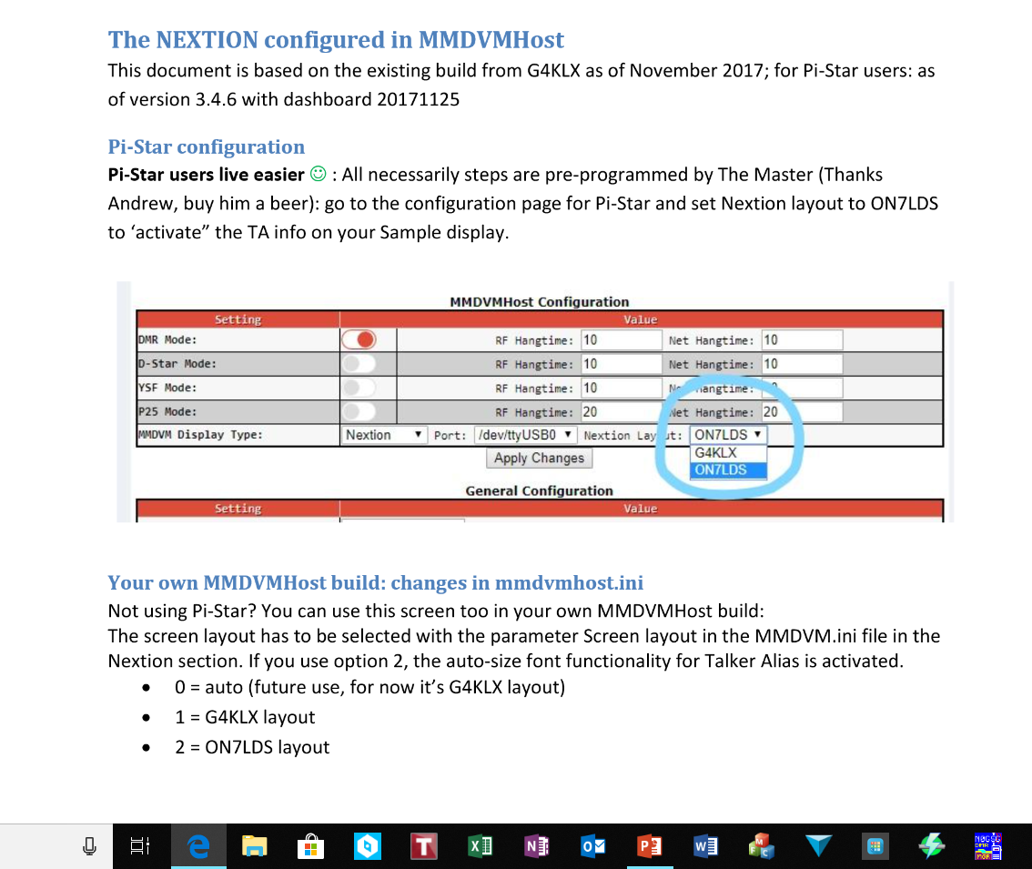
Configure MMDVMHost
Port
  For USB connection (with USB-to-TTL adapter or cable): dev/ttyUSB0
  Connected to Raspberry GPIO pins: dev/ttyAMA0
  Connected to your modem/radio board's pin-header: Modem
Nextion Layout: ON7LDS L3 (if using my Model 'X' screen layouts)
If you are using a Model 8 screen (NextionDriver installed is mandatory)
Display type to Nextion

Slide 26
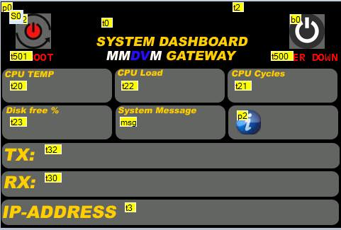
Nextion Display Fields
Example of various fields offered in Model 8 designs. Again must be sure your display has enough memory.

Slide 27
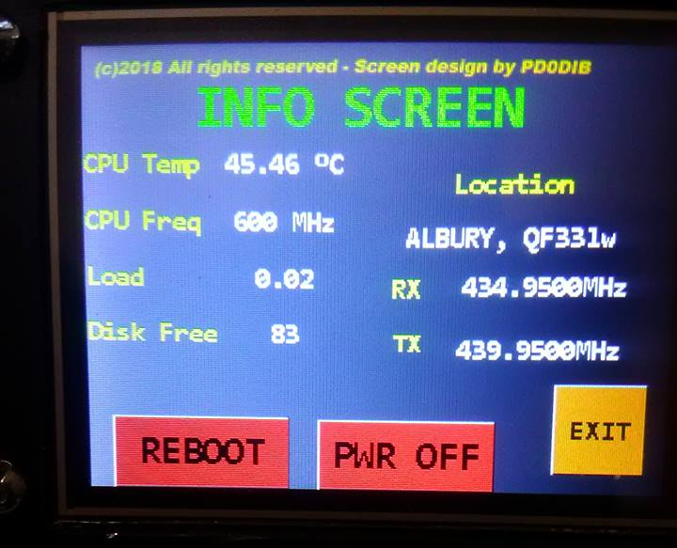
Utility Screen Example
Model 8 Design installed on an Enhanced Display with Touch Screen.

Slide 28
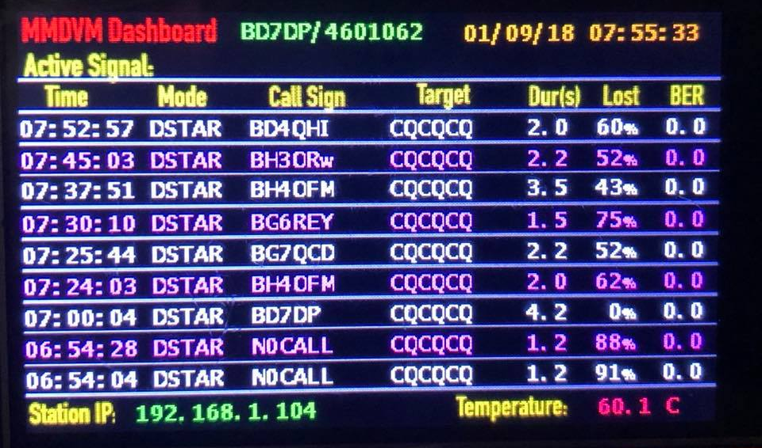
MMDVM Dashboard

Slide 29
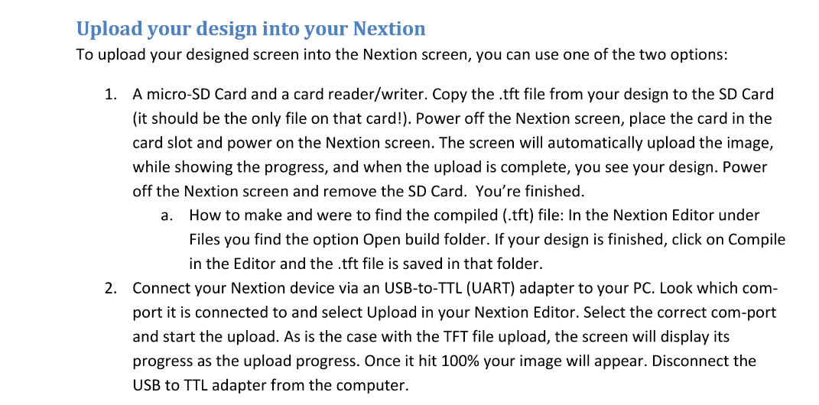
Upload Design to Display

Slide 30
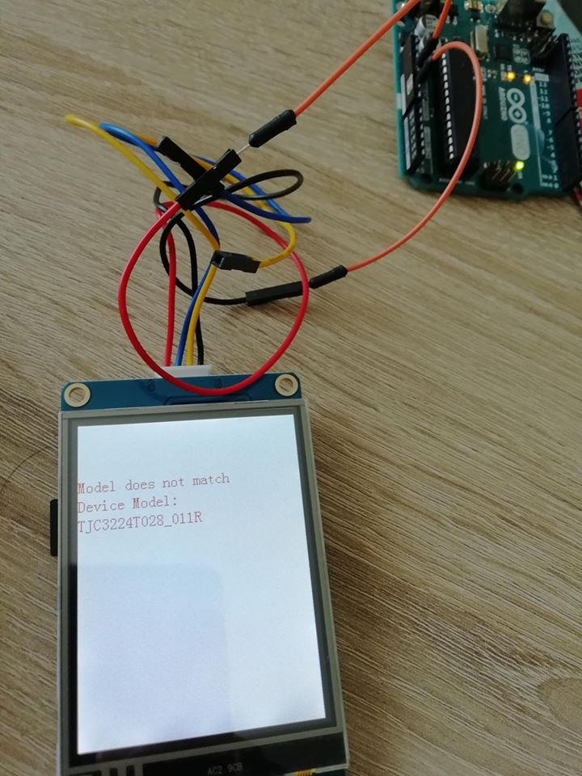
Display Compatability
It's not a nextion screen - it's a TJC (Chinese) version. Not compatible with nextion files. I found that out the hard way and bought a original nextion screen.

Slide 31
Dual Time Slot Display
Model 7 Design installed on an enhanced display

Slide 32
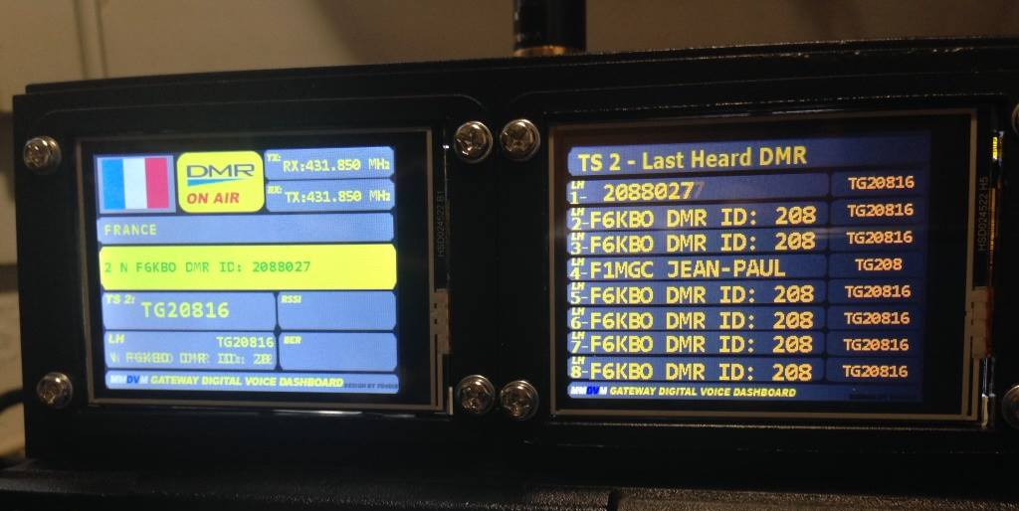
Dual Display Screen Capability

Slide 33
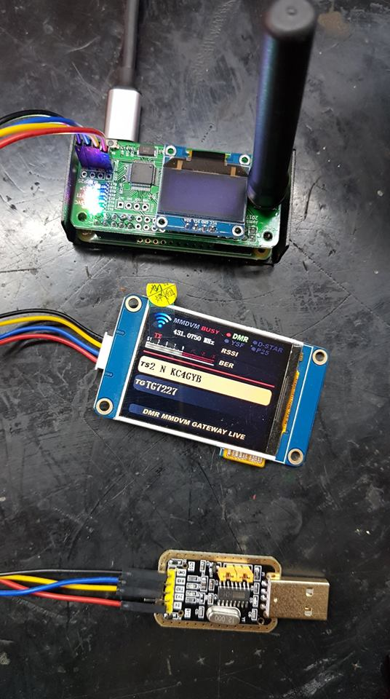
JumboSpot Display Configuration

Slide 34
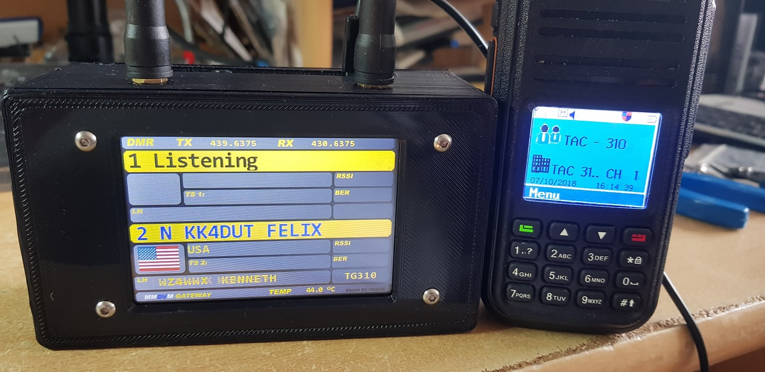
Example of Display

Slide 35
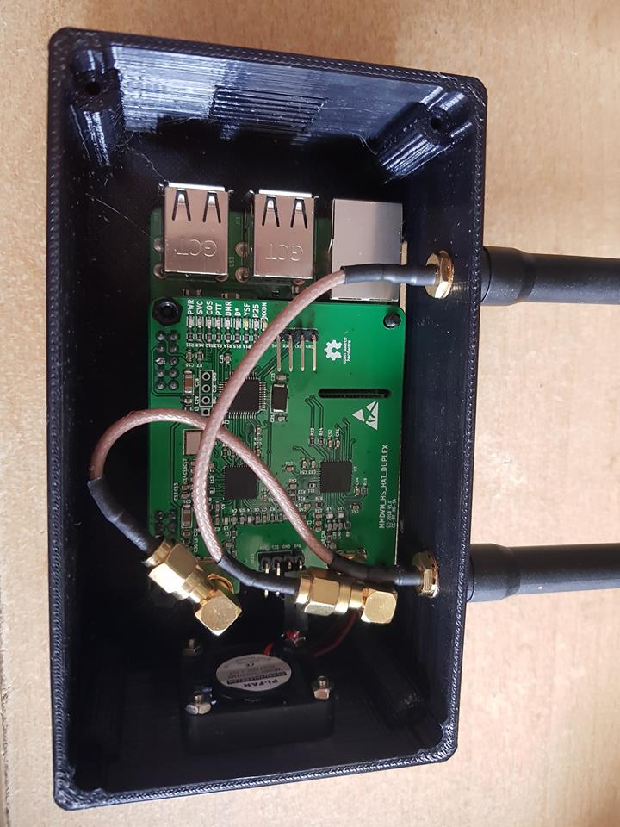
Extended Antenna Option

Slide 36
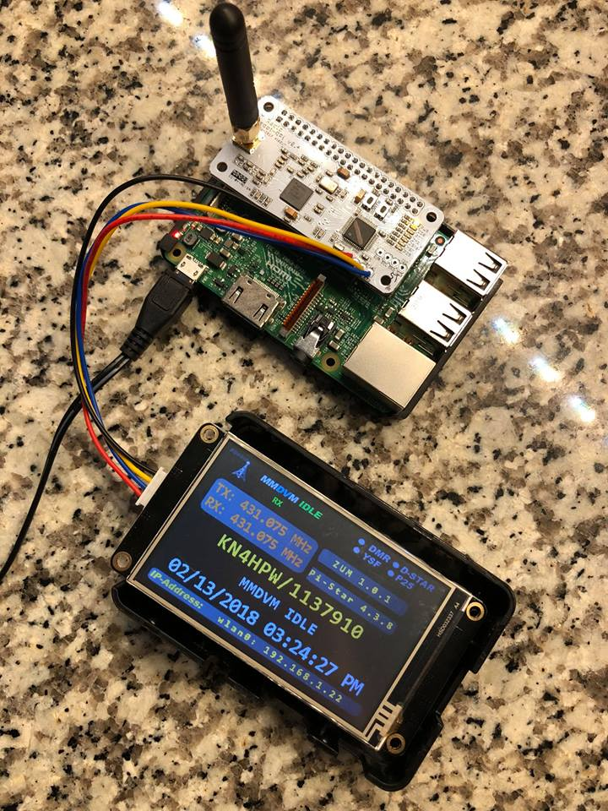
Zumspot with Nextion Display
If connecting an OLED display – use GPIO Pins

Slide 37
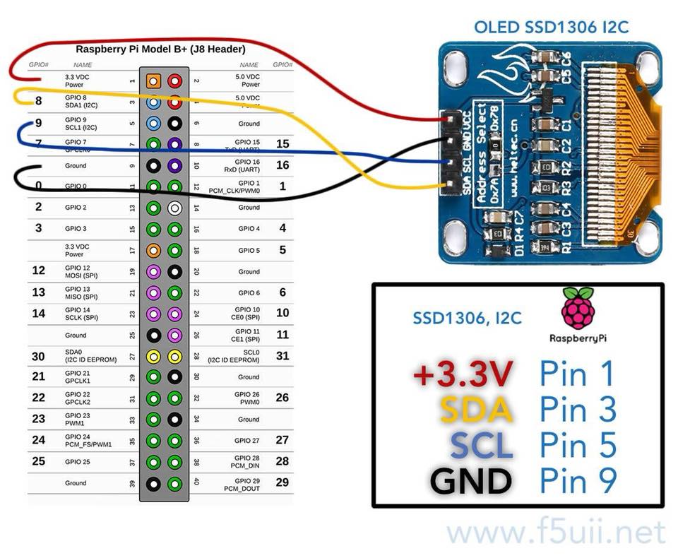
Connecting OLED to Zumspot
MUST USE GPIO PINS!
Do NOT connect the OLED to the LCD pads on the Zumspot board.
The OLED is addressed from the Pi NOT the Zumspot, the I2C pads are connected to the Zumspot processor.

Slide 38
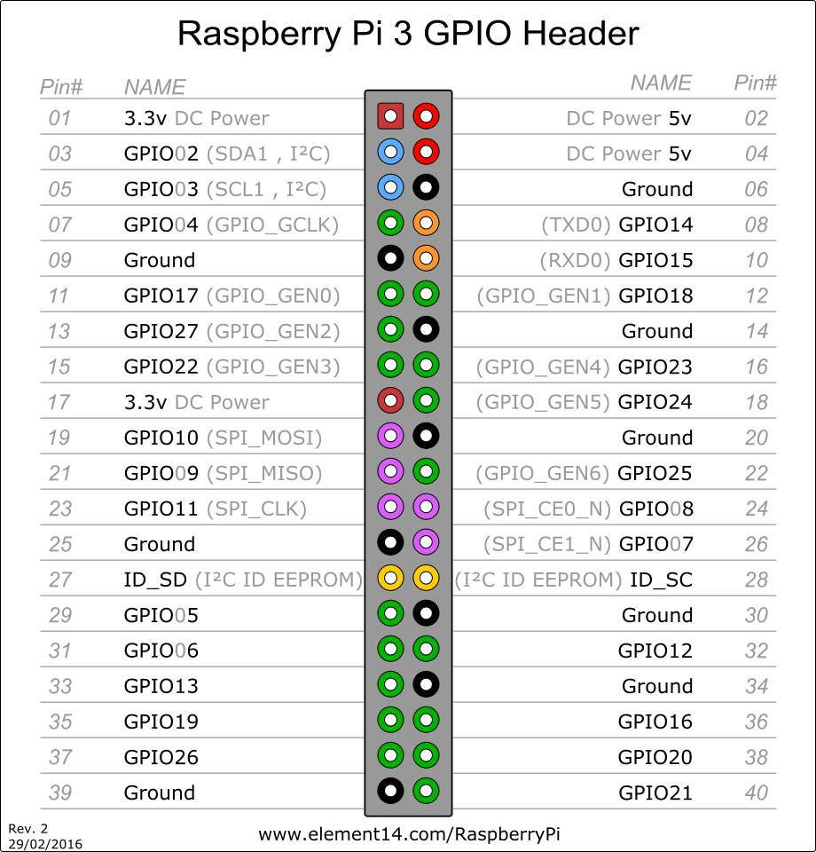
GPIO Header Connections
Note:
OLED connects to 3V SDA1 SCL1 GND
}
}
Note:
Nextion connects to the 5V TXD0 RXD0 and GND
See next slide for connection to ZumSpot

Slide 39
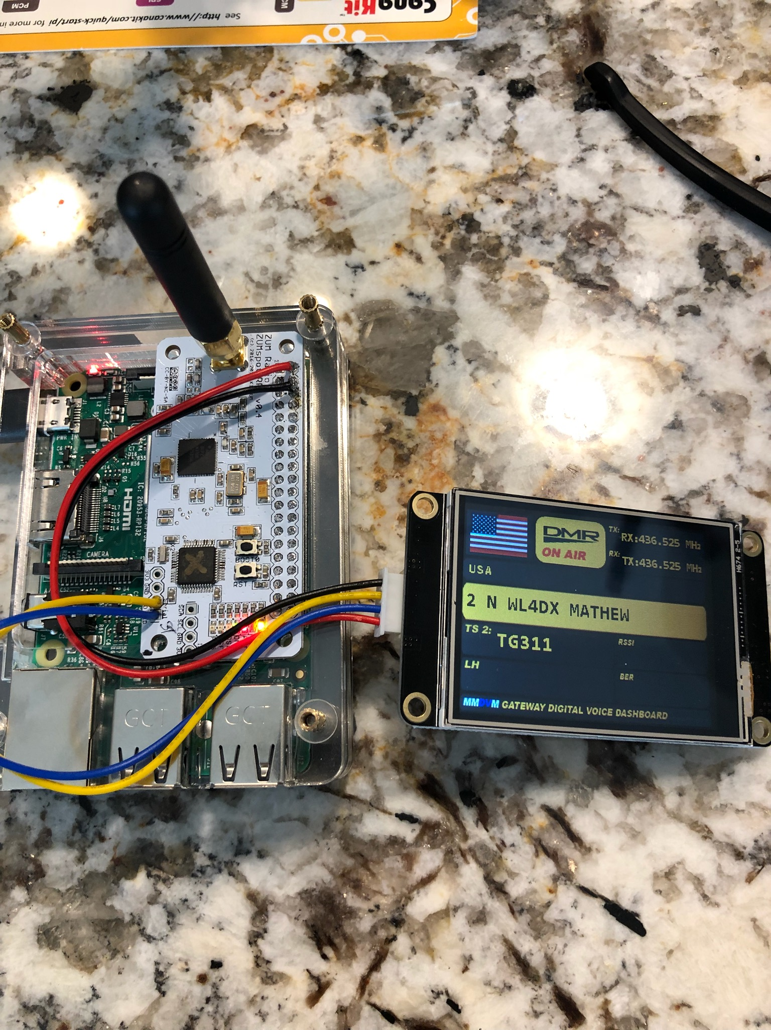
Connection Nextion to Zumspot
Nextion Display requires 5V
Data TX RX connections
Power port here is 3V

Slide 40
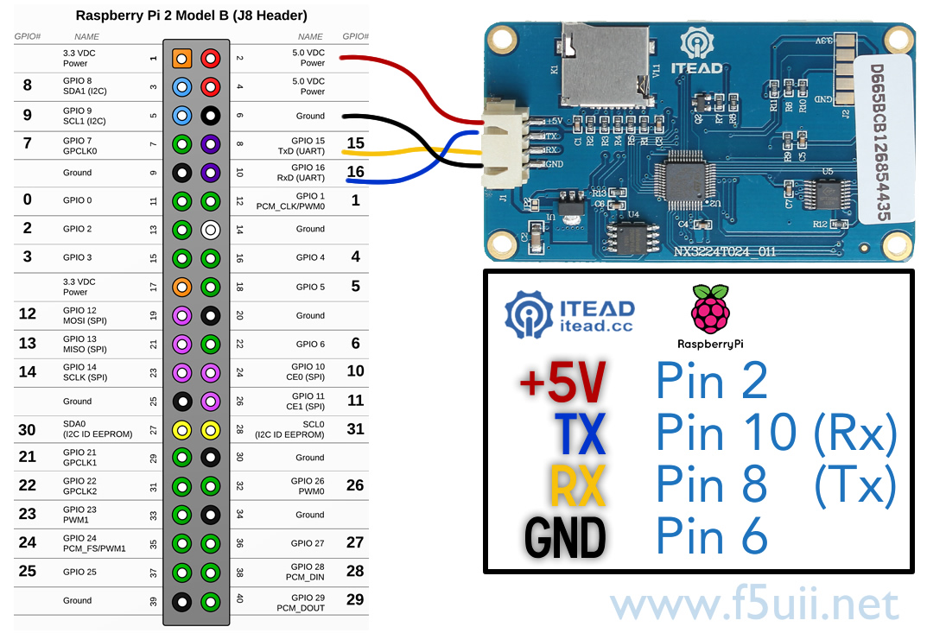
Standard Nextion Connection
Not applicable to ZumSpot

Slide 41
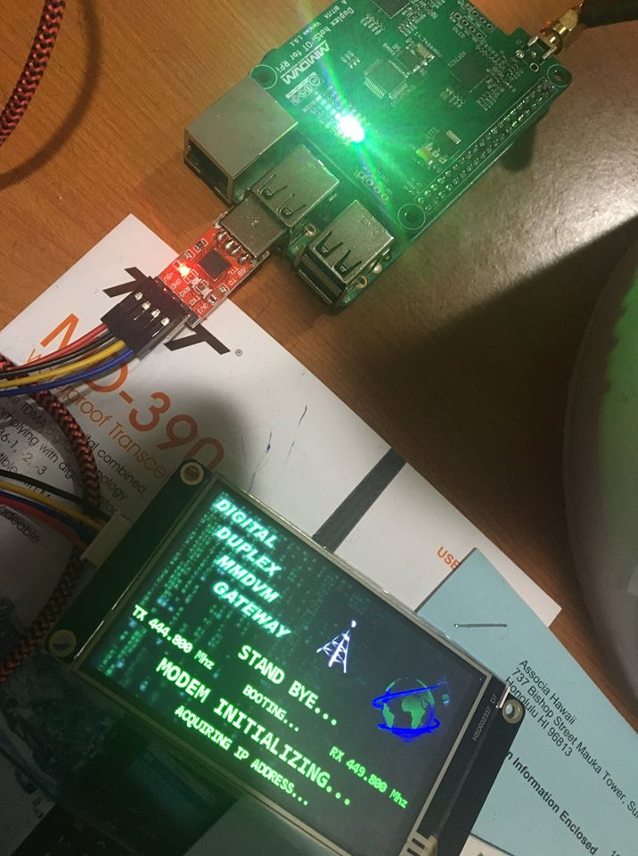
Utilization of USB to TTL Converter
Model 8 design utilizing Nextion Driver and the USB to TTL Converter interface to Pi-3 B+

Slide 42
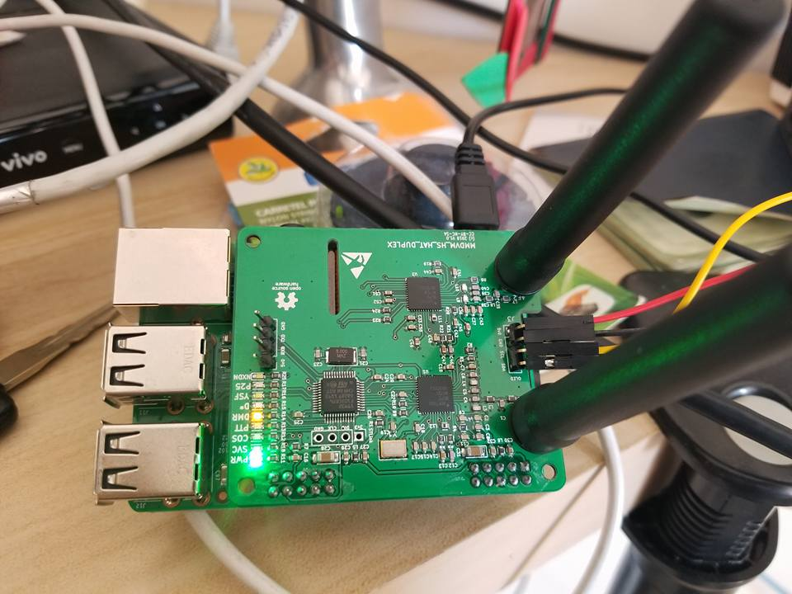
Display using Duplex Modem Port
Modem interface for Nextion Display on a Duplex Board

Slide 43
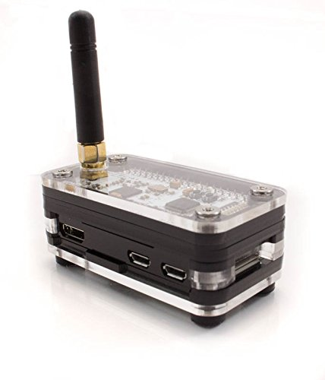
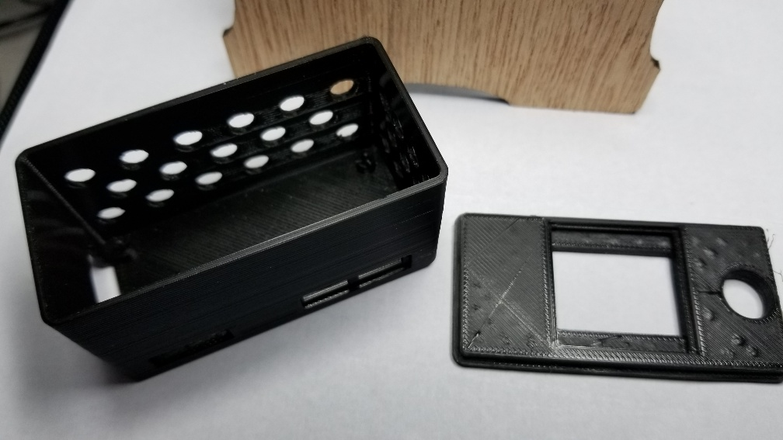
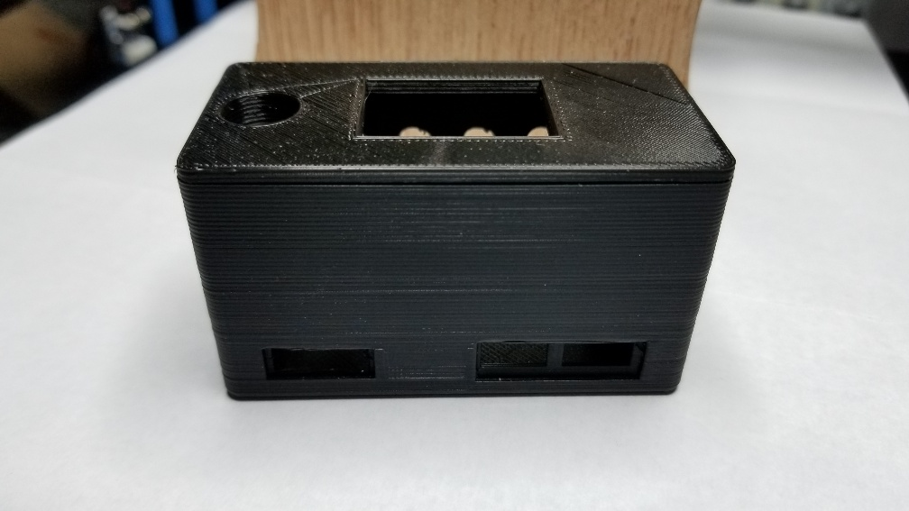
3D Printed or Plastic Case
3D printed case
Zum-Pi plastic Case is available on Amazon

Slide 44
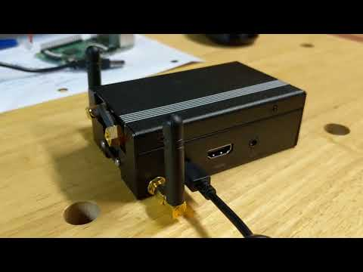
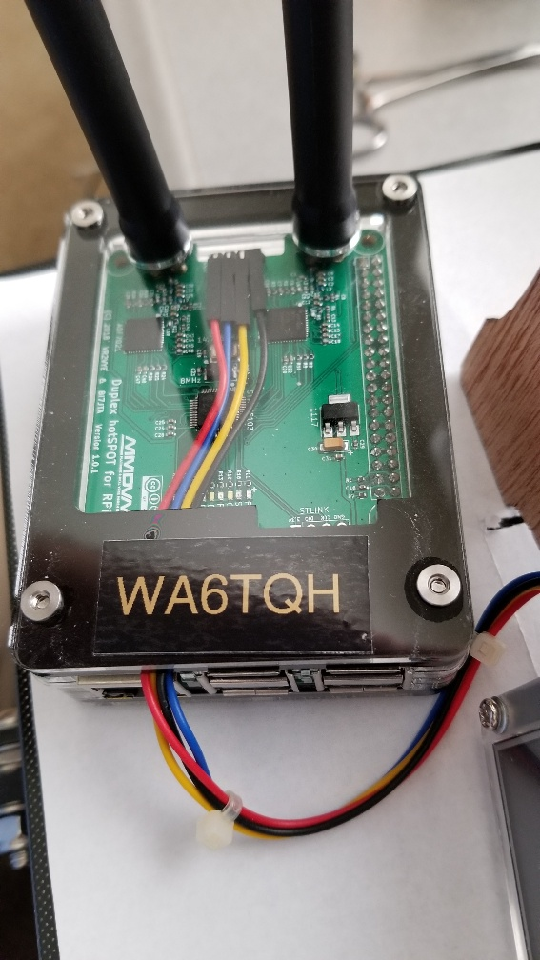
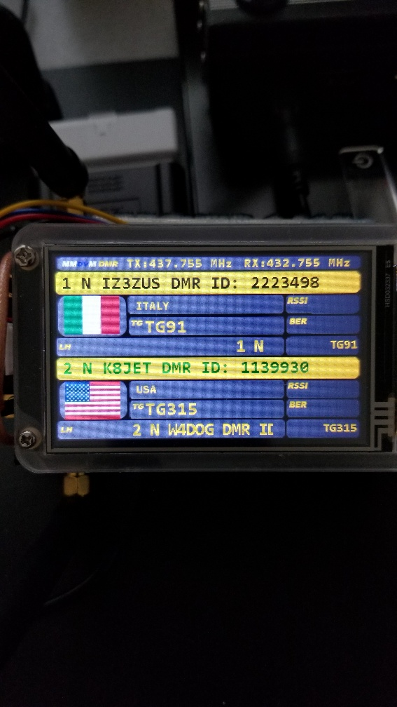
Eleduino Raspberry Pi 3, 2 and B+ Case Aluminum or Plastic
https://www.amazon.com/gp/product/B01LZ3I5R4/ref=oh_aui_detailpage_o09_s00?ie=UTF8&psc=1

Slide 45
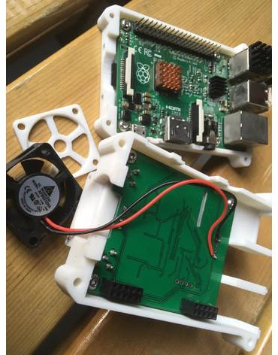
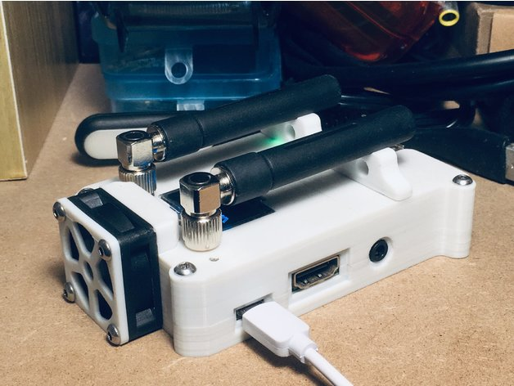
3D Printed Duplex Case

Slide 46
Nextion Display Training
Questions:

