Slide 1
NARS Repeater System Echolink
Marty Fitzgerald w5mf

Slide 2
NARS Repeater Original Proposal
Advance Repeater Controllers: http://www.arcomcontrollers.com/index.php
Add DMR repeater and or multimode repeater
Linking to Allstar/Echolink
More than one receive links
COVID-19 has severely impacted this proposal

Slide 3
146.66 minus .06 tone 141.3 Galleria 146.66 minus .06 tone 100.0 Klein Test* 444.375 plus 5.00 tone 103.5 Galleria 444.375 plus 5.00 tone 67.0 Klein**
NARS Repeater System
*Echolink connects to this repeater only. Galeria & Klein repeaters are not linked
**Multimode. Analog, DMR(Brandmeister), D-Star, & Fusion. Testing.

Slide 4
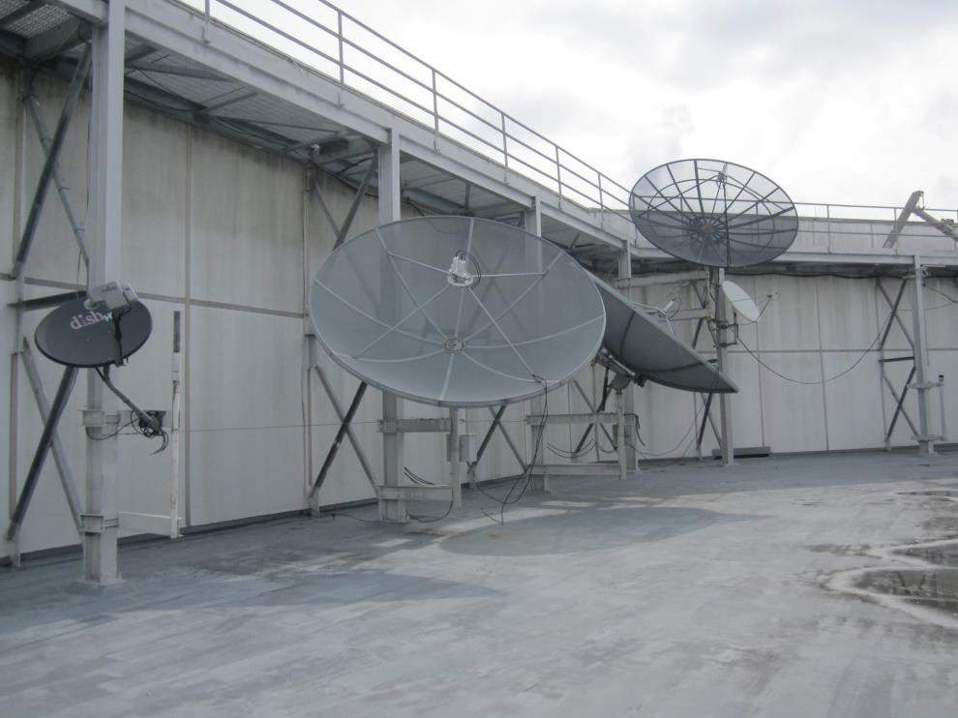
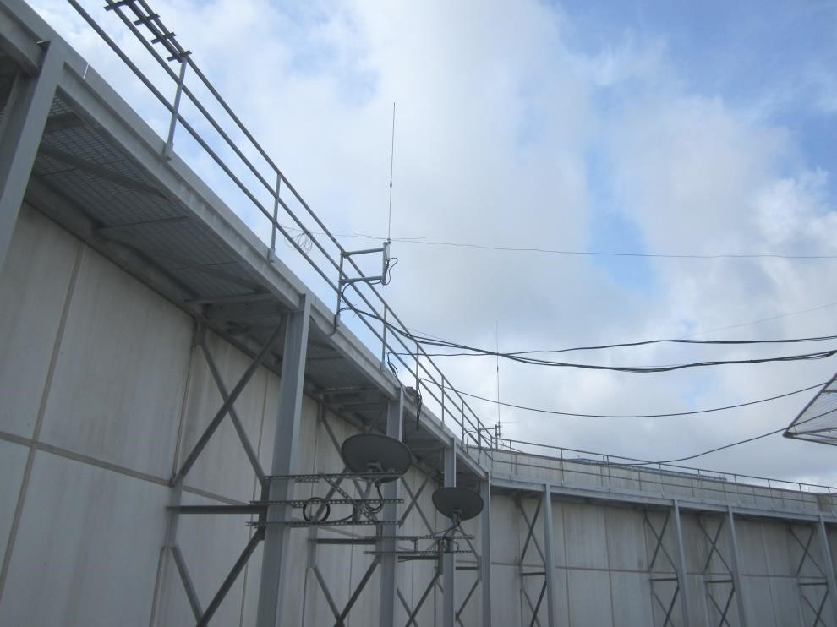
NARS Repeater Galleria 146.66 141.3PL

Slide 5
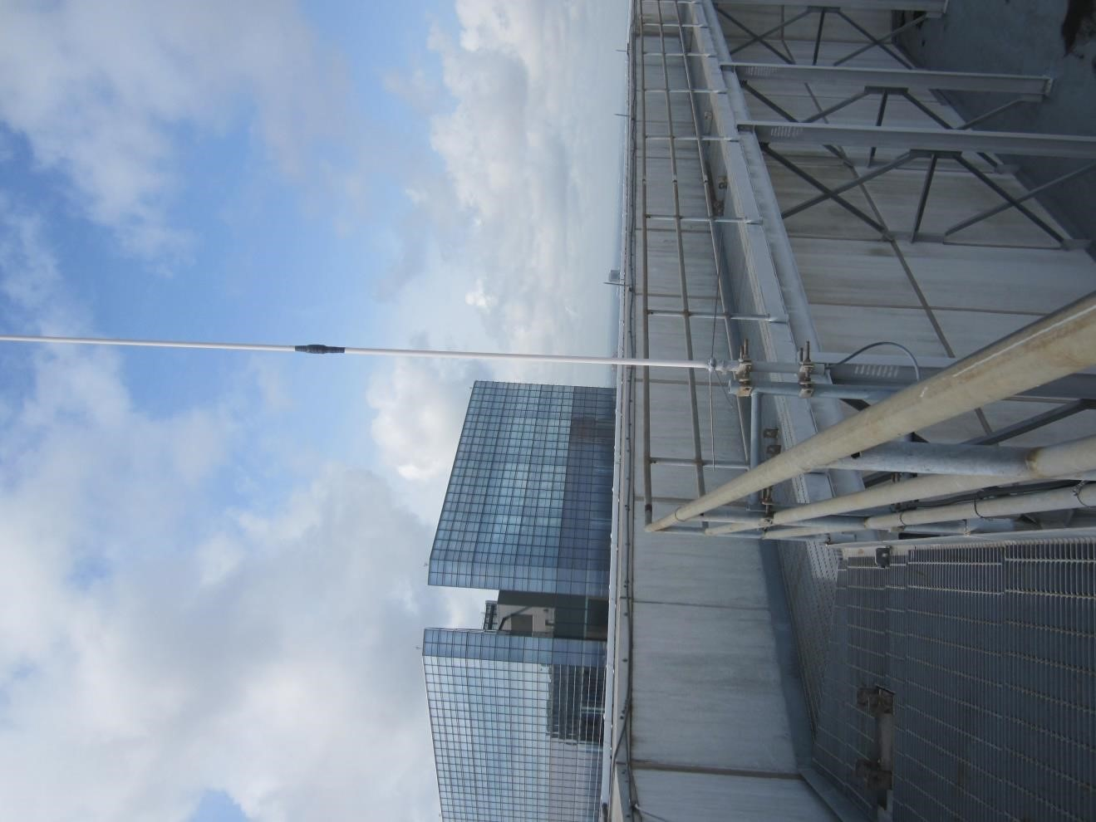
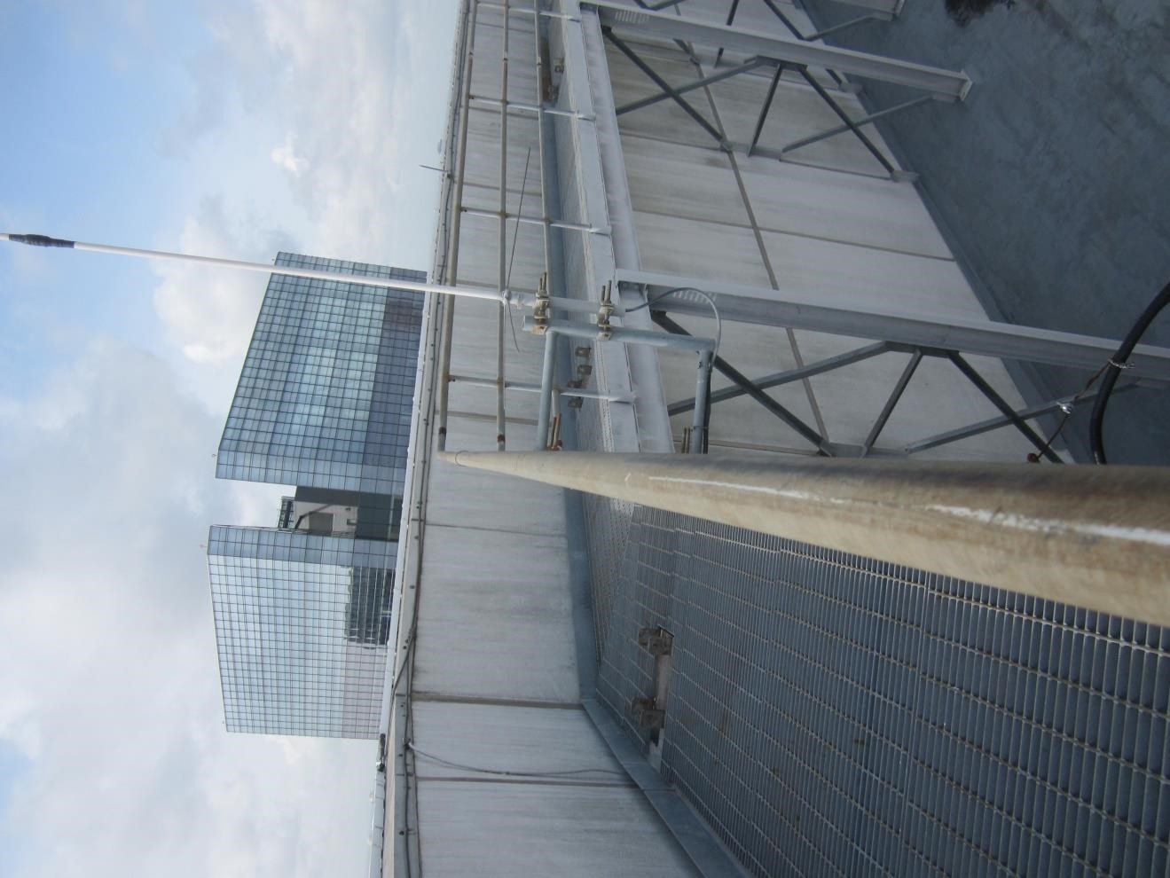
NARS Repeater Galleria

Slide 6
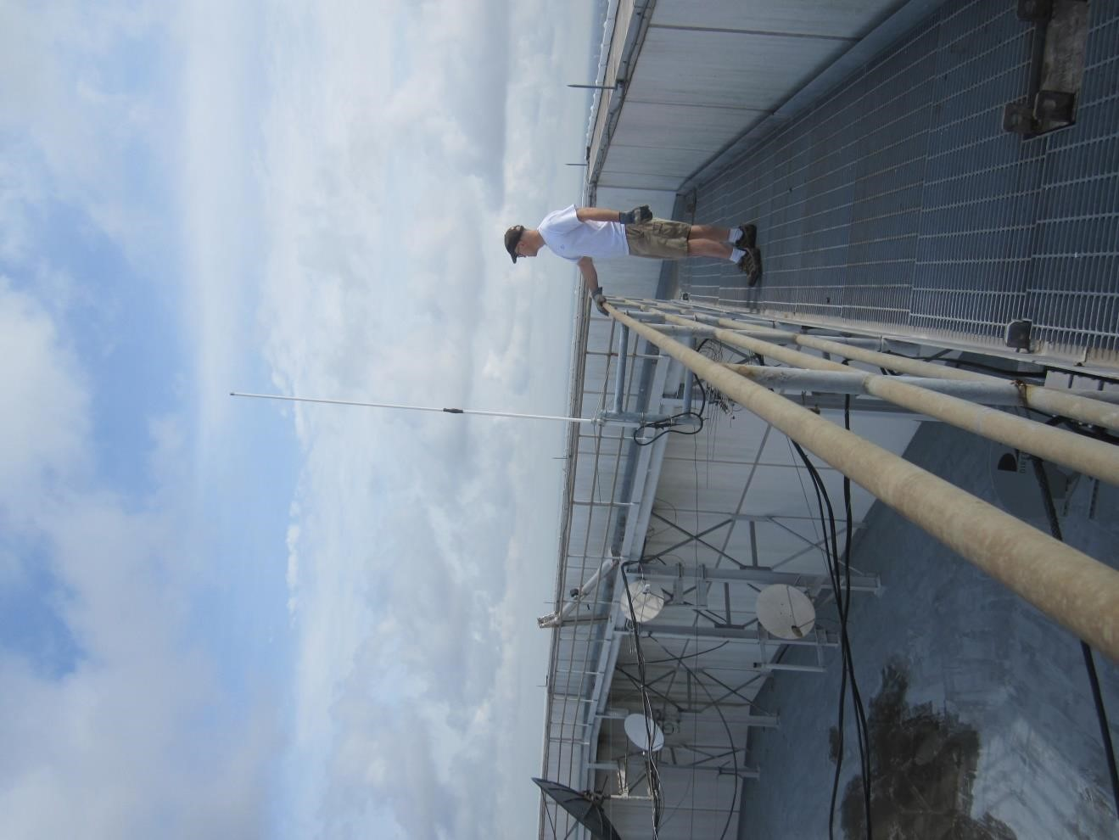
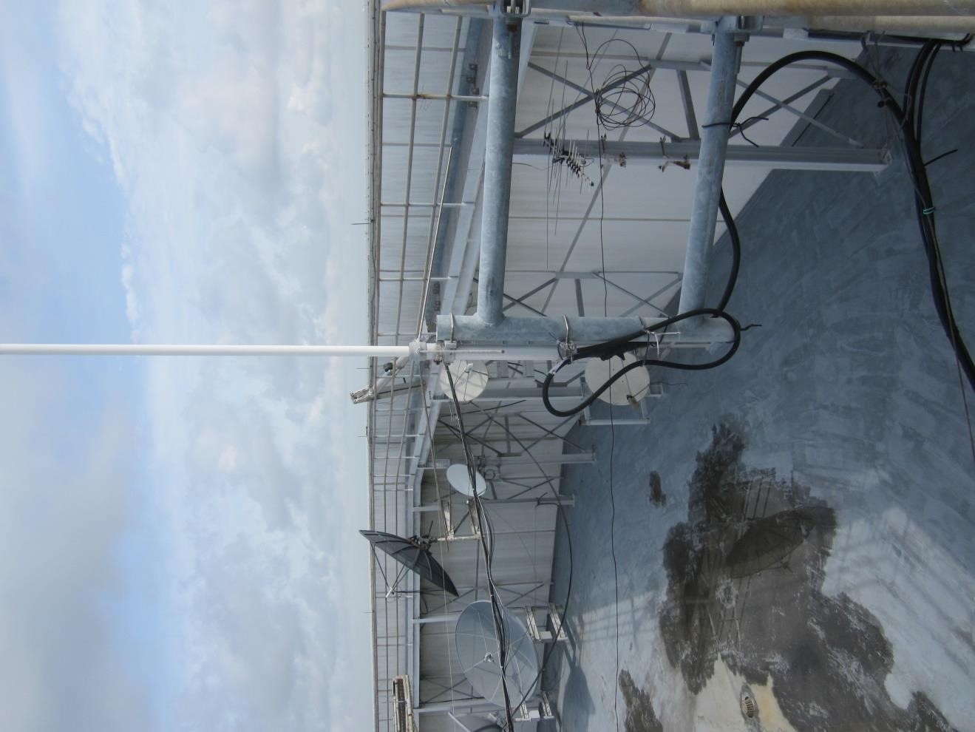
NARS Repeater Galleria

Slide 7
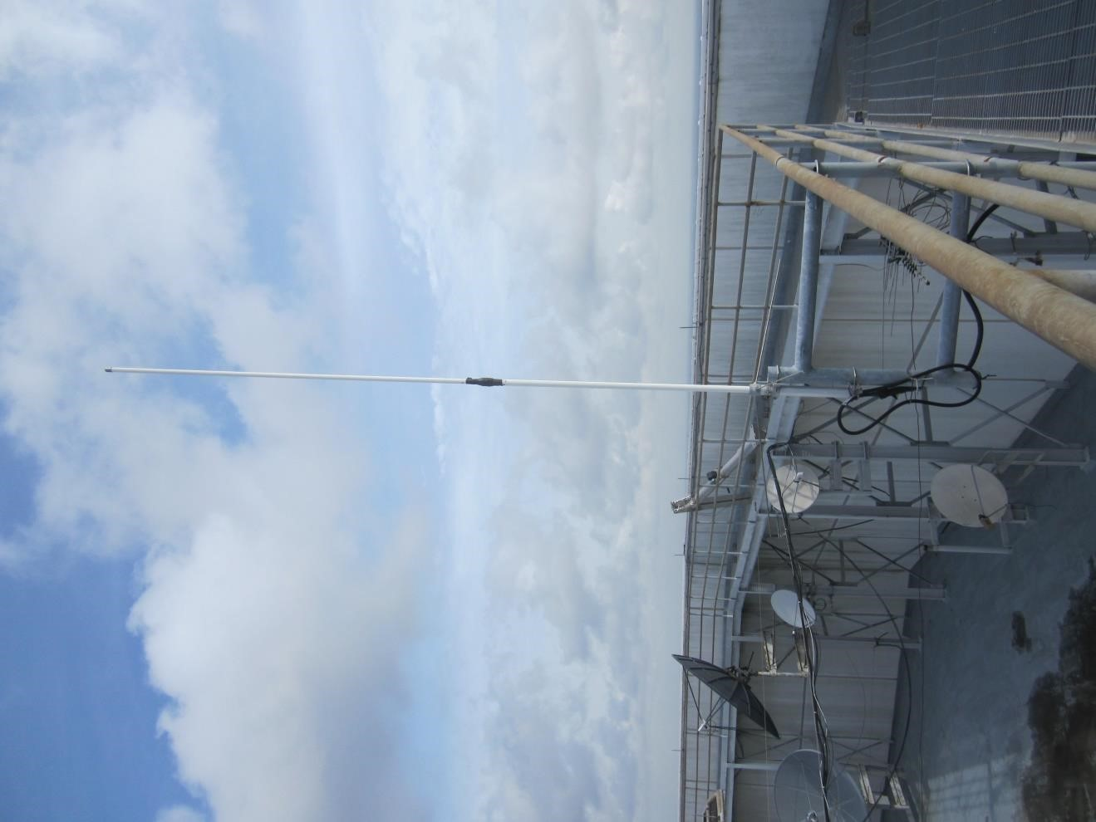
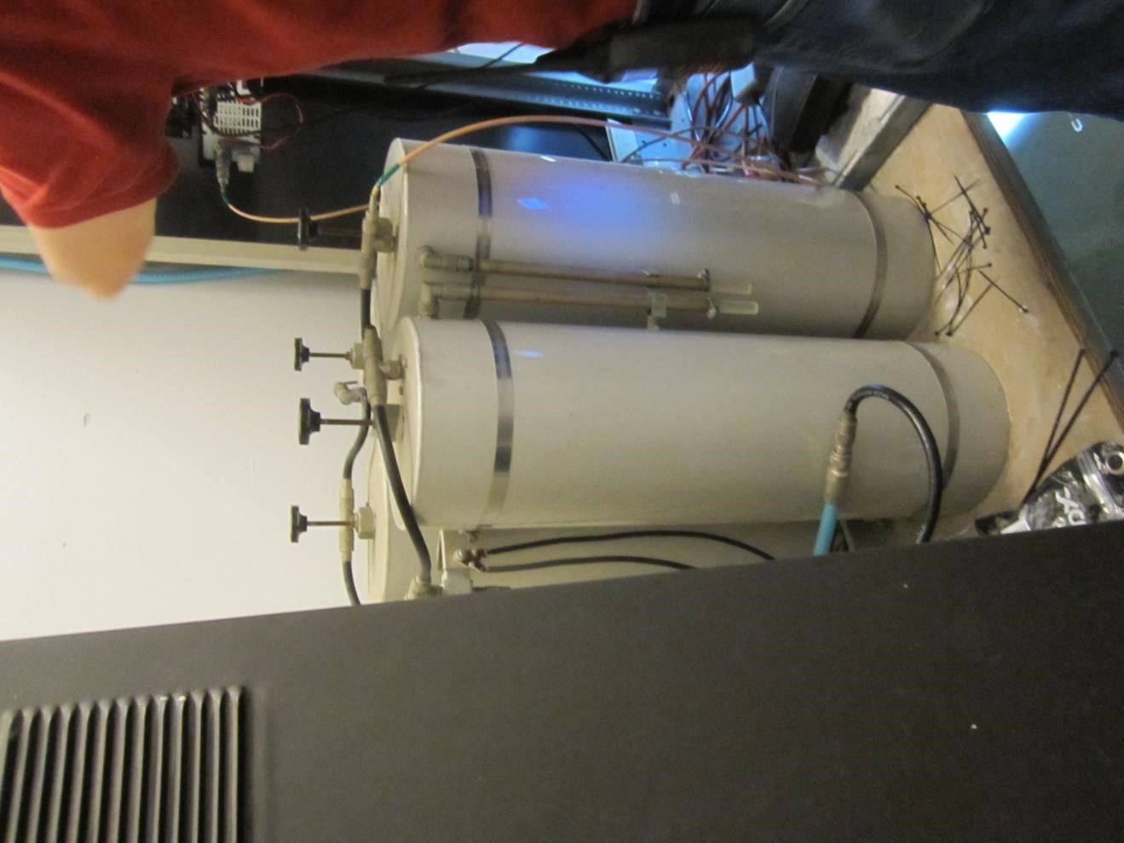
NARS Repeater Galleria

Slide 8
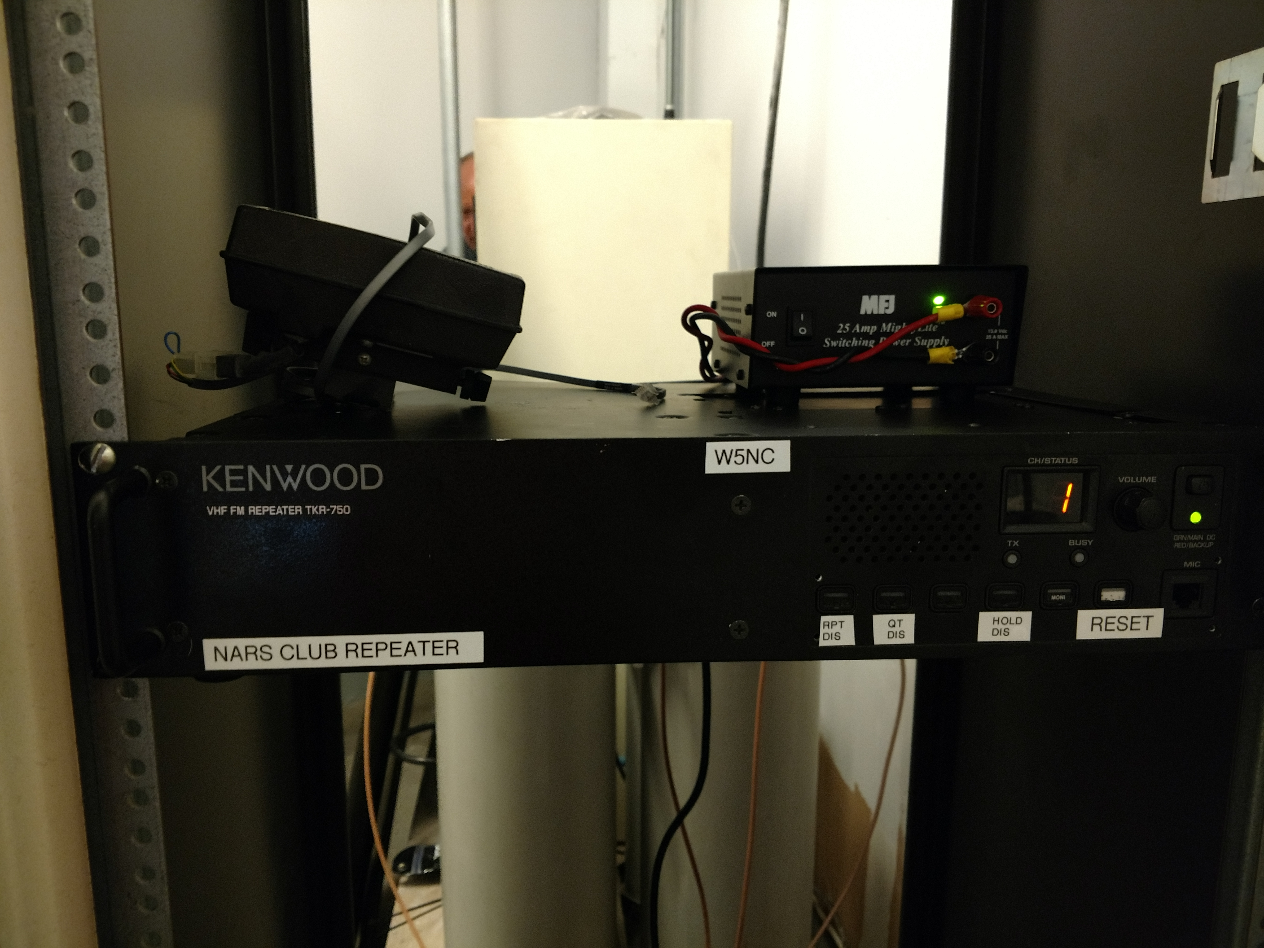
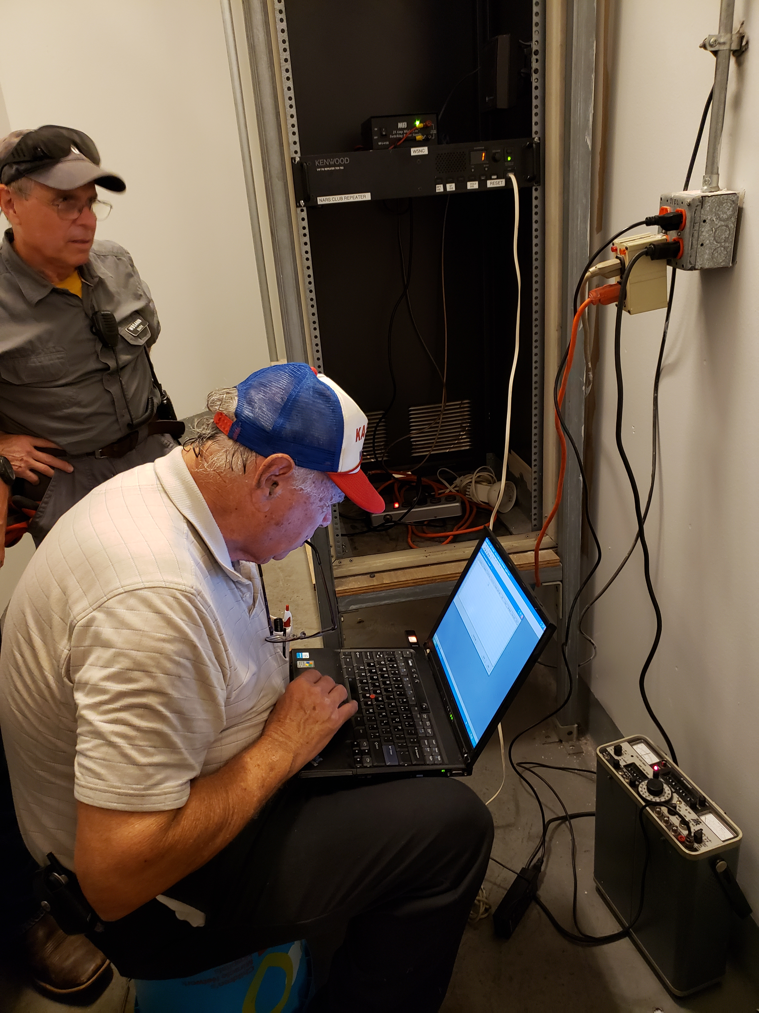
NARS Repeater Galleria

Slide 9
NARS Repeater Klein 146.66 100.0 PL
Same Repeater model as Galleria
Kenwood TKR-750
Propose use of Advance Repeater Controllers: http://www.arcomcontrollers.com/index.php
Currently linked to Allstar/Echolink
Not linked to Galleria repeater
Proposal for 300ft+ location.
Still looking for 300ft+ location in NW Harris Co.

Slide 10
NARS Repter Galleria 444.375 103.5 PL
40+ year repeater that still works, but not well.
Have Kenwood TKR-850 to replace it.
Will need 70CM Duplexer and Cables
No access to building with COVID-19

Slide 11
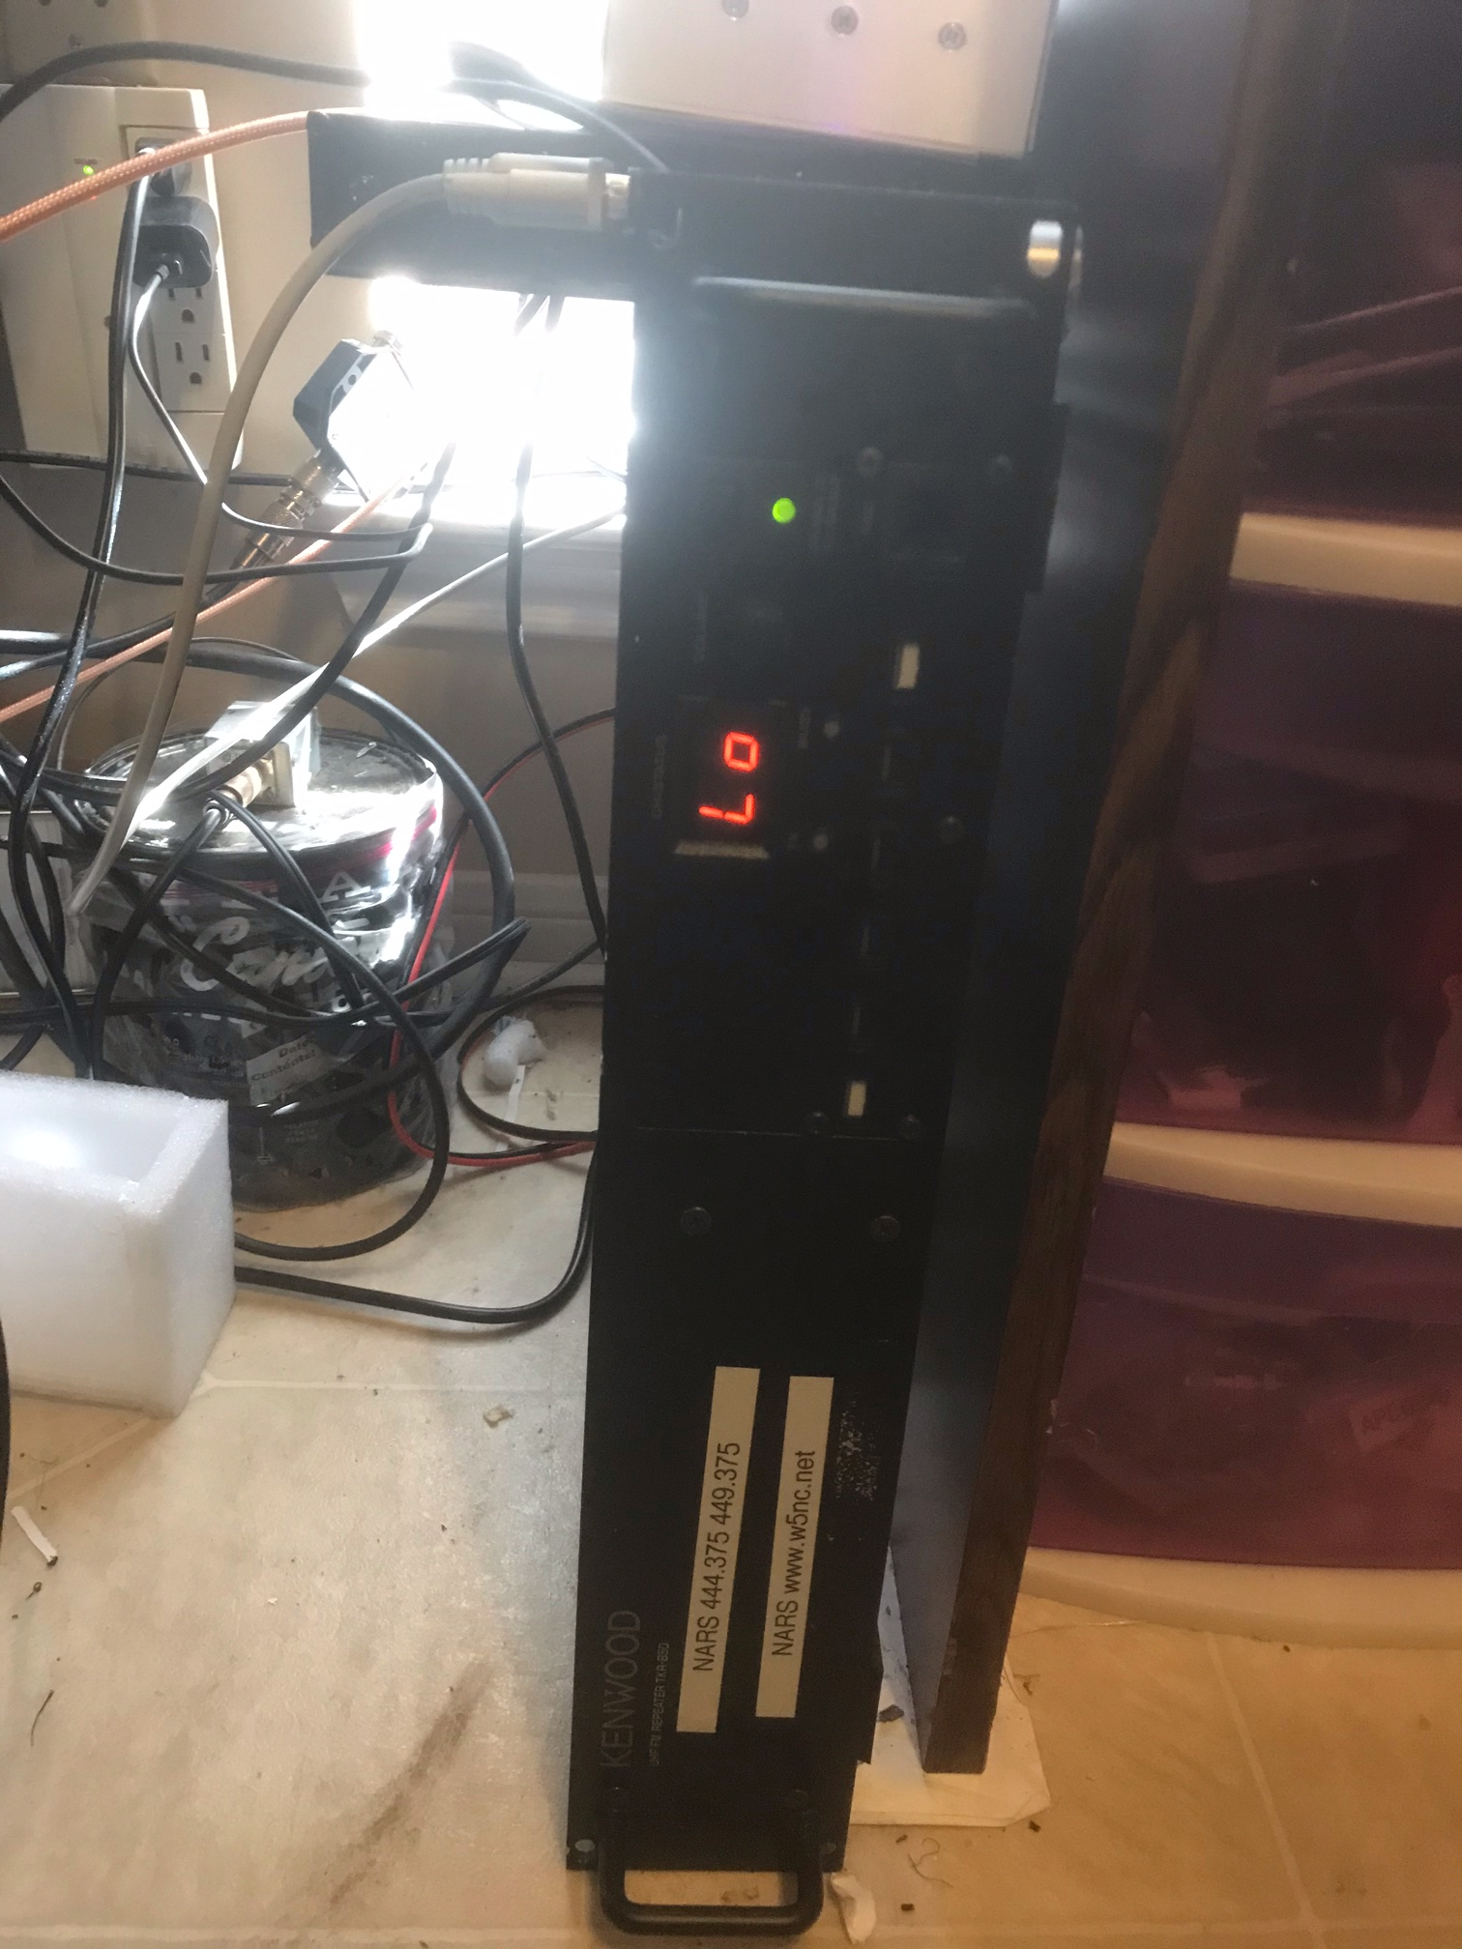
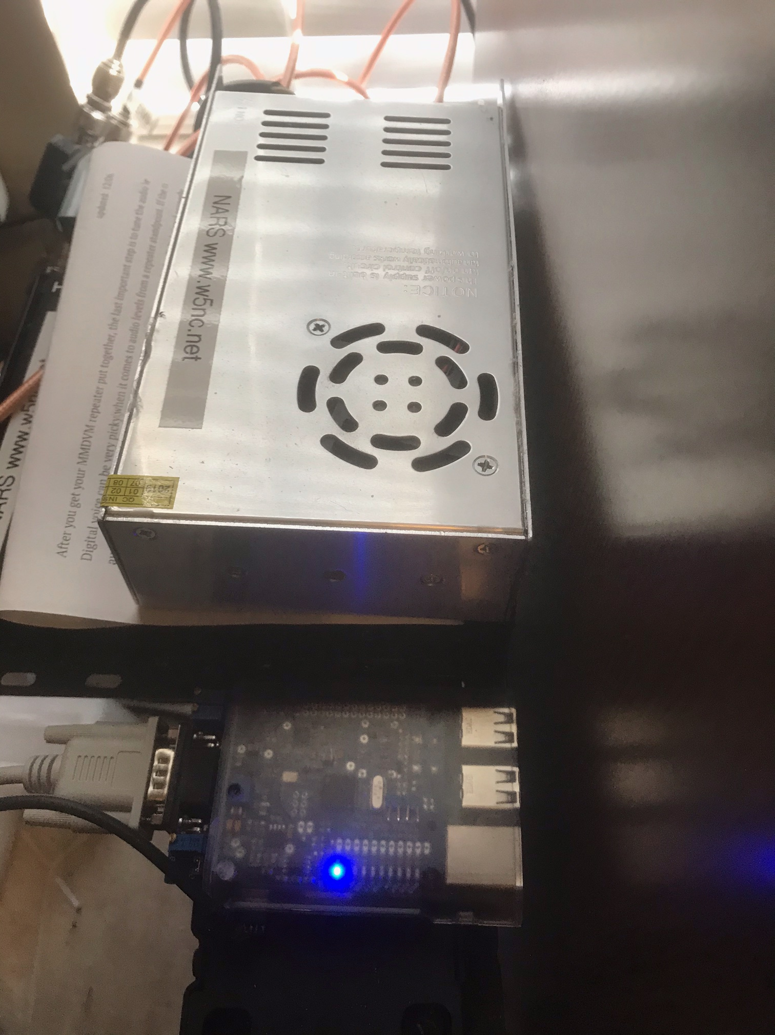
NARS Repeater Klein 444.375 67.0 PL

Slide 12
NARS Repeater Klein 444.375 67.0 PL
Simliar Repeater model as Galleria
Kenwood TKR-850
RPI 3+ with MMDVM board and PI-Star software
Mulitmode: Analog 67.0, DMR(Bradmeister), D-Star, and YSF.
Evaluating and testing at my home.
Proposal for 300ft+ location.
Still looking for 300ft+ location in NW Harris Co.

Slide 13
NARS Repeater Echolink
A way to access 146.66 Klein Repeater
Does not link to any other repeater at this time
Install APP on cellphone and tablets
Apple & Adroid via your App store for free
Install computer application http://www.echolink.org/download.htm

Slide 14
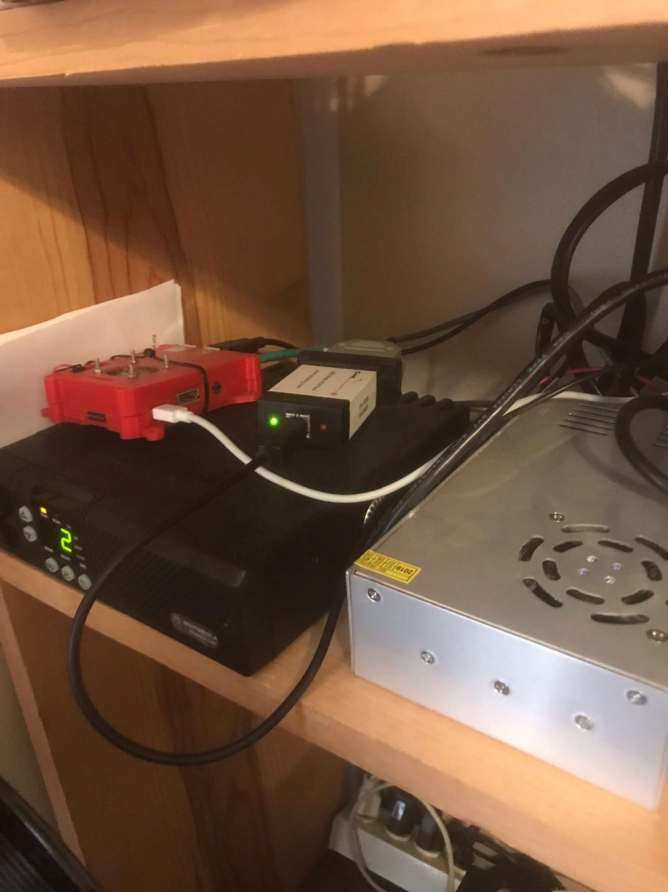
NARS Repeater Echolink
Motorola GM300
RPI 3+ with Allstar/Echolink software
DMK VOIP adapter
Power Supply

Slide 15
NARS Repeater Echolink
Echolink Validation – Get password
Application http://www.echolink.org/validation/
You will need a valid copy of you license.
Obtain documentation via FCC FRN system.
More info here: http://www.echolink.org/faq_validation.htm

Slide 16
NARS Repeater Echolink
Tablet or Cellphone
Install Echolink from your APP store

Slide 17
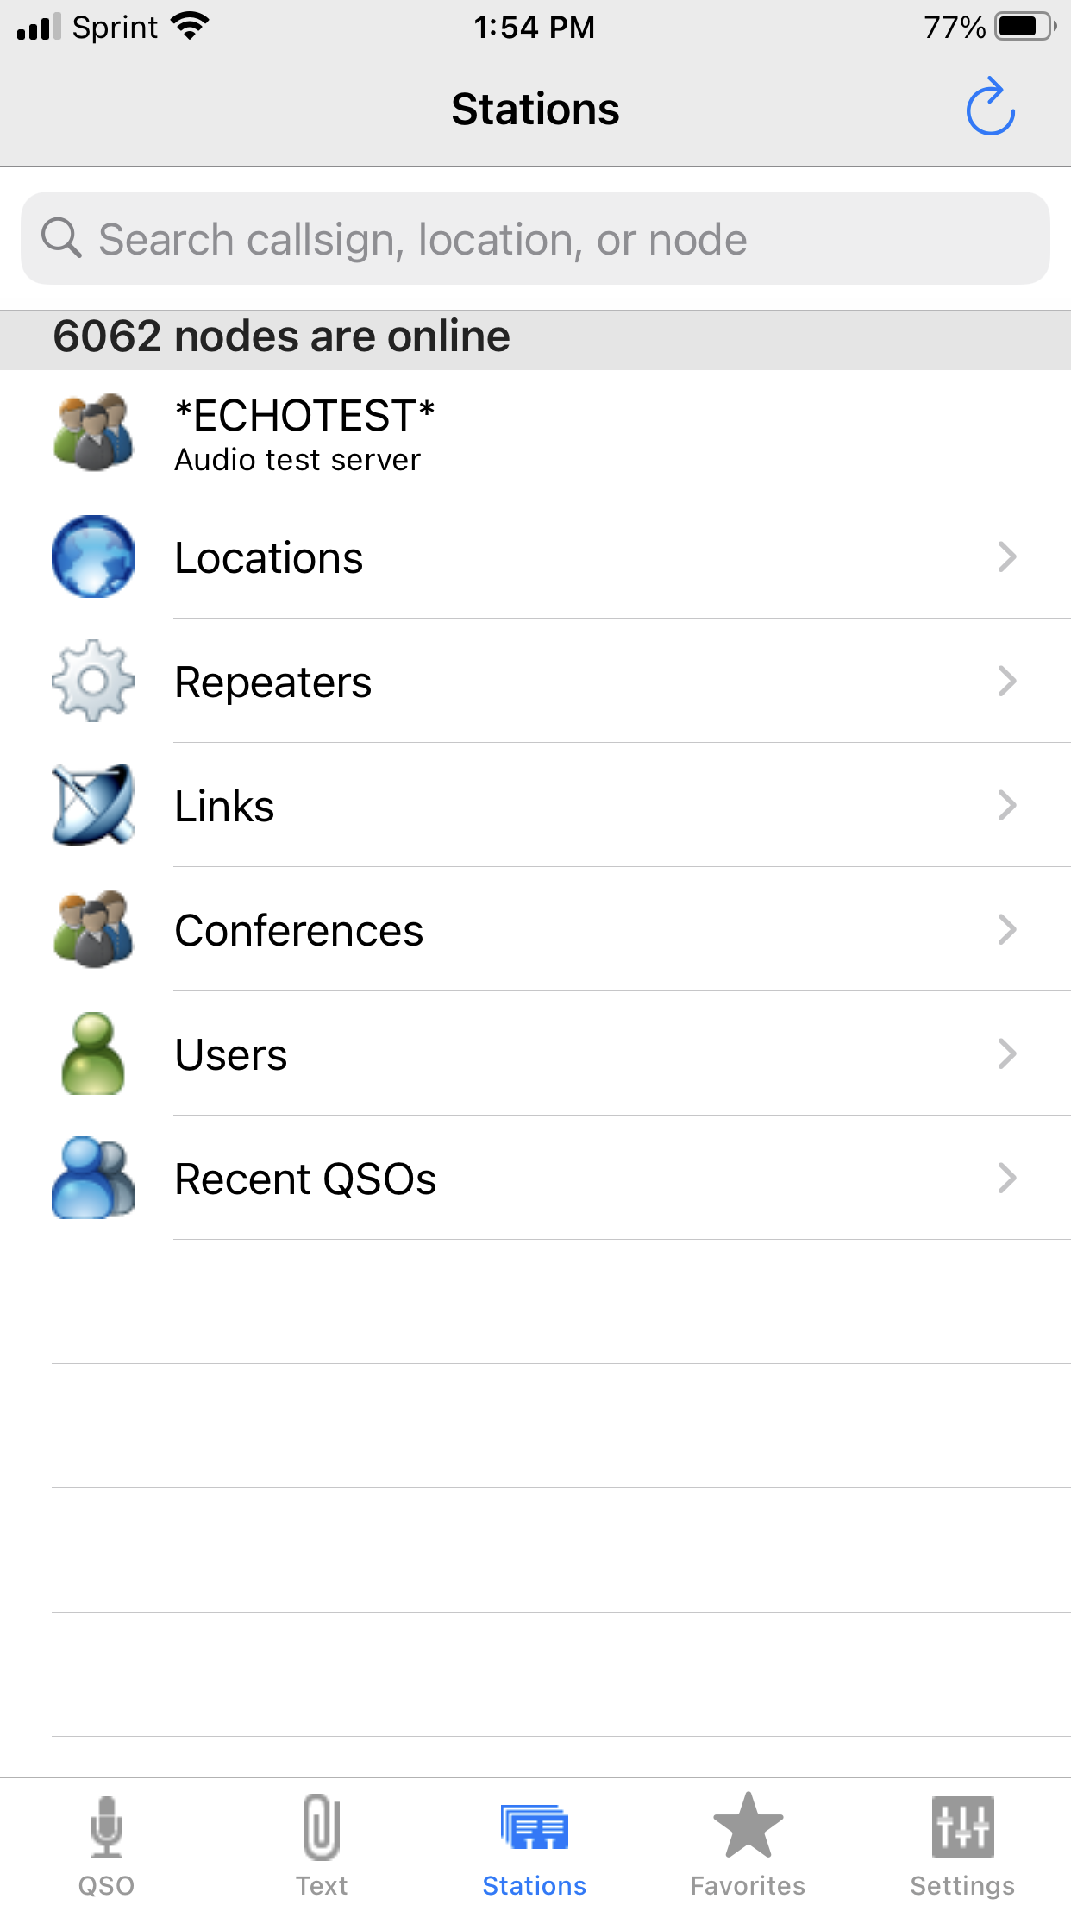
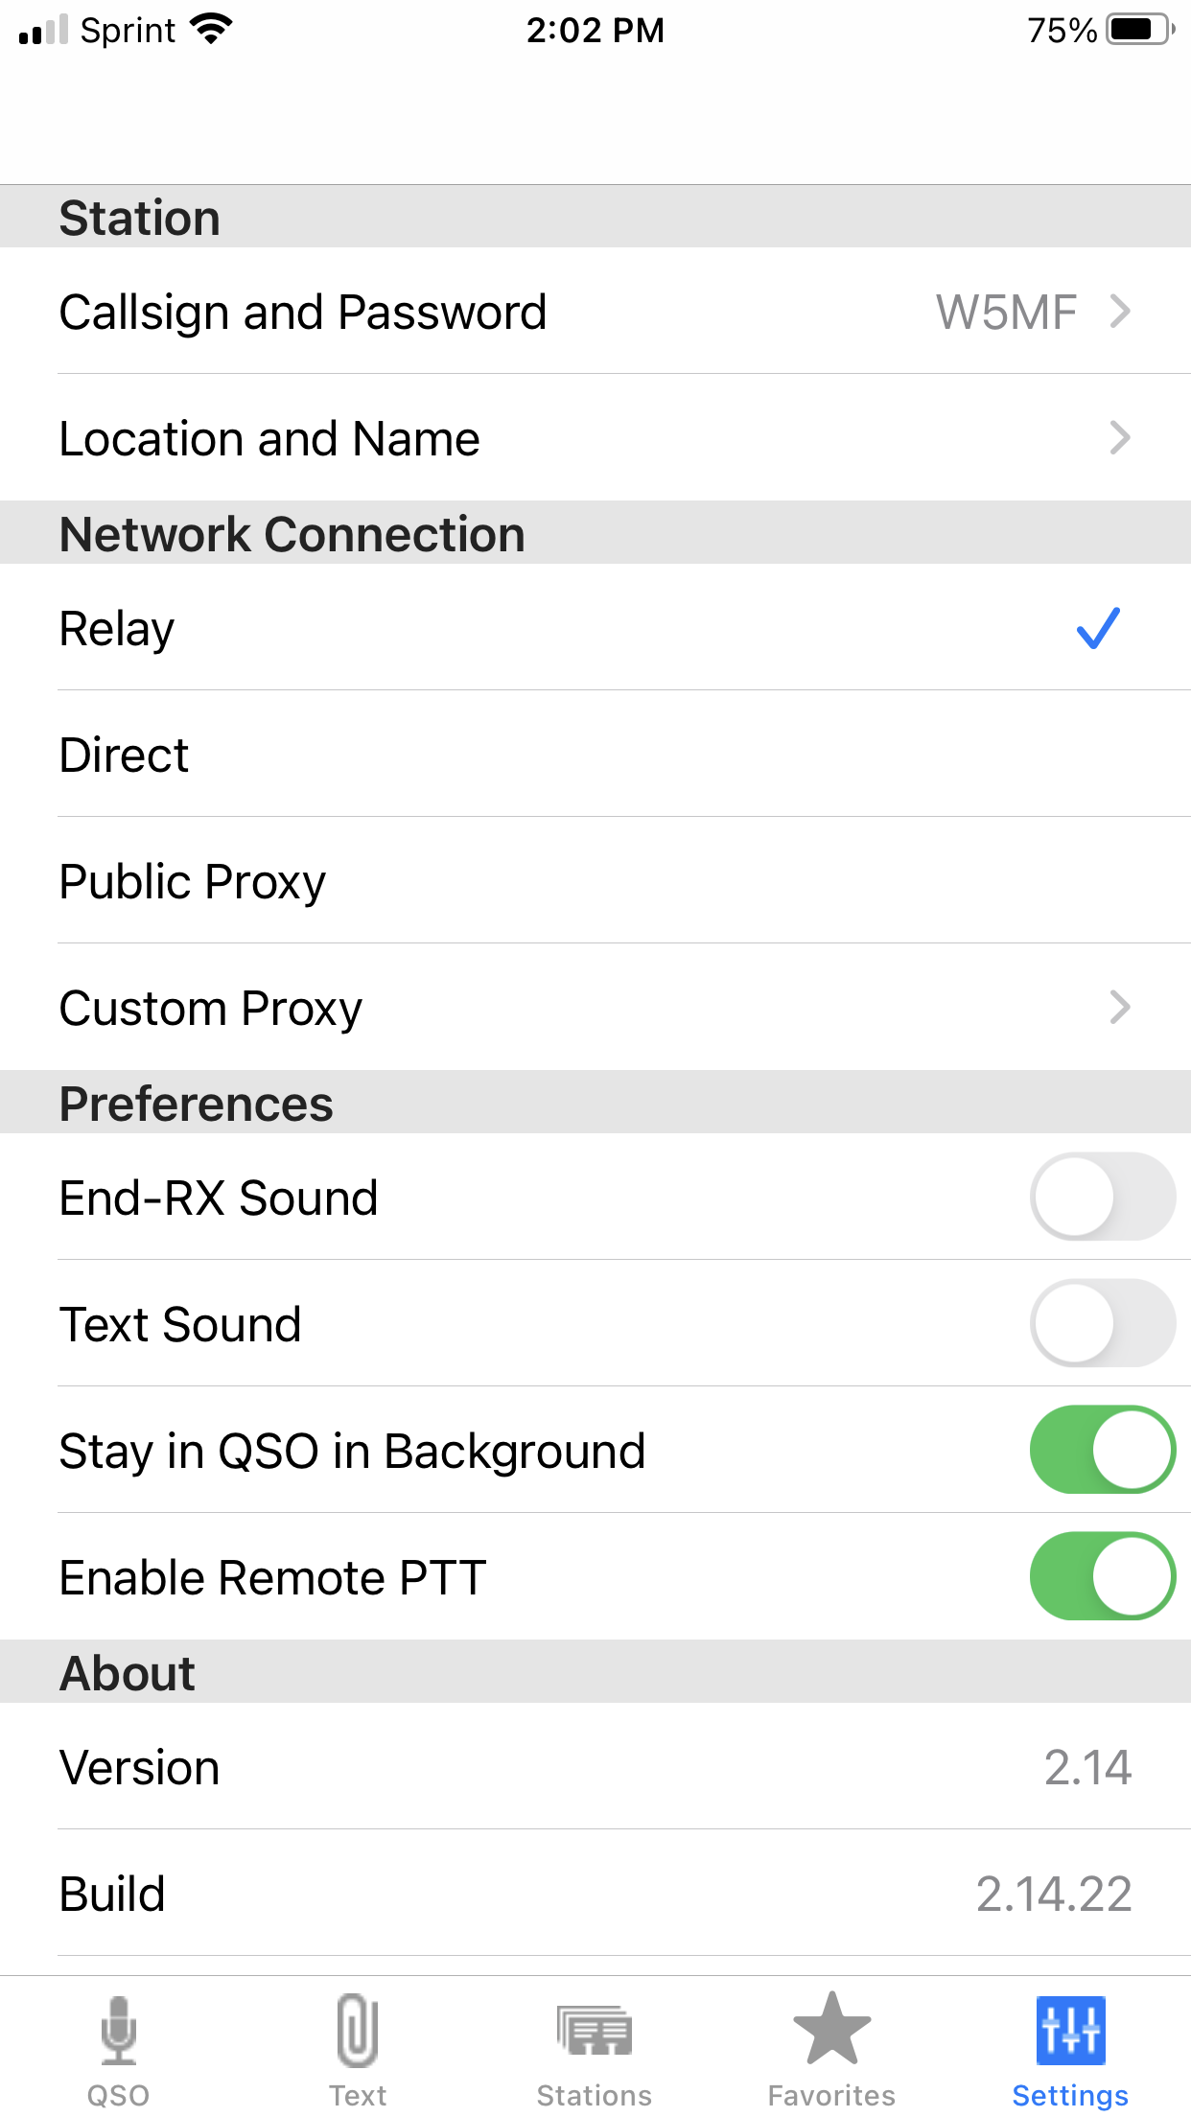
NARS Repeater Echolink
Tablet or Cellphone

Slide 18
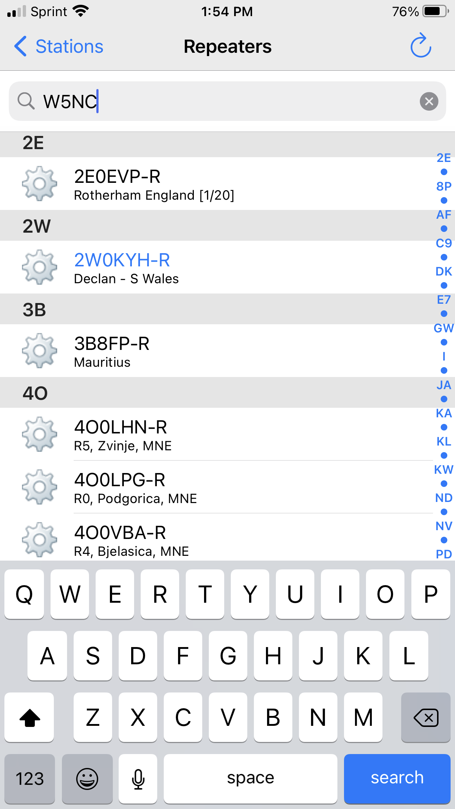
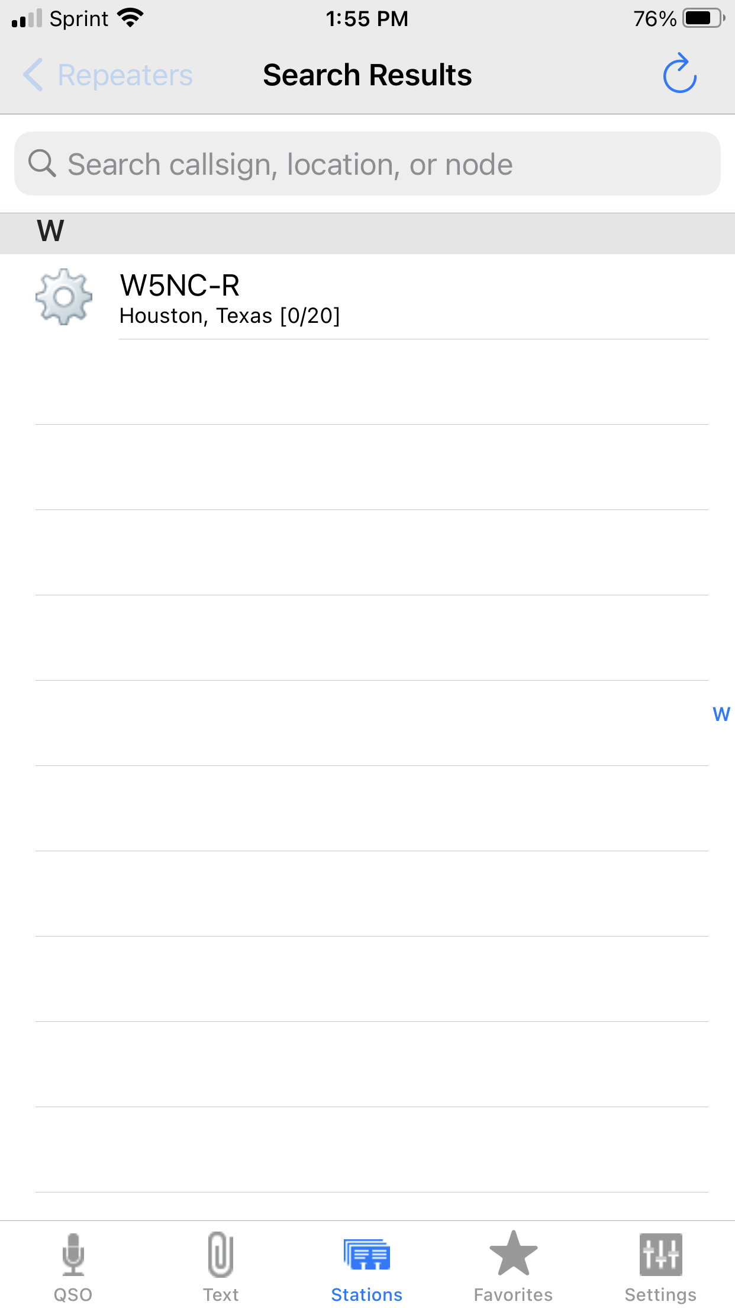
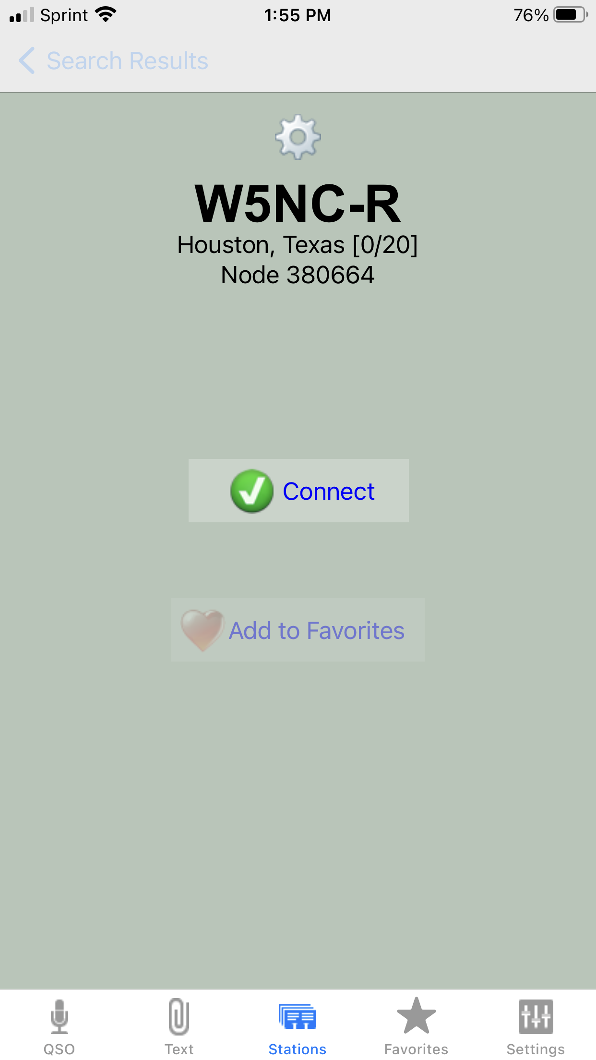
NARS Repeater Echolink
Tablet or Cellphone

Slide 19
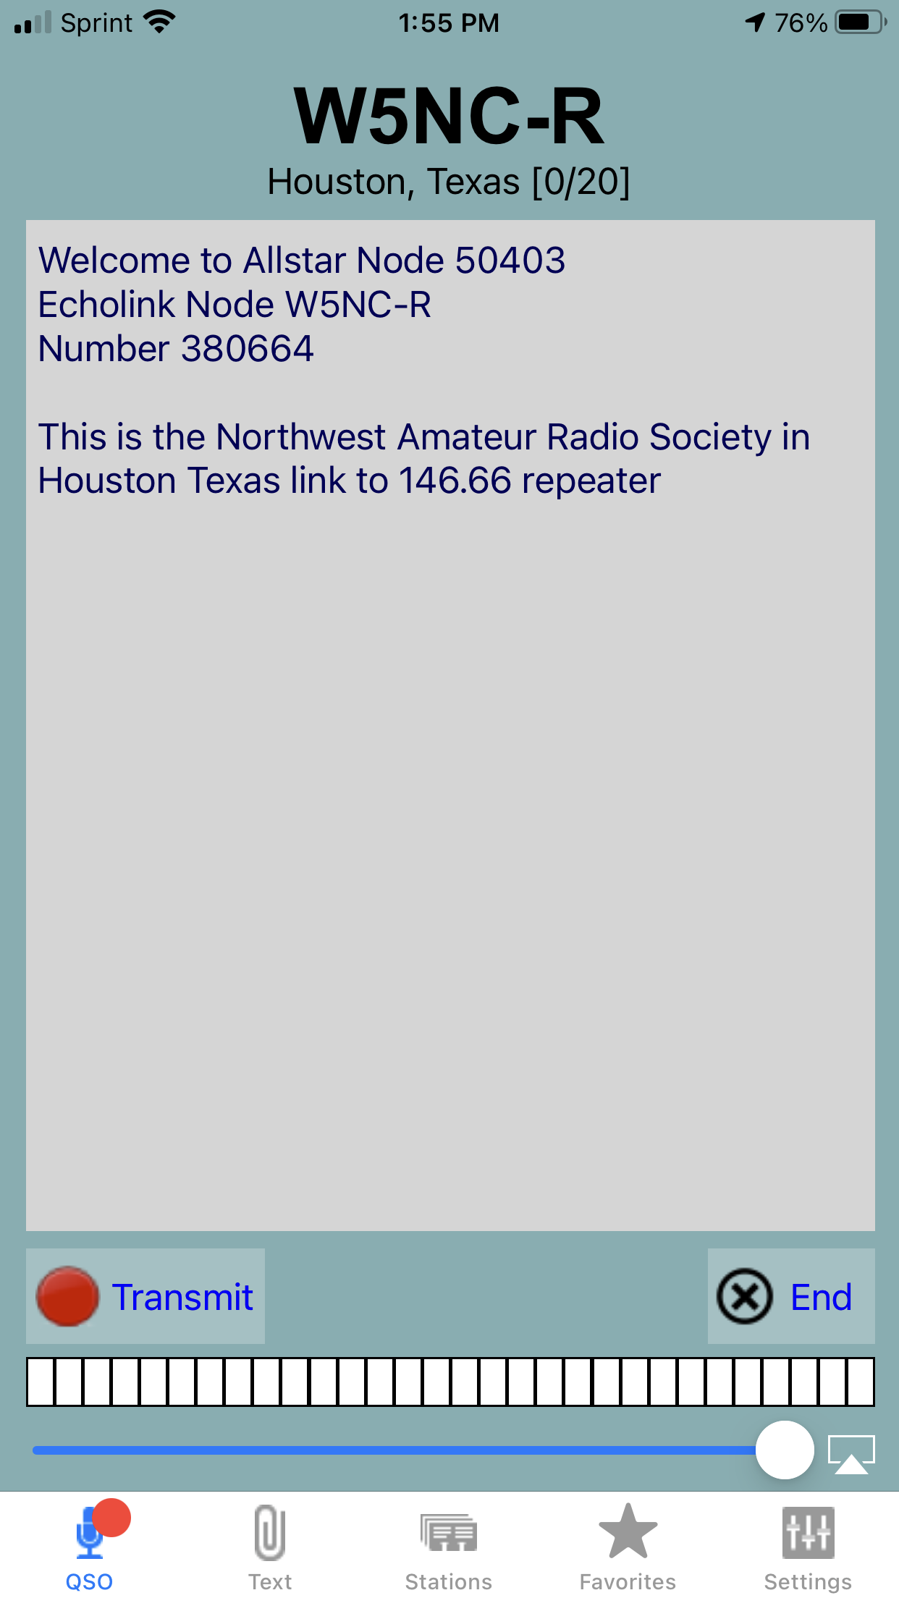
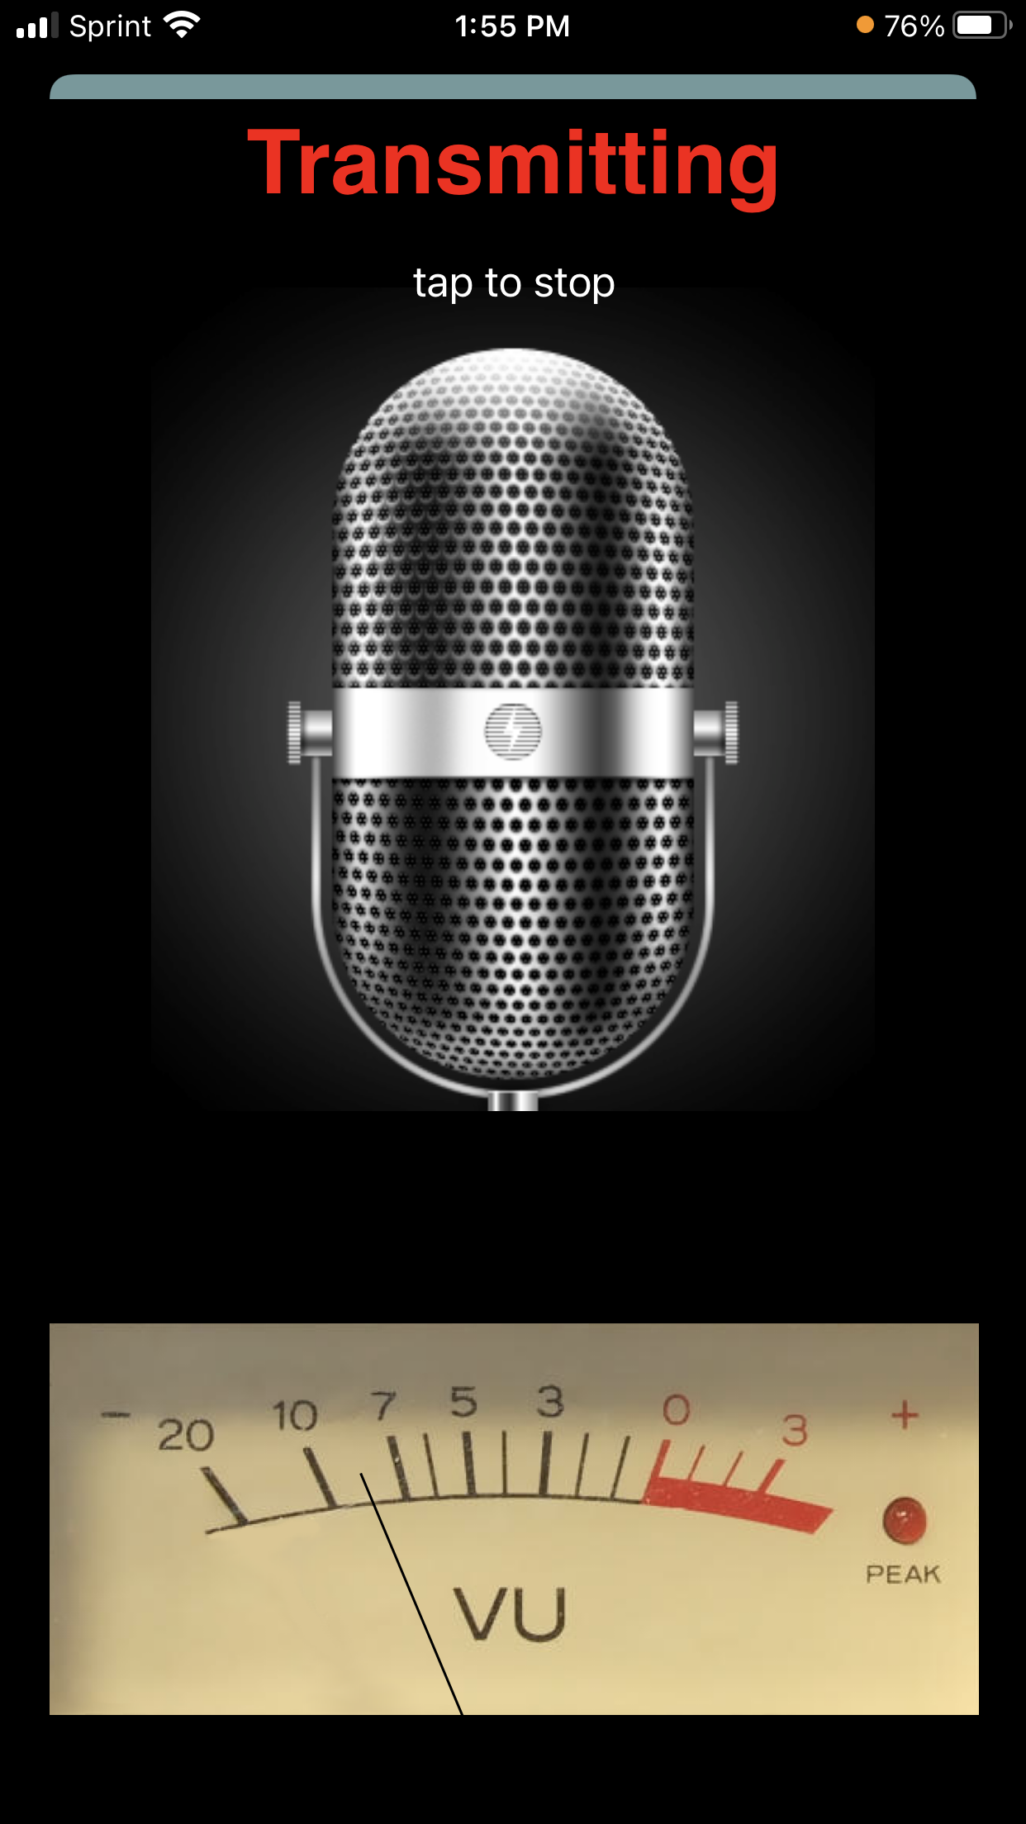
NARS Repeater Echolink
Tablet or Cellphone

Slide 20
NARS Repeater Echolink
Computer
Download Echolink
http://www.echolink.org/download.htm

Slide 21
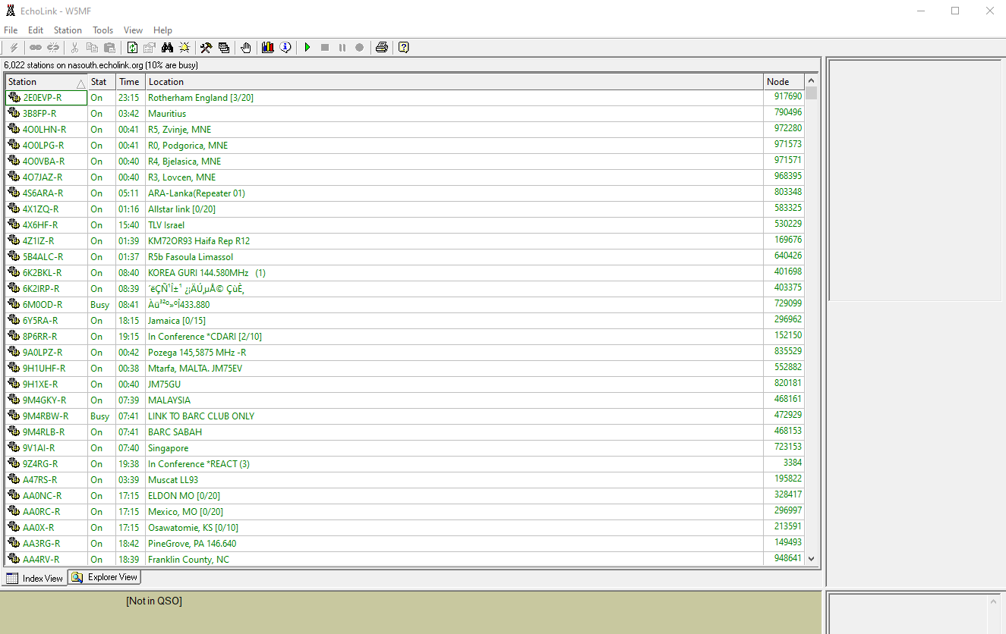
NARS Repeater Echolink
Computer

Slide 22
NARS Repeater Echolink
Computer
Goto Echolink on computer
Tools→Setup
Search→Select W5NC-R
Lightening strike to talk/listen toggle

Slide 23
Questions?
NARS Repeater

