Slide 1



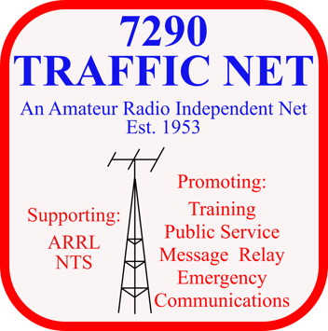
National Traffic System and Radiograms
Sheree Horton WM5N
ARRL South Texas
Section Traffic Manager
wm5n@arrl.net
August 19,2023

Slide 2

National Traffic System (NTS) – What Is It?
An ARRL – sponsored program. It provides an organized method for moving messages through a network of amateur radio operators to move information during disasters and other emergencies.
Started in 1914 as the formal ARRL system to relay messages across the country
The National Traffic System was officially established as an ARRL Public Service Field Organization in 1949
The relay in American Radio Relay League, as traffic is relayed from one location to another

Slide 3

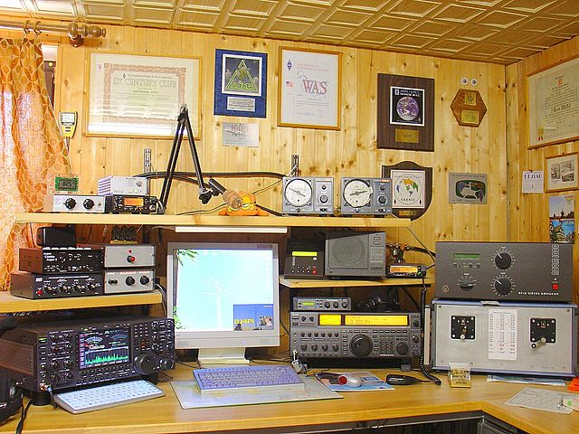
NTS Operations
Primarily set up to serve the United States and Canada
NTS does support global traffic, dependent on amateur radio reciprocity agreements with other countries
Transmit and receive modes
  Voice
  Morse code (CW)
  Digital Traffic Network (DTN)

Slide 4
Types of Nets
1. Local Nets
Generally cover a comparatively small area such as a city, county or designated zone within a section. They are usually operated on VHF serving as traffic or emergency nets. Coverage depends on the range of the repeater and its links.
2. Section Nets
Operate at ARRL Section Level and may consist of more than one state within the section, depending on availability of operators, traffic and terrain. They may be phone or CW.
3. Region Nets
Coverage basis is usually a call area. In some areas this may differ because of time zone changes, etc.
4. Area Nets
Are the highest-level nets and consist of Eastern, Central and Pacific areas.
5.
TCC (Transcontinental Corps) liaison stations take traffic from area-to-area nets on schedules, dictated by the TCC Director or on an individual basis.

Slide 5
Types of Nets, continued
Local Nets
Section Nets
Region Nets
Area Nets
TCC Liaison Stations
All these nets are bound together by liaison stations.
Independent Nets – nets that are recognized but not sanctioned by the ARRL. They may or may not have assigned liaison stations. Coverage depends on the band of operation, sometimes covering wide areas. The Net Managers are usually elected by the net membership. Many members are usually affiliated with NTS. The 7290 Traffic Net is an example of an independent net.

Slide 6
Principles of NTS Operation
A transcontinental message starts with the originating station in a local net, is carried to the section net, the region net, the area net, via Transcontinental Corps (TCC) to a distant area net and then back down the line to deliver.
Originating Station
TCC
Local Net
Section Net
Region Net
Area Net

Slide 7
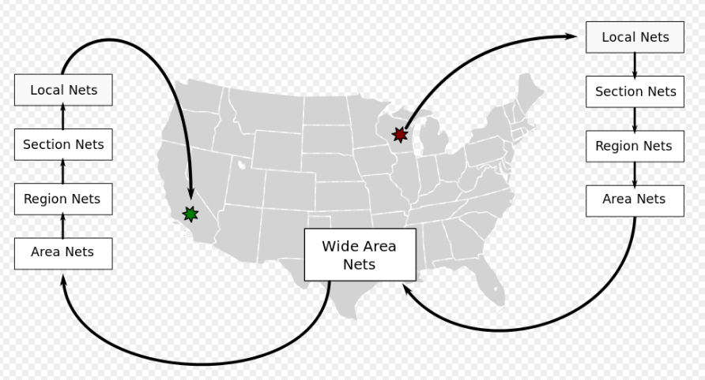
Message Flow From Origination to Delivery

Slide 8
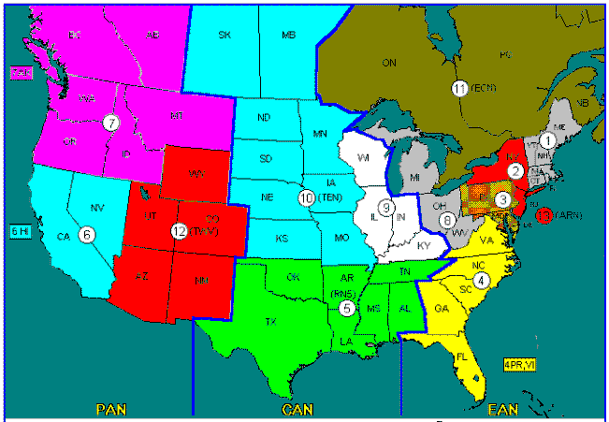
NTS Regional Map
Region 5 includes:
Alabama
Arkansas
Louisiana
Mississippi
Oklahoma
Tennessee
Texas

Slide 9
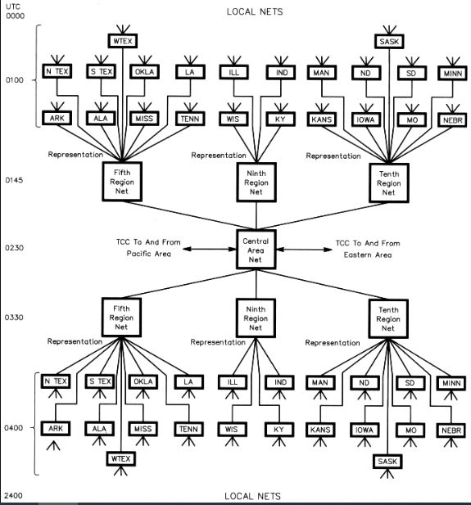
Evening Cycle - Four NTS Setup in the Central Area

Slide 10
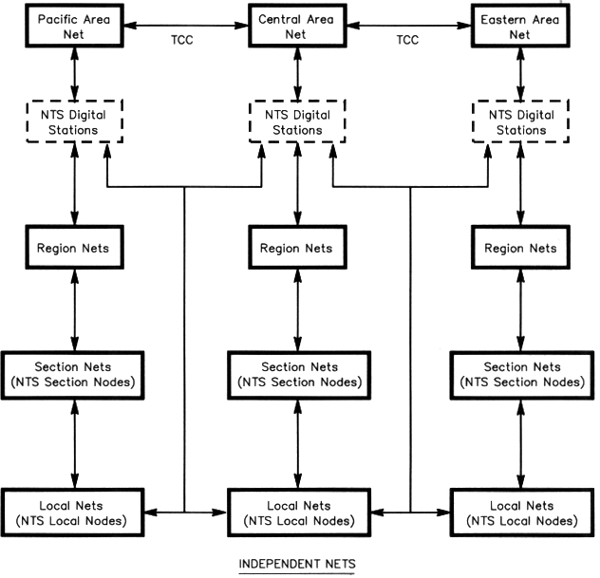
NTS Organization Chart

Slide 11
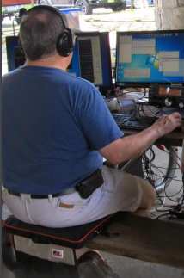
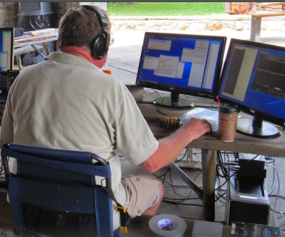
The NTS Benefits Amateur Radio Operators:
You learn how to speak on the air
When relaying a message, “slow is fast, fast is slow”
Speak clearly
You’re not reading a message, you are SENDING it
You learn on-air skills:
Build familiarity with participating in formal nets
Become proficient with ITU phonetics
Learn and use procedural signs (prosigns)
Become concise by working with short, comprehensive messages

Slide 12
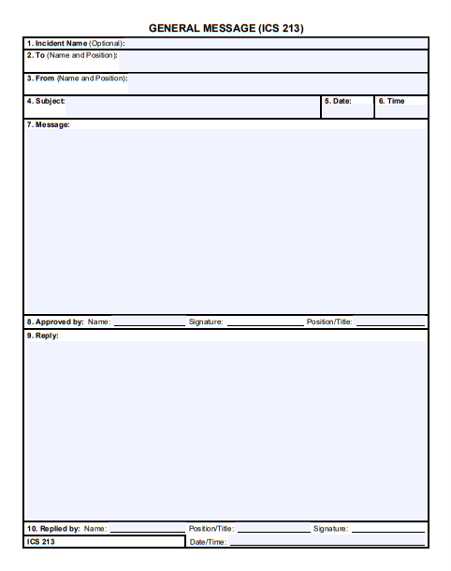
You learn emergency assistance skills:
“When the disaster begins, the time to prepare ends”

Slide 13
When assisting during an emergency…
Radiogram skills enable you to effectively relay information into and out of an affected area
NTS net participation skills transfer to communicating with dispatchers over public safety radios and moving ICS-213 forms

Slide 14

How radio operators learn…
Smart mistakes are OK. It is far better to make them on a practice net and learn from them before an actual disaster strikes
If you make a mistake and you know it, correct it and keep going
If you are corrected during a net, keep in mind that the feedback will help you build your skills

Slide 15

And most important of all…
Overcome your fear!

Slide 16
Why radiograms
?
?
?
Standardized message format
  We all follow the same thing, even internationally
  Allows for faster relaying
Traceable
  We can follow the message’s movements if we need to understand why it didn’t reach its destination
  Keep a log of all messages you handle

Slide 17

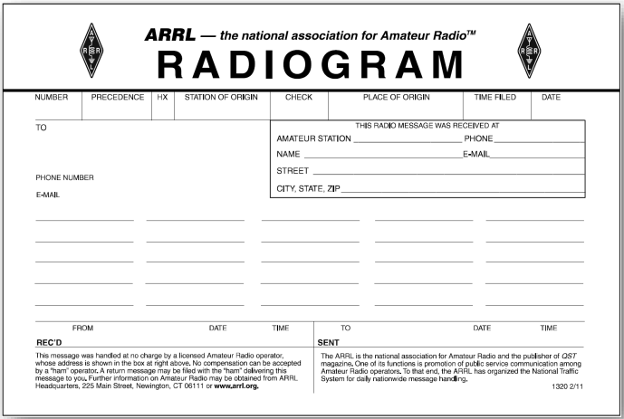



ARRL radiogram form

Slide 18
Parts of a Radiogram
Preamble
Preamble
Address
Text
Signature
Address
Text
Signature

Slide 19
Radiogram Preamble (or Header):
The tracking information for the message, stays with the message to delivery
Number – do not use zeroes in front of numbers, keep a log, SVC may be used in front of Service messages
Precedence – R, W, P, EMERGENCY. Use TEST + space before or after Precedence in exercise traffic
Handling Instructions – optional HX codes
Station of Origin – first amateur handler’s call sign

Slide 20
Radiogram Preamble continued
Check – number of words/groups in text only. ARL + space used if ARRL numbered radiogram in text
Place of Origin – signer’s location, not necessarily location of station of origin
Time Filed – optional, if not UTC then add time zone letters and adjust DATE as necessary
Date – use 3 letters, must agree with TIME FILED

Slide 21
Precedence – type of traffic being handled
Type of Traffic | Code | Meaning
Emergency | EMERGENCY | Life/death urgency in a declared emergency
Priority | P | During declared emergencies where time is of the essence
Welfare | W | Inquiries about the health and welfare of an individual in an affected area
Routine | R | Everything else, and is the most frequently used type of message

Slide 22
Handling Instructions
HX | Meaning
A## | Collect landline delivery authorized by addressee within X miles. (If no number, authorization is unlimited)
B## | Cancel the message if it isn’t delivered within X hours of the filing time. Used in cases where the message becomes pointless after a certain amount of time. These types of messages should be sent at least as a Priority message.
C | Report the date and time of delivery back to the originating station.
D | Report to the originating station the identity of the station you received the message from, as well as the date and time you received it. Also, report the identity of the station to which you relayed the message along with the date and time, or if you delivered it to its destination, report the date, time and method of delivery.
E | The delivering station should ask for a reply from the addressee, and then originate a message back with the reply.
F## | Hold delivery until (specific date).
G | Delivery by mail or landline toll call not required. If toll or other expense involved, cancel message and service originating station.

Slide 23
How do you say preamble information on the air?
Please copy message number One Two Three Four → Routine → Hotel X-ray Golf → Whiskey Mike Five November → One Four → Richmond, Texas → June One Four

Slide 24
Radiogram address
Address – complete with zip code, telephone number, email address etc., may include an OP NOTE
An op note relates to handling and/or delivery of the radiogram

Slide 25

How do you say the address info on the air?
FRED.FLINSTONE@CAVEMAN.COM
Going to Fred… Flinstone Call Sign Romeo Uniform Bravo Niner Lima Echo
Address Figures Five Eight Some I spell Sierra Oscar Mike Echo… Cave Drive
Anywhere Michigan Zip Figures Four Eight Zero Zero One
Phone Figures Two Three One…Four Five Eight…Eight Eight Eight Eight
Email Address Fred Dot Flinstone Atsign Caveman one word dot com
Break for Text (BT)

Slide 26
Radiogram receiving station info
You generally don’t need to fill this out unless you are going to hand deliver or mail the radiogram to the addressee

Slide 27
Radiogram text
TEXT – typical limit 25 groups, some countries allow more; X punctuation counted as one word

Slide 28
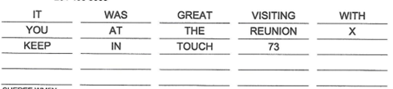
How do you say this text on the air?
It…was…great…visiting…with…you…at…the…reunion…Initial XRAY…keep…in…touch…Figures seven three
…Break for Signature (BT)

Slide 29
Radiogram signature
Signature – person (name and/or callsign) for whom message originated, may include a full address and OP NOTE
If you originated the radiogram for someone other than yourself, then the signature of that person IS NOT YOU!

Slide 30
How to say the signature on the air
Signed Sheree…I Spell Sierra Hotel Echo Romeo Echo Echo…call sign…Whiskey Mike Five November

Slide 31
Radiogram received/sent info
RECEIVED – from whom you got the radiogram, the date and time
SENT – to whom you relayed or delivered the radiogram, date and time
Use the 24-hour time format, ideally UTC. The date should match the time.
Indicate the time zone (Ex. 21:00 CST) if UTC isn’t used.

Slide 32
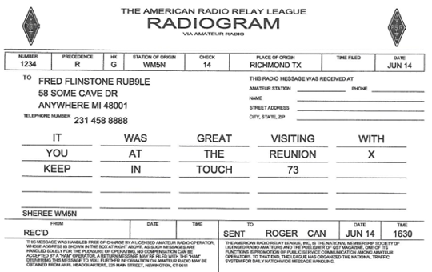
Completed radiogram

Slide 33
Multiple radiograms with the same text
Book traffic – multiple radiograms that have most everything the same except the message number and the addressee
Your sent/receive times will change, but that information is for your records
Relay the header without the message number, Break for text and then relay the text. Break for Signature, then give signature. You then say End of Common Parts. You then give each message number and addressee, one at a time.

Slide 34
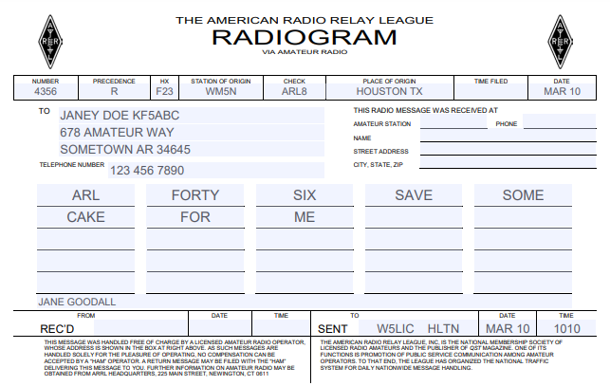
ARL Numbered Radiograms
Condensed way of sending text
Include ‘ARL’ in check
In text, include ‘ARL’ and the radiogram number, spelled out
Ex: ARL FIFTY SEVEN – counts as 3

Slide 35
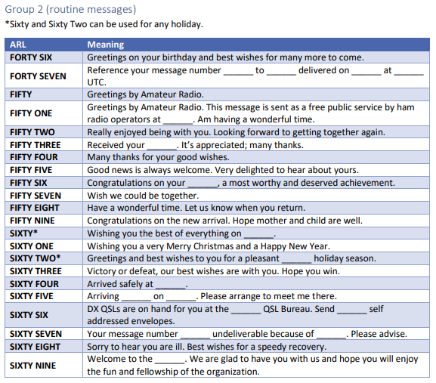
ARL shorthand numbers

Slide 36
Questions and Review
How would you read this?
What is HXF23?
What does a different signature from the station of origin signify?
Who lives in Houston?
What would the check count be if the message were written out?

Slide 37
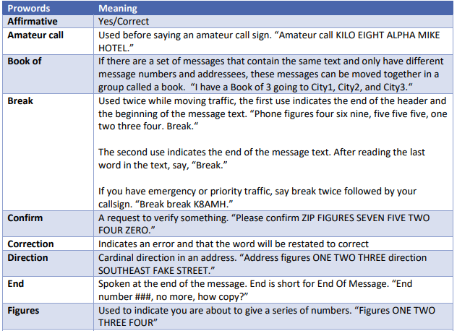
Prowords

Slide 38
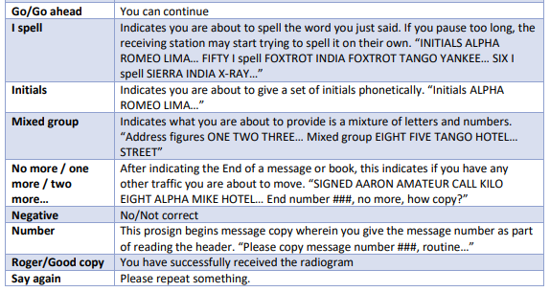
More Prowords

Slide 39
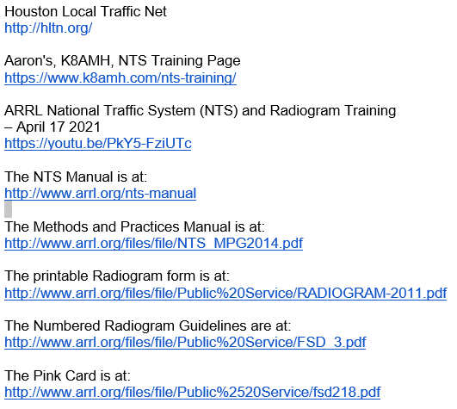
Resources

